Slide 1
Resourcing TEE for the global Diaspora

Slide 2
Global Migration Patterns

Slide 3
Typical Diaspora Situation
A church in England needs:
14 copies in Chinese
6 copies in Mongolian
2 copies in Hindi
4 copies in Bahasa Indonesia
Is there an easier way?
Notes:
How will they obtain the courses?
It will require
4 country-to-country or church-to-country agreement
4 separate payments in different currencies
4 separate shippings
Many, many emails
By the time this has been arranged, 6 months could have been passed and interest to start TEE may be gone.

Slide 4
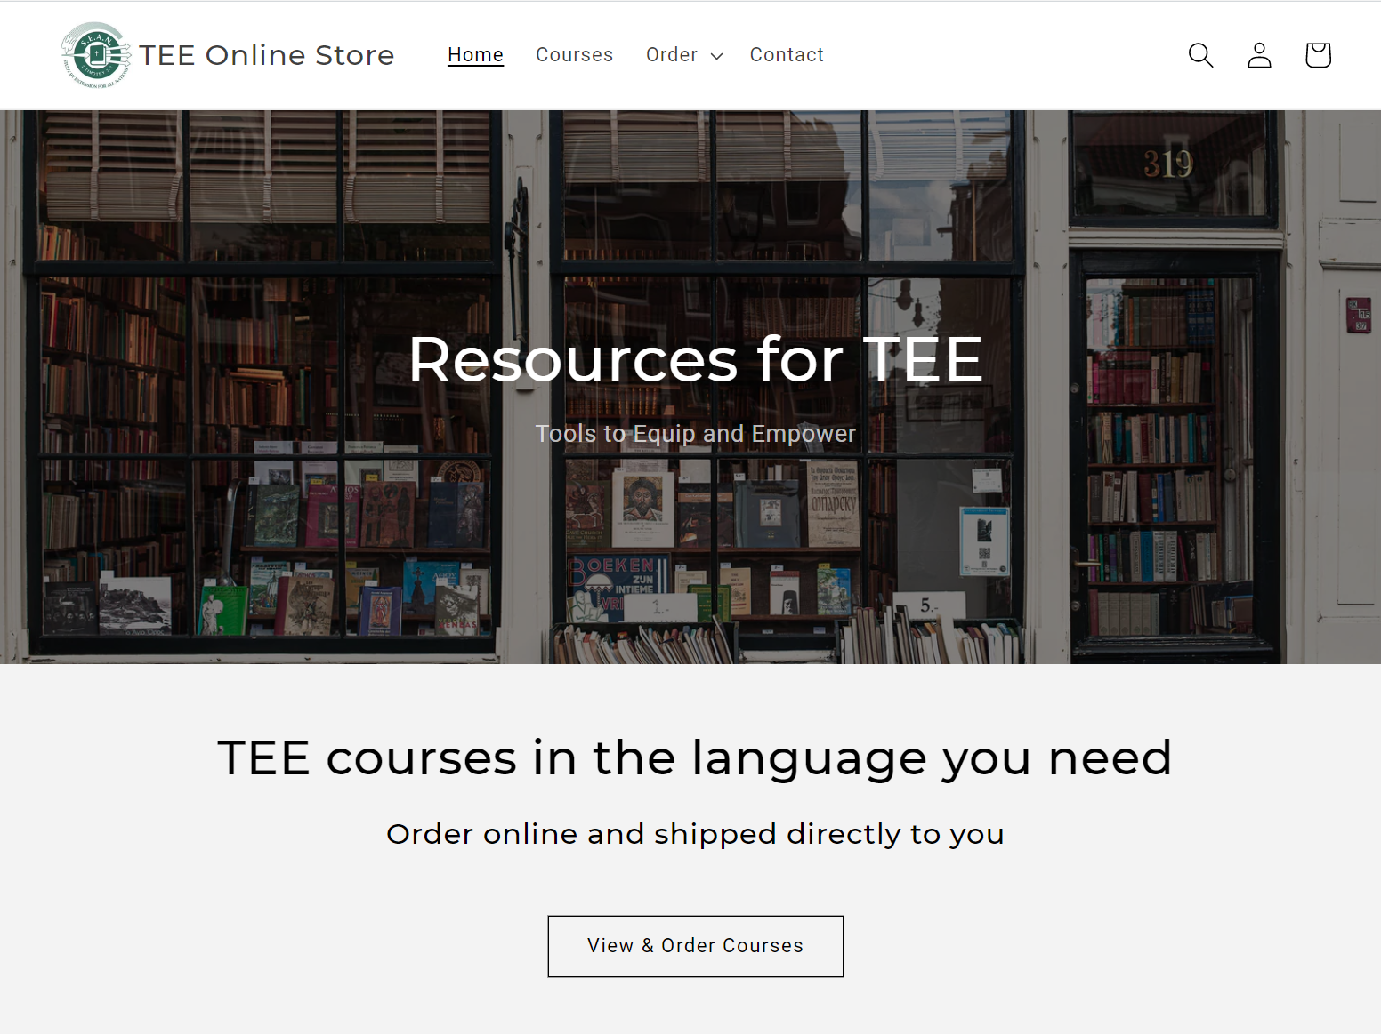
TEE Online Store
✓
Protect course content
Restrict to qualified users
Efficient ordering process
Keep contact with customers
Receive & distribute payments/royalties
✓
✓
✓
✓
www.shop.seaninternational.org

Slide 5
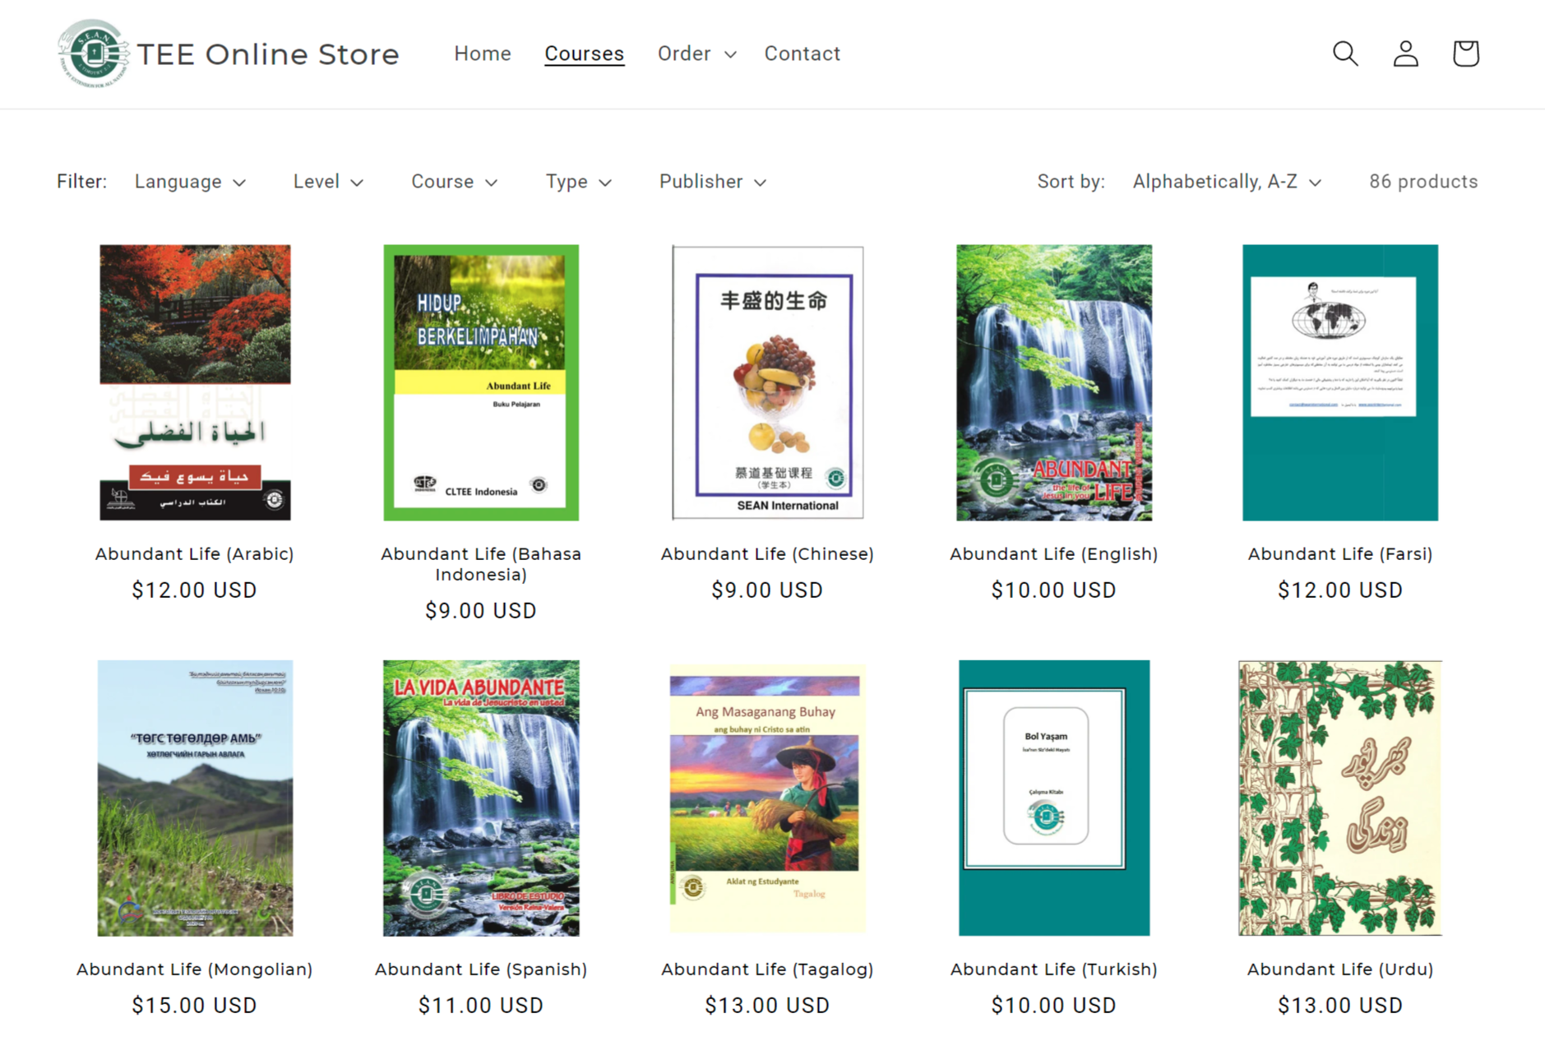
Like
… but with control over who can purchase courses
Notes:
Nasdaq - National Association of Securities Dealers Automated Quotations Stock Market

Slide 6
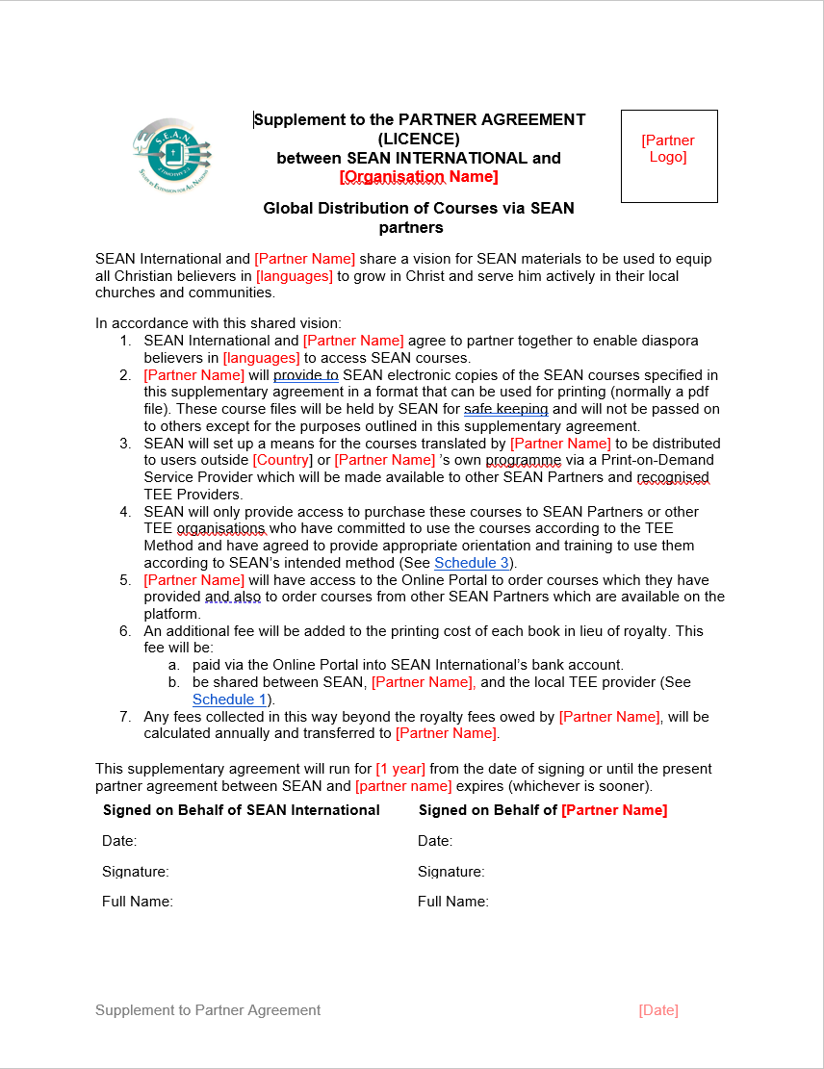
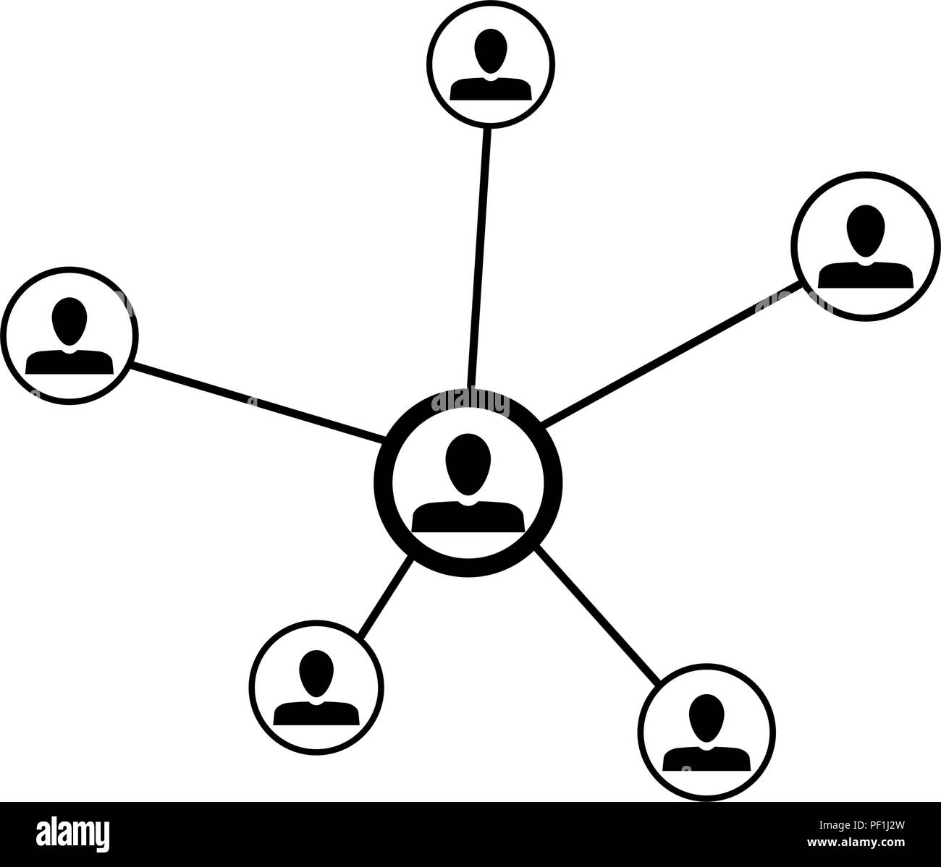
Efficient ordering process
No need for multiple signed agreements to use courses.
No need to liaise with people in different countries and languages.
Payment in local currency via PayPal/Credit Card (no international bank transfers).
Printing and shipping handled automatically, from closest physical location
Course books typically arrive within 7-10 business days.

Slide 7
Next Steps
Paul’s Vision of the Man of Macedonia – Acts 16
⁹ During the night Paul had a vision of a man of Macedonia standing and begging him, “Come over to Macedonia and help us.”
¹⁰ After Paul had seen the vision, we got ready at once to leave for Macedonia, concluding that God had called us to preach the gospel to them.
Help resource young TEE organisations and equip them to disciple the worldwide diaspora.
Notes:
Paul and his companions are in modern day Turkey.
⁶ Paul and his companions traveled throughout the region of Phrygia and Galatia, having been kept by the Holy Spirit from preaching the word in the province of Asia. ⁷ When they came to the border of Mysia, they tried to enter Bithynia, but the Spirit of Jesus would not allow them to. ⁸ So they passed by Mysia and went down to Troas.

Slide 8
Like to know more?
Find out more at the Special Interest Group on Wednesday at 7:30pm
www.shop.seaninternational.org
Notes:
Technical qns – ask me later

