Slide 1
Digitally Enhanced Learning
Day 2: Using Mobile devices

Slide 2
Table groups
C&MA
CAMACOP
Cambodia Institute of TEE
Deir Mar Thoma
ITEEN
ITEEP
KLTC (Mongolia)
Lao Evangelical Church
Mongolian TEE
Open Theological Seminary
ORTA
SEAN Azerbaijan
TAFTEE
TEE Kazakhstan
TEE Malaysia
South Korea (Russian Diaspora)
UMIT

Slide 3
Quiz Question
What is mobile learning?
learning on and with portable devices
learning that happens while you travel
it is the same as e-learning

Slide 4
introduction
Mobile learning or m-Learning
Anything people learn on a device they can carry
Challenge: use the unique capabilities of mobile phones to help people learn better.
Notes:
We want to focus on mobile learning, also called m-learning. We believe that for many of you this will be more useful than e-learning for many courses.
A very short definition of mobile learning is: anything people learn on a device which they can carry
The real challenge in mobile learning is not putting the information on an app. It’s using the unique qualities of devices like mobile phones to enhance people’s learning experience.

Slide 5
Features of mobile devices
Play the game and find out how a mobile phone affects learning!
Rules:
One person opens the piece of paper.
They describe the word to the group.
No speaking and no writing!
Use your hands, or draw, to explain it.

Slide 6
Features of mobile devices
Battery powered: more accessible than laptop / pc.
Portable: it’s always nearby
Social Media: people stay connected and share information.
Accessible: relatively cheap and normal to own
Small screen: limitation for design
Usage: brief but often
Notes:
If we use these features we can make the learning experience much more engaging. We can make it just-in-time so people can learn in short times when they feel ready. We can use the social media to our advantage by giving meaningful opportunities for interaction and application. We can make use of the fact that this is very accessible to many people, much more so than a paper course in many contexts.

Slide 7
mobile learning: definitions
e-Learning … learning activities designed to be delivered via computers and laptops (bigger screens), but may be accessible on a mobile device
m-Learning … learning activities designed to be delivered on mobile devices (smaller screens), but accessible also on computers or laptops
Notes:
Rick

Slide 8
mobile learning: definitions
Instructional Design models
Mobile Responsive:
course design for e-Learning courses,
for computers and laptops (bigger screen size),
but also accessible on a mobile device
Notes:
Rick

Slide 9
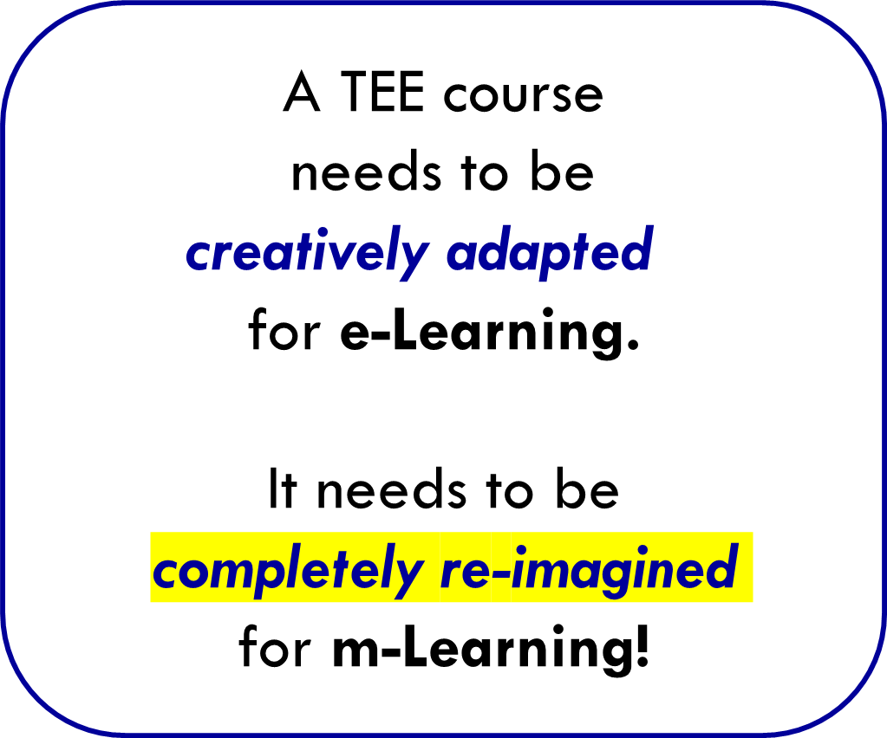
mobile learning: definitions
Instructional Design models
Mobile First:
course design for m-Learning courses,
planning to use the small screen size of mobile devices,
designed to fit typical use of mobile-device
(usually also accessible on computers …)
Notes:
Rick

Slide 10
mobile learning: definitions
learning units, designed for mobile learning and presented into multiple "chunks"
A CHUNK:
Is 3-15 minutes long
has varied - but integrated - learning activities
has on one learning objective
Notes:
Rick

Slide 11
Quiz Question
Why should a “chunk” be under 15 minutes long?
people do 1 activity for max 15 minutes
young people get bored easily
it takes very long to create

Slide 12
Micro-Learning
m-Learning
Microlearning
A
B
C - group discussion

Slide 13
Micro-Learning
m-Learning
Microlearning
A1
A2
A3
A4
B1
B2
B3
B4
A5
A6
A7
A8
B5
B6
B7
B8
C - group discussion

Slide 14
Micro-Learning
m-Learning
Microlearning
A1
A2
A3
A4
B1
B2
B3
B4
A
B
A5
A6
A7
A8
B5
B6
B7
B8
C - group discussion

Slide 15
MICRO-LEARNING ACTIVITIES
Multi-media (videos/graphics/photos/audio)
Interactive content: touching the screen
Class interactions (group chat and responses)
Reflective interactivity
Quizzes (with visual media)
Short practical application activities
Photo/video/audio recording/posts
by students

Slide 16
GAMIFICATION
Using game elements to increase motivation
On-screen rewards (pop-ups, certificates, encouragements)
Direct feedback (for right and wrong answers)
Student progress tracking / level completion:
Badges / points / trophy objects
Leader boards (friendly competition)
Class polls (some serious; some fun)
Challenges with increasing difficulty
Task completion “unlocks” special feature
or new content

Slide 17
Experience m-Learning for yourself
Take a Growspace course, on your mobile phone!
Gnowbe courses, on your mobile phone
Gnowbe microlearning instructional design training
Explore online (Google, YouTube)
SEAN mobile learning guidelines
Try new educational apps
GET STARTED!!!

Slide 18
Example Canvas

Slide 19
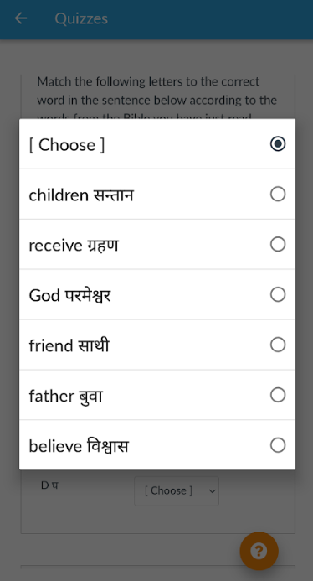
canvas

Slide 20
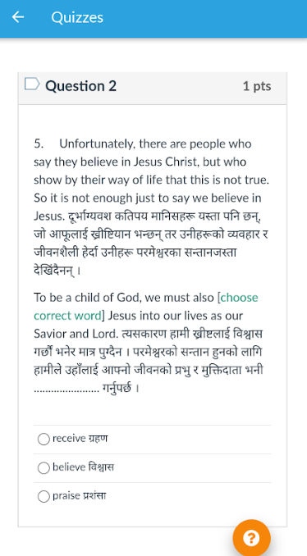
canvas

Slide 21
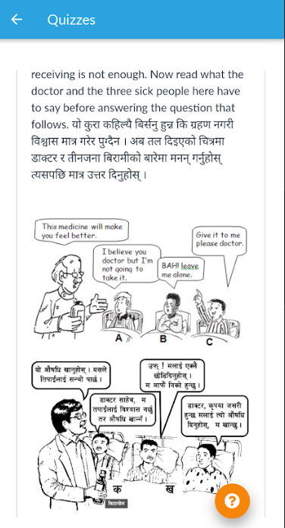
canvas

Slide 22
Example: schoology

Slide 23
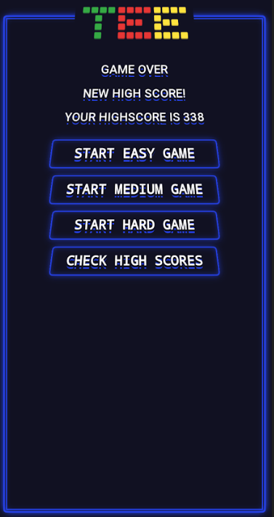
Example: GROWSPace

Slide 25
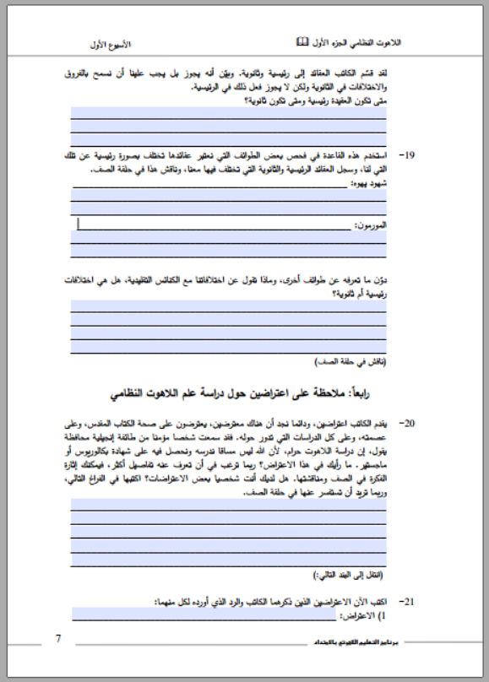
Bachelor level course workbooks
PDF Forms
Program for Theological Education by Extension (PTEE)
e-Learning size (A4) (other sizes possible)
Divided into 10 parts
Foxit PDF Reader (not Adobe or browser)
Students upload to LMS - tutors can check their work!
2 weeks’ work (!) to convert MS Word doc
Embedded Audio

Video link (URL)
www.xyz.com

Slide 26
COURSES ON growspace
COME FOLLOW ME (WORD OF LIFE)
ABUNDANT LIFE (SEAN)
OTHER COURSES TO COME

Slide 27
Example: gnowbe

Slide 28
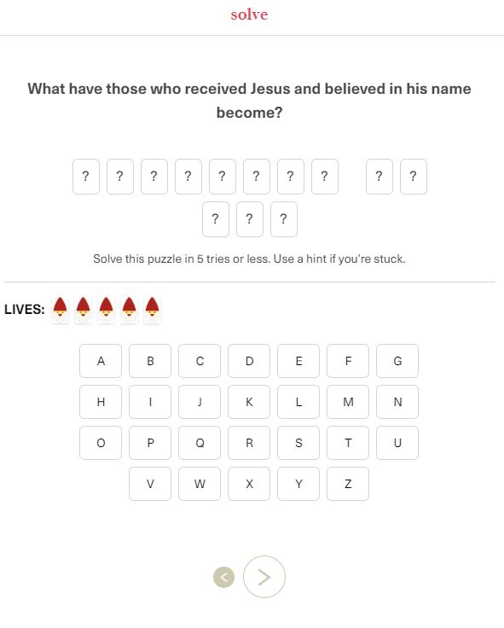
Example: Gnowbe

Slide 29
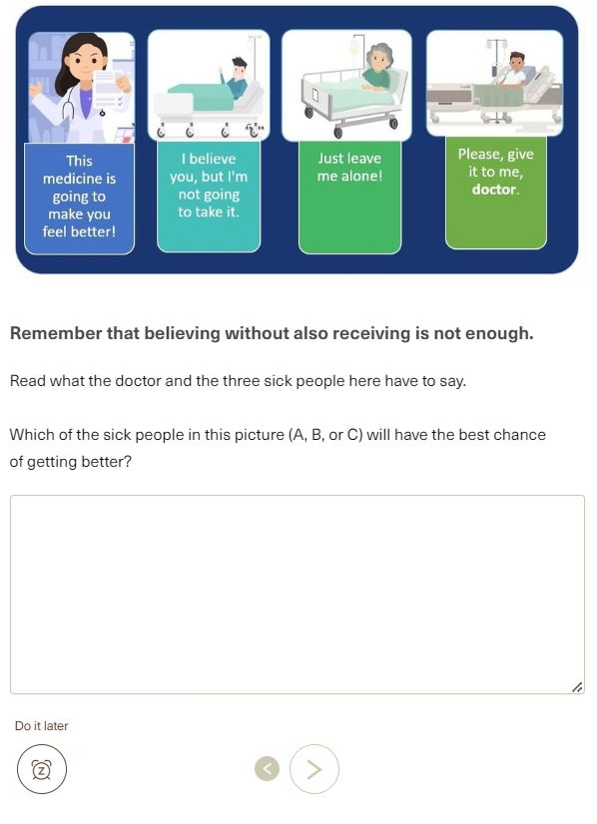
Example: Gnowbe

Slide 30
Enhance a TEE lesson for mobile phones
Notes:
Sharjeel and Hanna-Ruth

Slide 31
Make it focused.
Make text and layout simple.
Make it visual.
Make it short.
Make it interactive
Make it social.
Make it adaptable for mobile phones.
7 tips for a
meaningful learning experience
Source: Corbeil, Khan and Corbeil: Microlearning for the digital age.

Slide 32
Create your own mobile learning
Use chapter 1 of Abundant Life.
Discuss Task 1
Choose Task 2 OR Task 3

Slide 33
Pray together
That God will show you opportunities
For talented people to join the teams
That God will use developments like Growspace (and others) for his glory

