Slide 1
Think of a positive life-changing moment you have had Tell your neighbour about it

Slide 4
You must begin with the GOAL! The destination determines the journey.

Slide 5
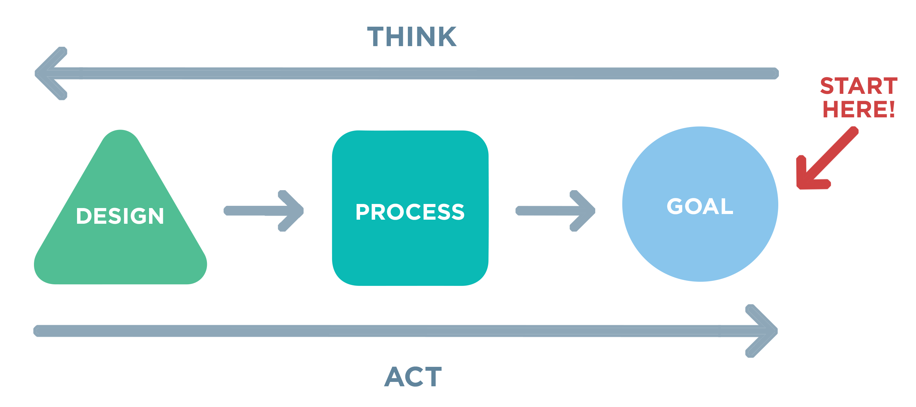
You must have a clear goal, and it must be the right goal.

Slide 6
So…
Gospel ministry works backwards!

Slide 7
Why life change? How life change?
2 Cor 3:18
And we all, who with unveiled faces contemplate the Lord’s glory, are being transformed into his image with ever-increasing glory, which comes from the Lord, who is the Spirit.

