Slide 1
Practice contextualization

Slide 2
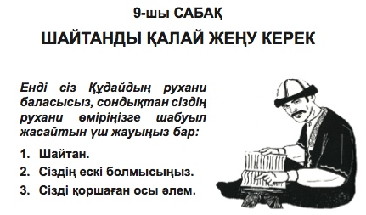
ALife L9
Make a quick drawing how a teacher looks like in your culture. Also ow lesson and title would be shown
Notes:
Illustration –tutor and how to show chapter

Slide 3
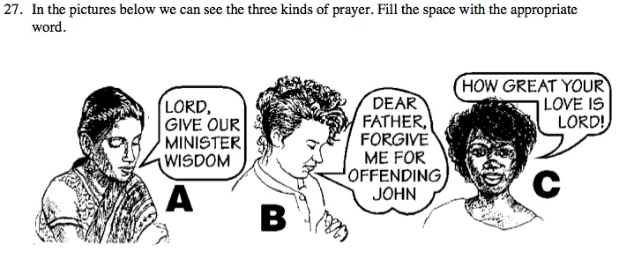
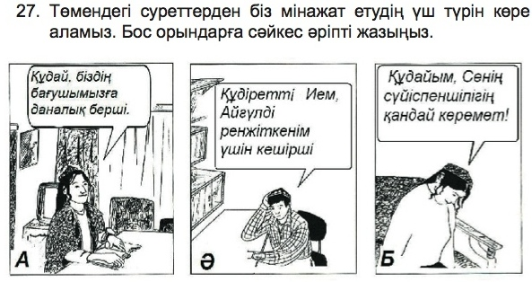
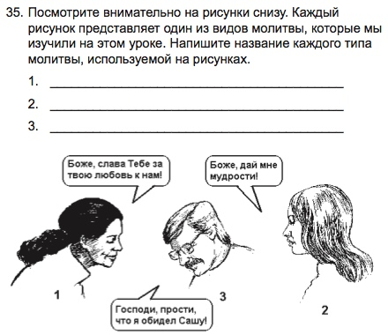
ALife L8
What would be some appropriate female and male names in your context?
Notes:
Illustration & names

Slide 4
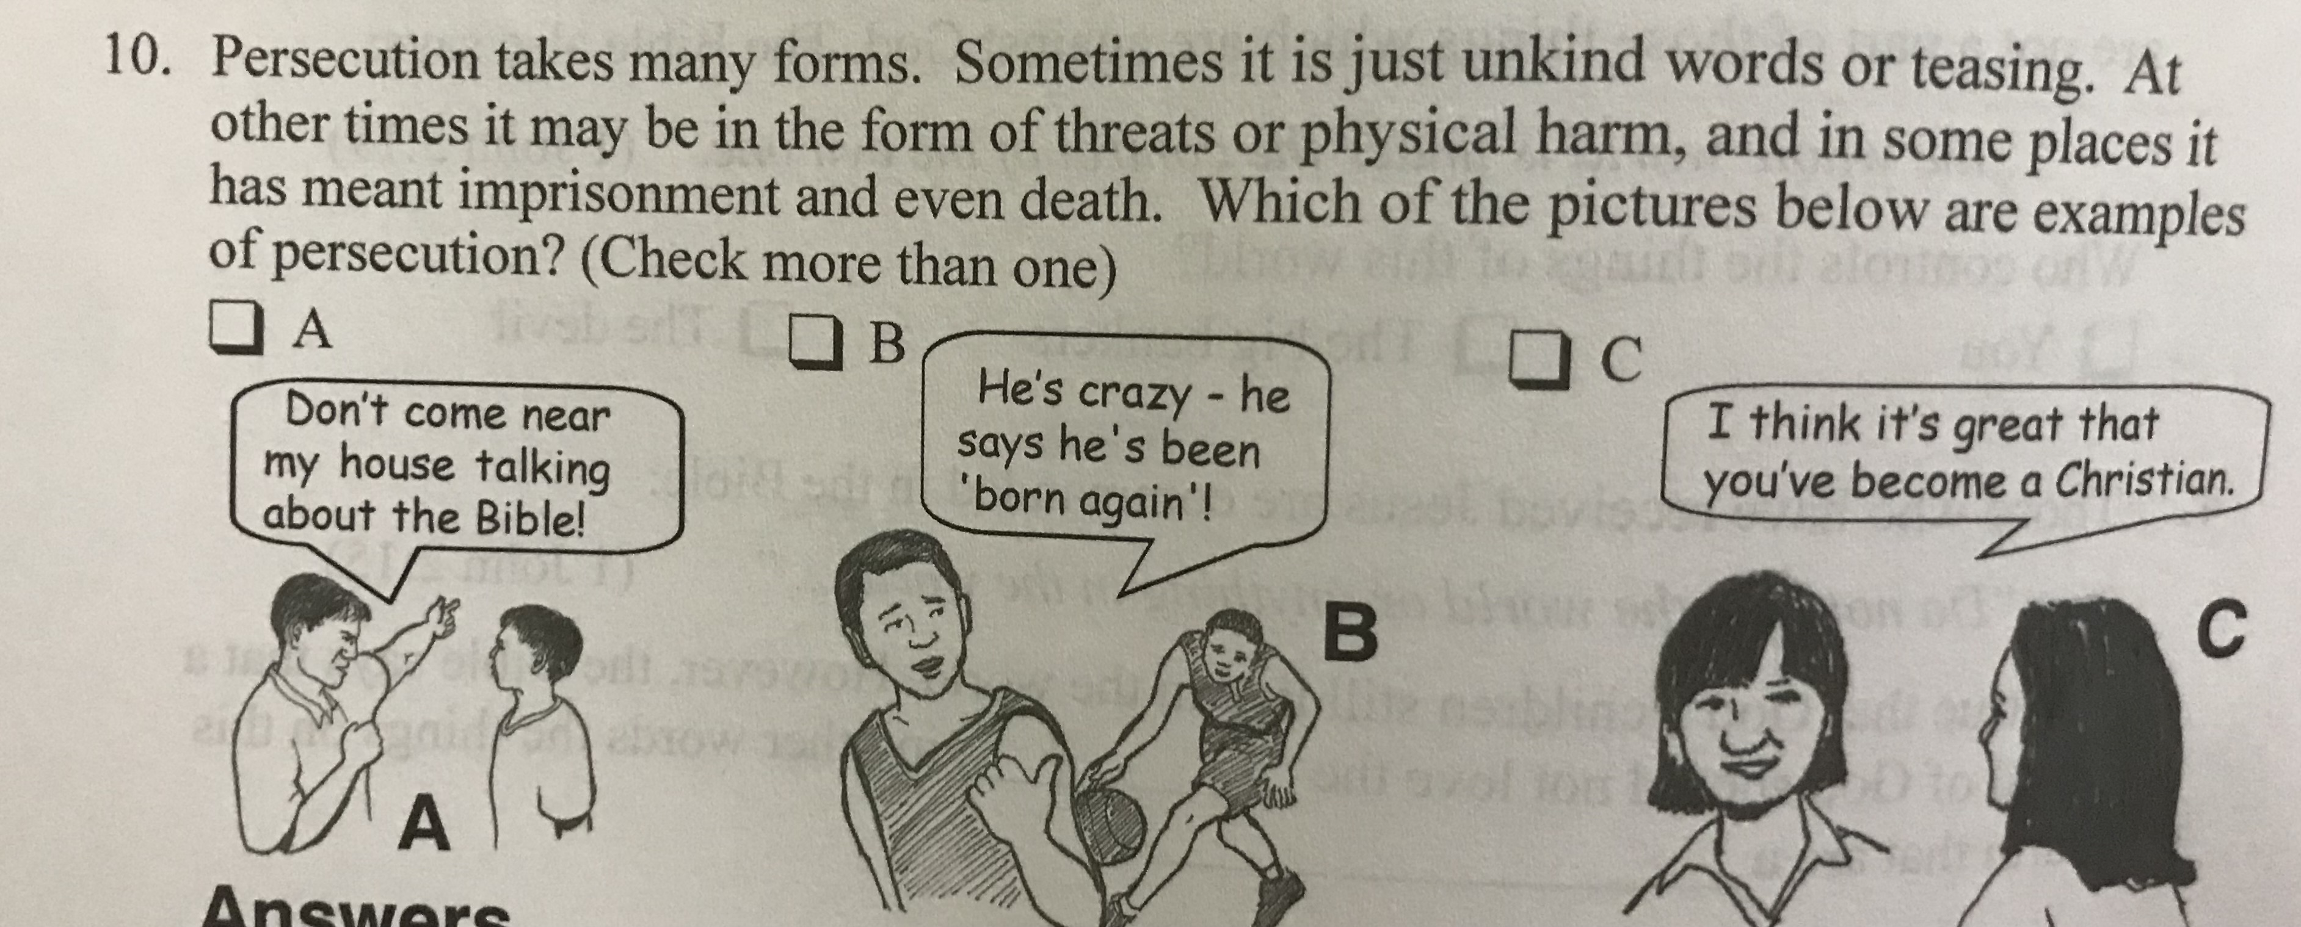
How would persecution look like in your culture?
How would you change this frame to fit in your culture?
Think of both text and illustration

Slide 5
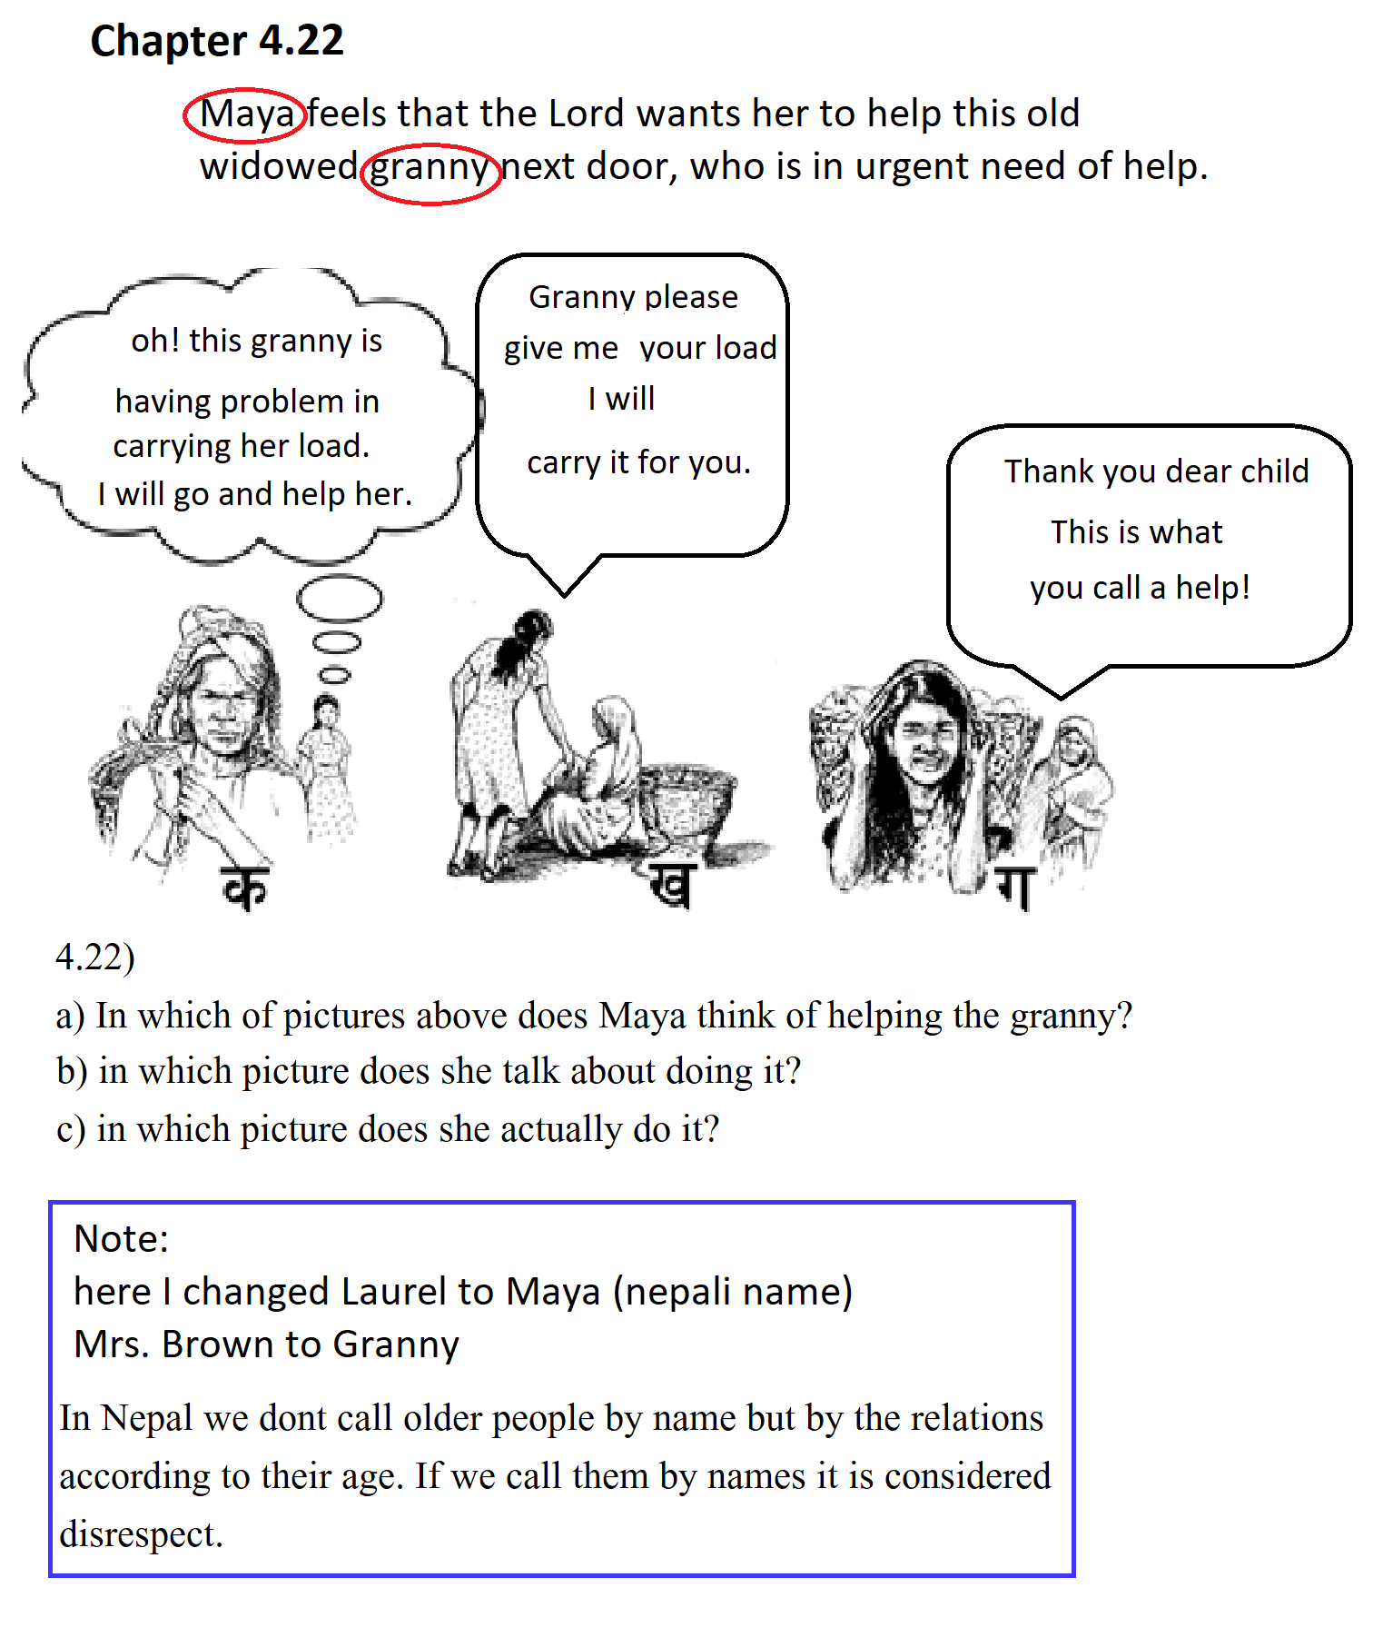
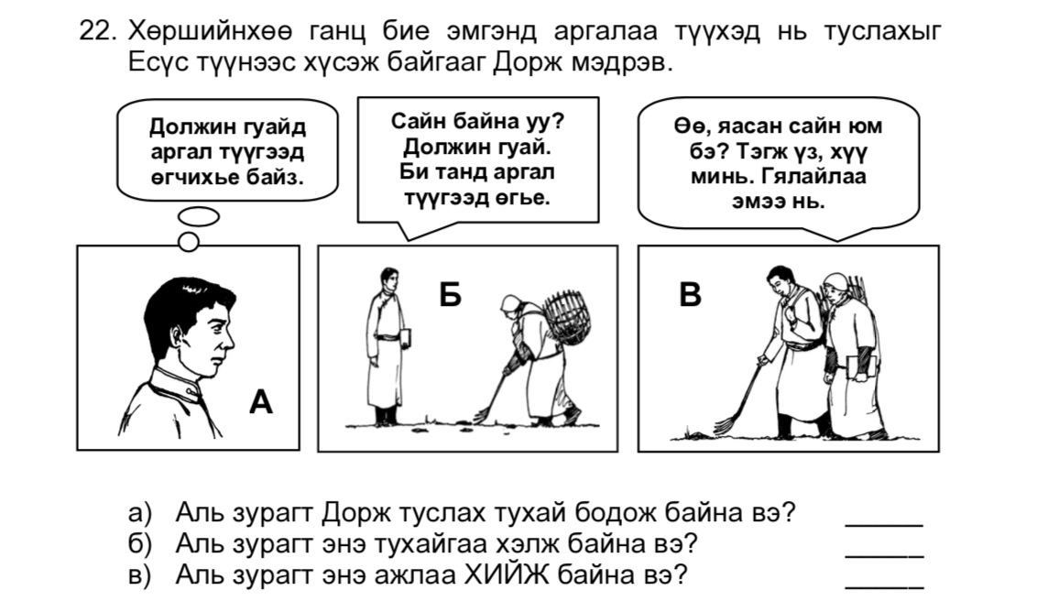
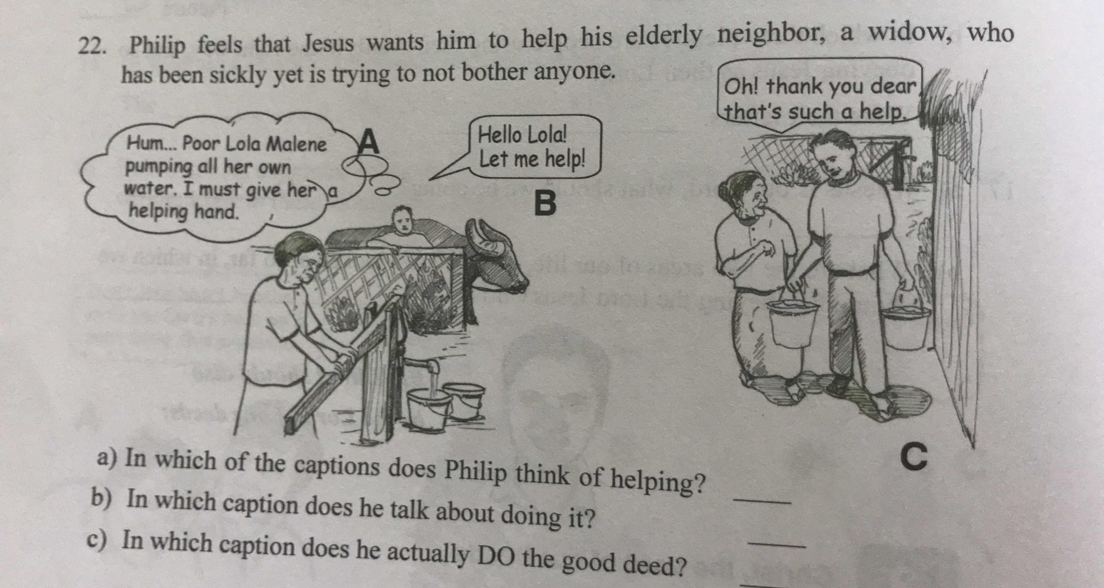
Names: How would you rewrite this
frame to fit in your culture? Given here is Nepal, Filipino and Mongolian culture. Again; think of text and illustration
Translation
Dorj knows that Jesus wants him to help his elderly single neighbor collecting argal (dung).
A: I should give Mama Doljin a bit of help collecting argal. B: Hello Mama Doljin. I'll collect argal for you. C: Oh, what a great thing. That's the way my child. Your grandma is very grateful.
a. Which picture shows Dorj thinking about helping? ․․․․ b. Which picture shows him talking about it? ․․․․ C. Which picture shows him DOING this work? ․․․․

Slide 6
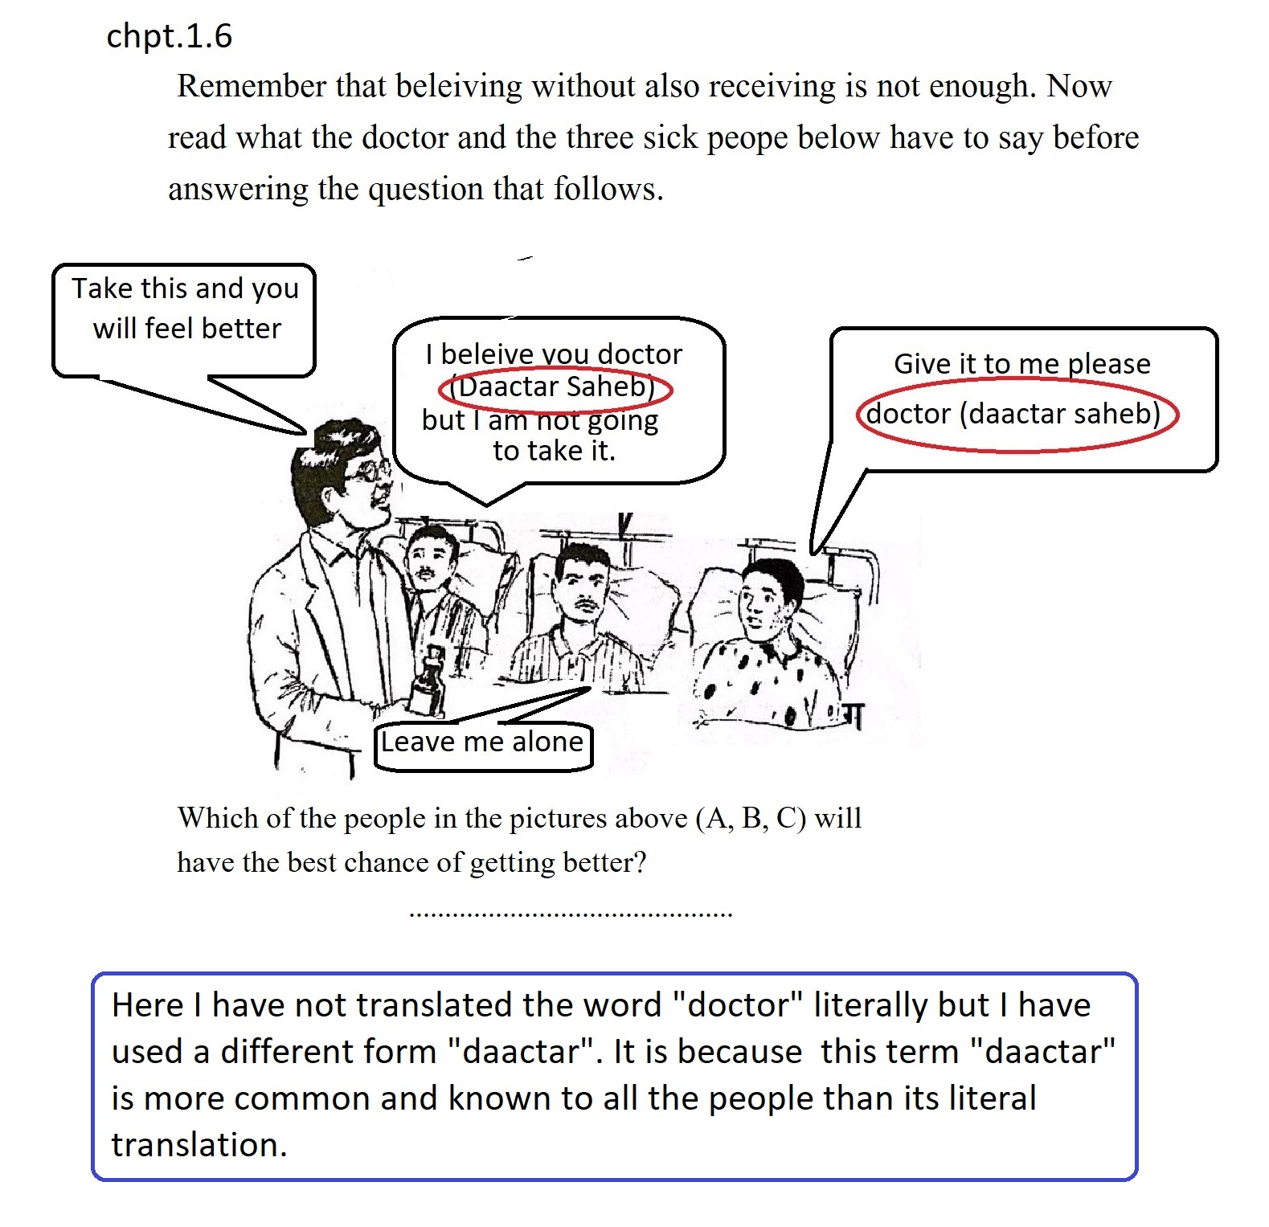
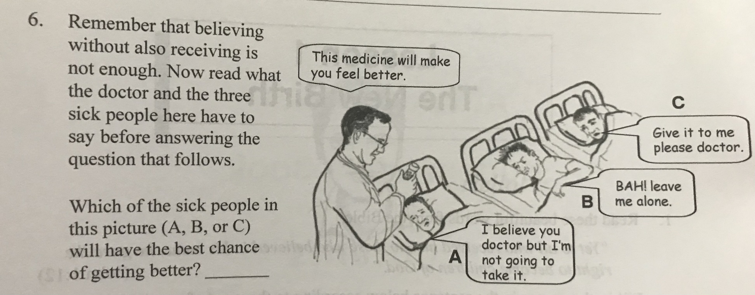
How would you adjust this frame in your context? Think of terms used, how hospital looks like etc.

Slide 7
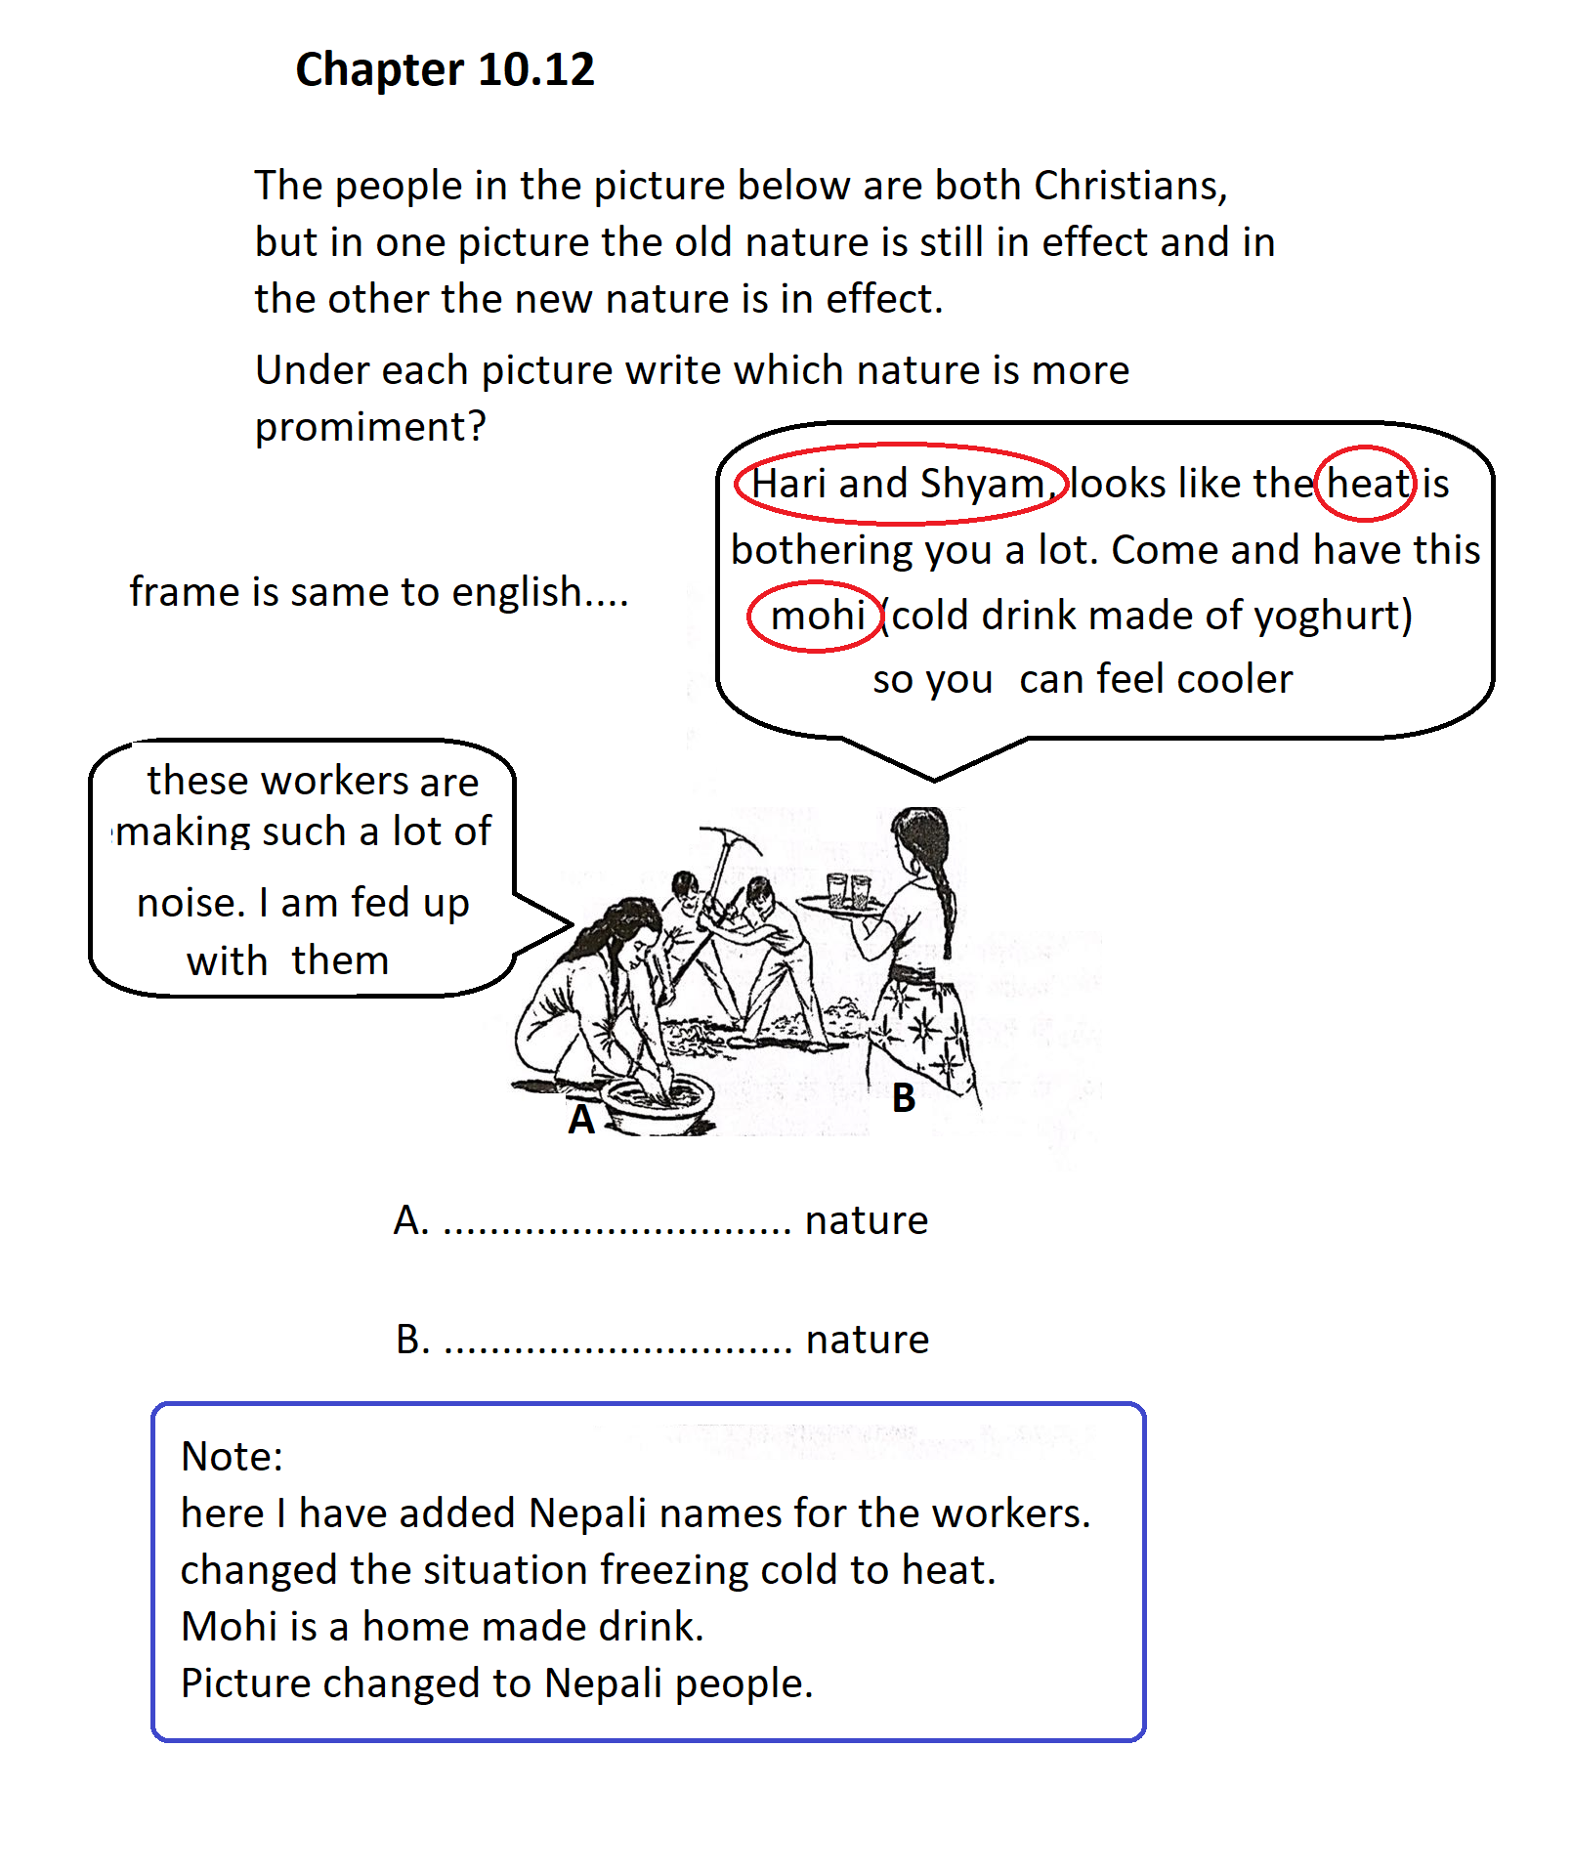
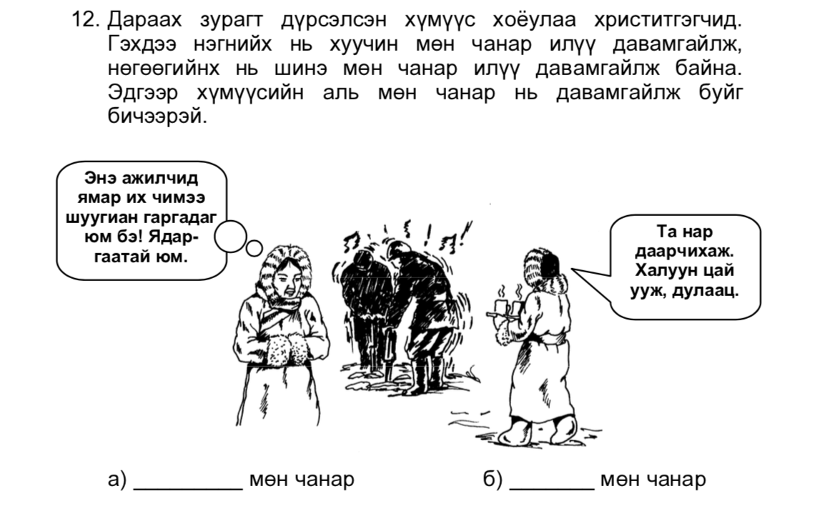
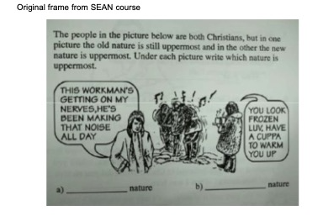
Mongolian:
The main text is the same as for English. Only the illustration captions are different. These are:
What a racket these workers are making. It's so tedious.
What would you change if this would be written
for your context?
Do you think his is appropriate conduct in Pakistani context?

Slide 8
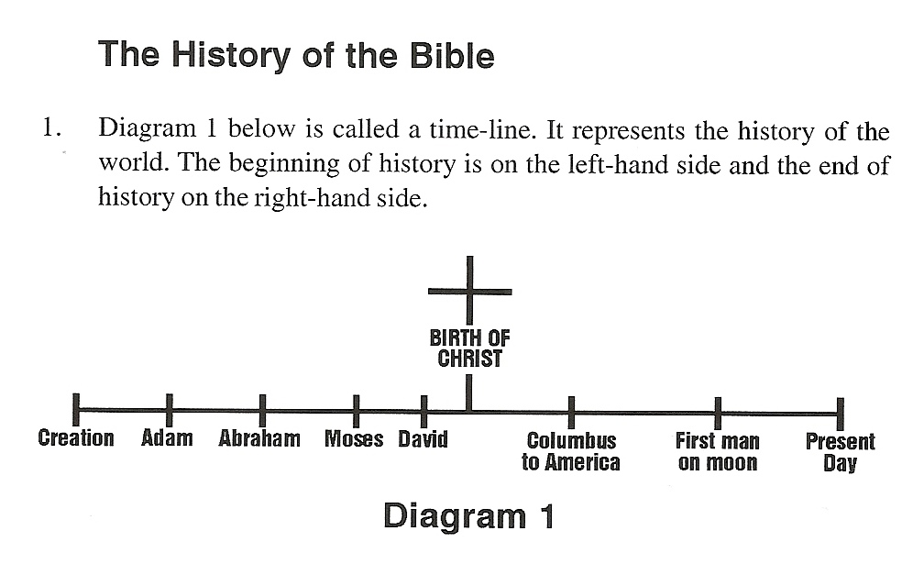
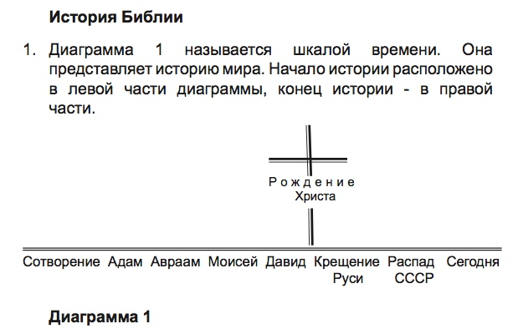
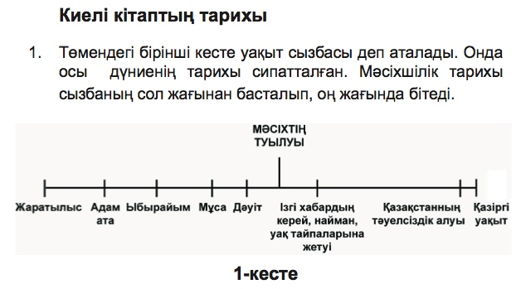
Abraham, Moses, David, Exile, Christ, Genghis becomes Khan, Communist Revolution, Present time.
ALight L3a
Notes:
Diagram 1

Slide 9
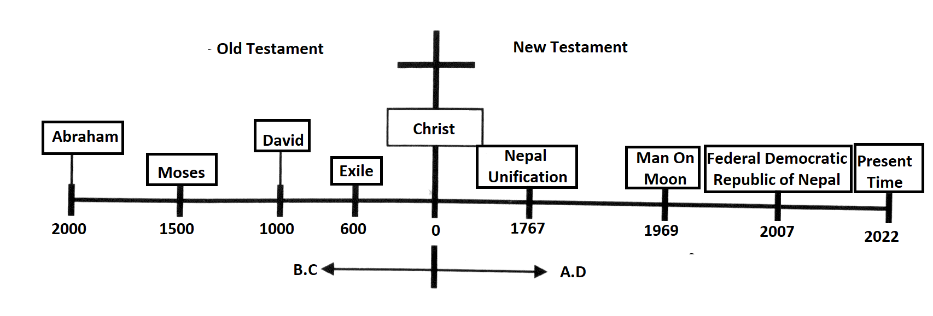
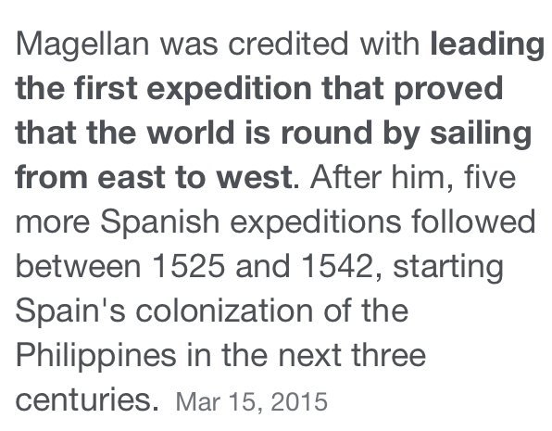
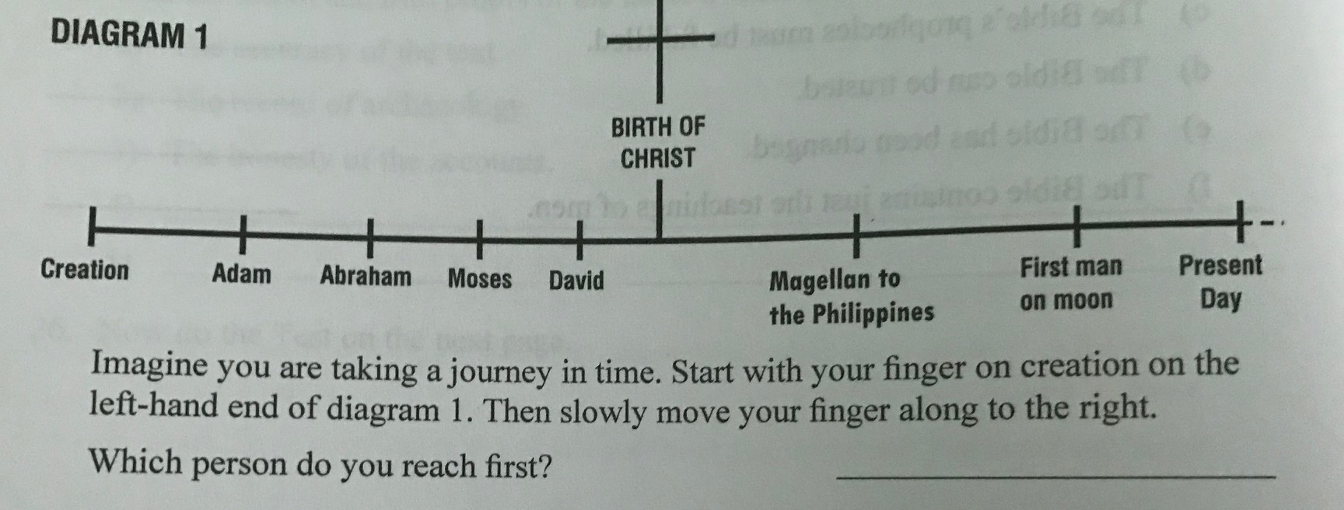
Pakistan
Russian
Creation, Adam, Abraham, Moses, David,
christening of Russia, collapse of Soviet Union, today
Mongolian
Nepali
Abraham, Moses, David, Exile, Christ,
Genghis becomes Khan, Communist Revolution, Present time.
Which translations do you think are good and which ones not so good? Why?
Notes:
What is the disadvantage if we do not translate these into logical frames for goal culture? What happens if you do it w

Slide 10
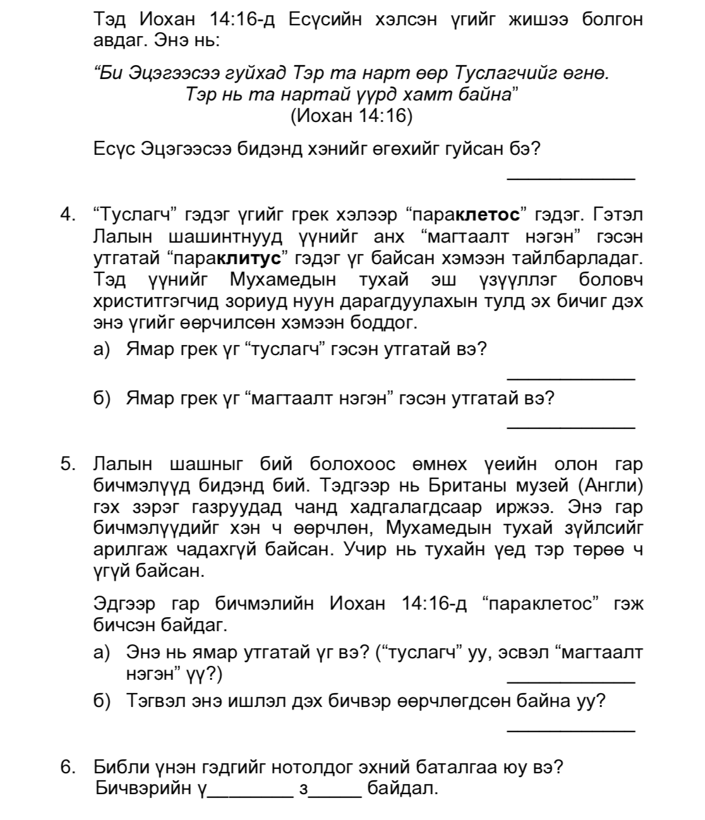
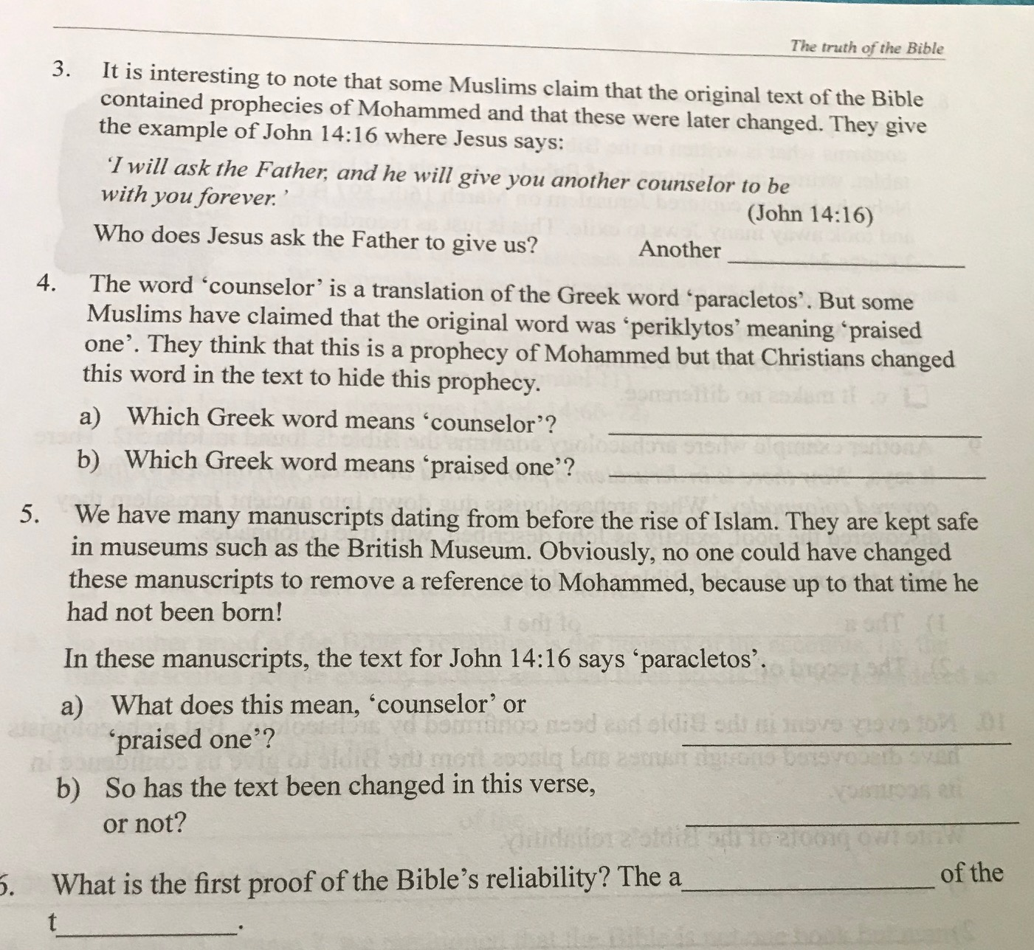
In a non-M context, what could you change to make it more clear?
Think of Roman Catholic, Hindu, Buddhist context. What are some issues people in your culture need to deal with when it comes to the Bible being trustworthy?
Mongolian and Filipino English literally translated the text.
Notes:
Permission needed for bigger changes and need more mature church

Slide 11
4. Jesus has the Divine Nature
It is an amazing claim which the Jews of Jesus’ day found difficult to accept, just like our Muslim brothers.
a. What did Jesus claim in John 10:30? __________________________________________
b. What was the people’s response in the next verse? ________________________________
Once again John’s Gospel provides us with important information about Jesus’ divine nature. When Philip, one of Jesus’ disciples said “Lord, show us the Father…” (John 14:8) then what did Jesus answer him? (John 14:9) ______________________________________________
It is not possible for us to understand what God is like. No one has ever seen God (John 1:18) but the amazing truth is that Jesus has shown us what God is like, because both of their natures are the same, that is, both Father and Son have the same divine nature. Write below the central part of John 14:9 and memorize it.
“Anyone who has _______________________________________________”
Write down the four reasons on which grounds we can truly call Jesus the “Son of God”.
1. _____________________________________________________________________
2. _____________________________________________________________________
3. _____________________________________________________________________
4. _____________________________________________________________________
In Pakistan culture they felt they needed to add some more frames. Why do you think this is?

Slide 12
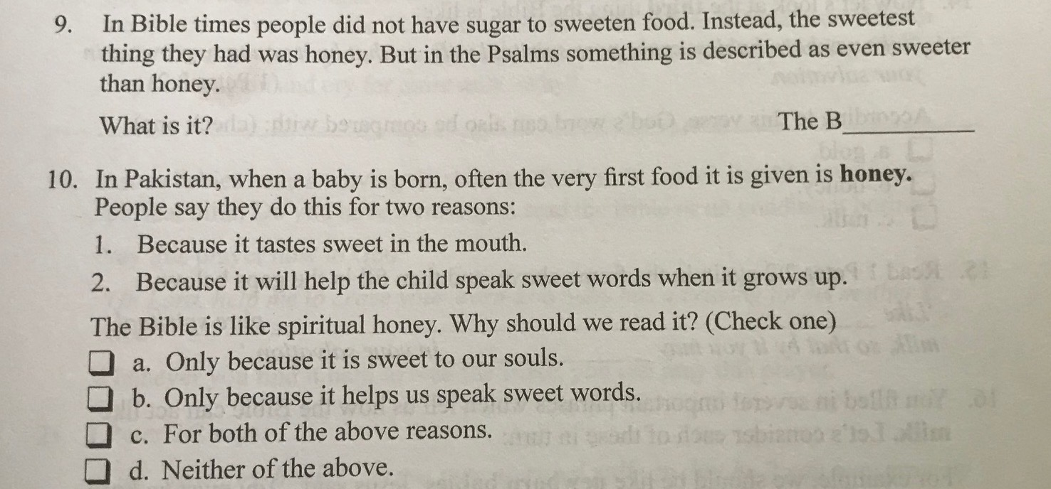
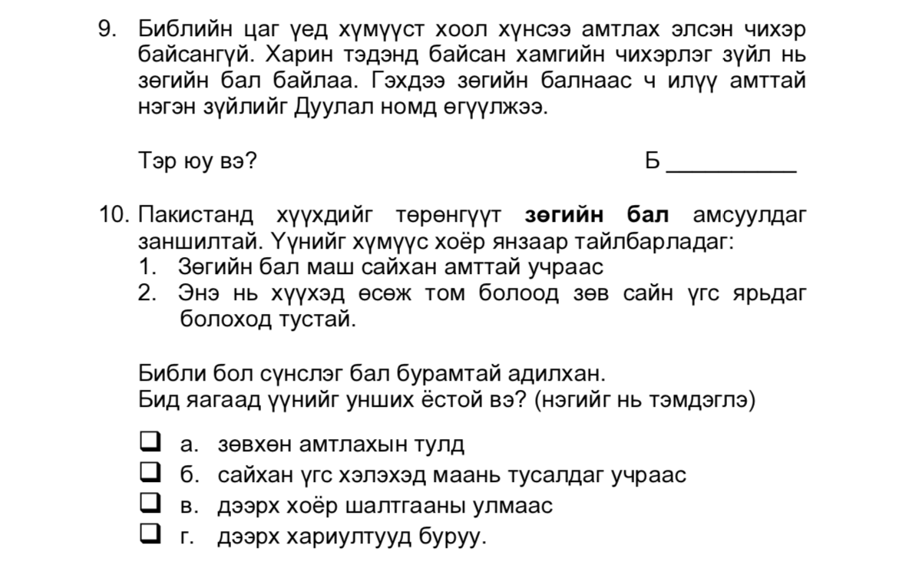
Mongolia:
Pakistan there is a custom of putting honey in a baby's mouth after it is born. People explain this two ways: 1. because honey has a very nice flavor. 2. Because it will help the child to become someone who speaks good and right words when they grow up.
The next two lines of frame 10 are the same, then
a. just for the seasoning/flavor
b. because it helps us to speak nice words
c. for both of the above reasons.
Neither of the above.
What is better: use a great example from a foreign culture or find an example from your culture? Explain.
What could be a way to rewrite this in your culture? Is there any use of Honey in your culture that can connect to the Word of God being sweeter than honey?

Slide 13
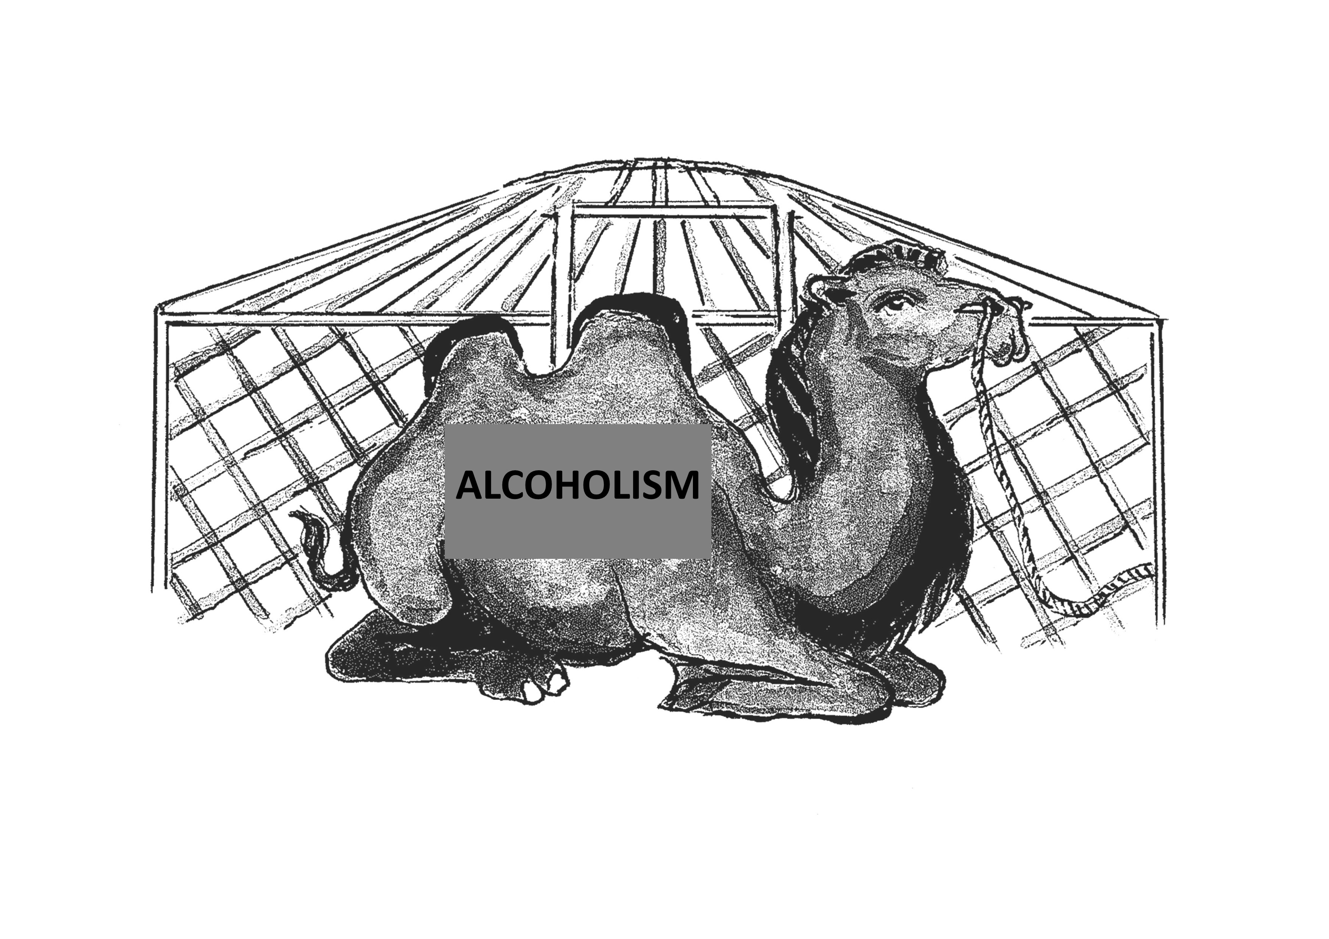
What if you do not have a ger? Or alcoholism is not a problem? How can you change this frame?
A camel in our ger
3. Such families usually refuse to accept that there is a problem until it is too late. When they finally acknowledge the problem, they have already experienced so many troubles and so much misery that they feel it is impossible to talk about it openly! Although everyone knows the problem is there, they pretend it is not there.
Imagine you had a big camel living in your ger: it would take up almost all the space and have a huge influence on everybody living there and on everything happening there! Every family member would be constantly aware of its presence! Now imagine that everyone in your ger would pretend the camel was not there and behave as if everything were normal. Wouldn’t that be strange?
But that is exactly how family members react who have an alcohol-dependent person living with them! It is a huge problem, influencing everyone and everything they do, but the family members usually pretend that there is no problem. They do not talk about it and behave as if life goes on as normal.

