Slide 1
Resourcing TEE for the global Diaspora

Slide 2
Global Migration Patterns
The width of the arrows shows the amount of net migration between regions of the world.
Countries with net migration are in red.
Countries with net out migration are in green.

Slide 3
Typical diaspora scenario
A multi-ethnic church in England have been using the Abundant Life course with their English-speaking members.
Now they also want to roll out the programme for the members of the congregation who are more comfortable reading in their mother tongues.
The church needs:
14 copies in Chinese
6 copies in Mongolian
2 copies in Hindi
4 copies in Bahasa Indonesia.
They are used to running TEE courses in the church and familiar with the method.
Notes:
How will they obtain the courses?
It will require
4 country-to-country or church-to-country agreement
4 separate payments in different currencies
4 separate shippings
Many, many emails
By the time this has been arranged, 6 months could have been passed and interest to start TEE may be gone.

Slide 4
Resourcing challenges for Diaspora TEE
TEE Users
How to order courses efficiently, quickly and cost effectively
TEE Course Providers
How to make sure TEE courses aren’t misused
How to make sure only qualified users are accessing the courses
How to know who is ordering/using courses
How to receive payment/royalties from around the world

Slide 5
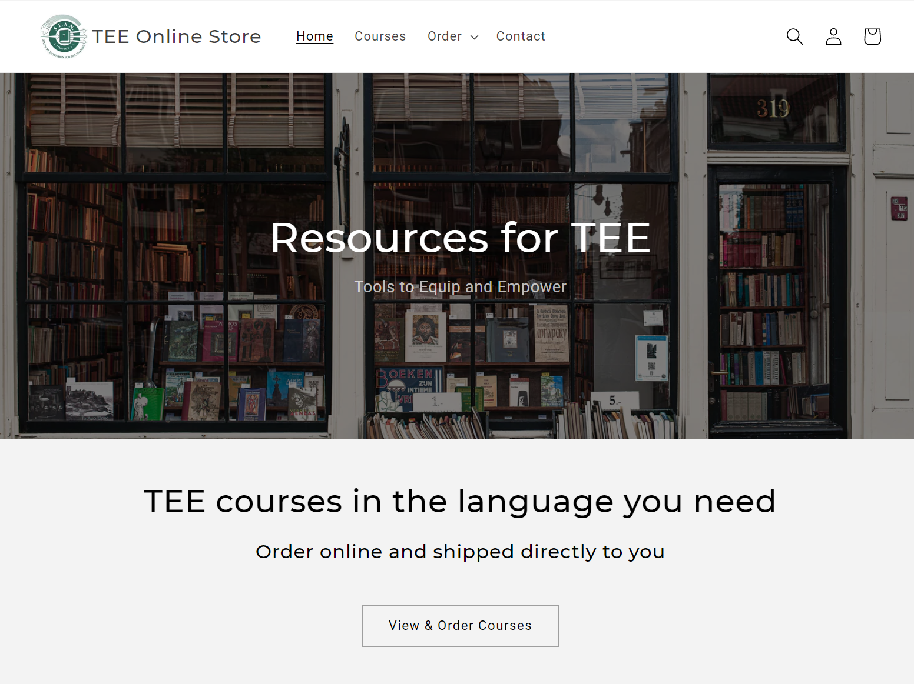
TEE Online Store
✓
Protect course content
Restrict to qualified users
Efficient ordering process
Keep contact with customers
Receive & distribute payments/royalties
✓
✓
✓
✓
Not seeking to replace the way national TEE bodies already supply courses in their own country. Primarily targeting (but not limited to) countries with significant diaspora populations.

Slide 6
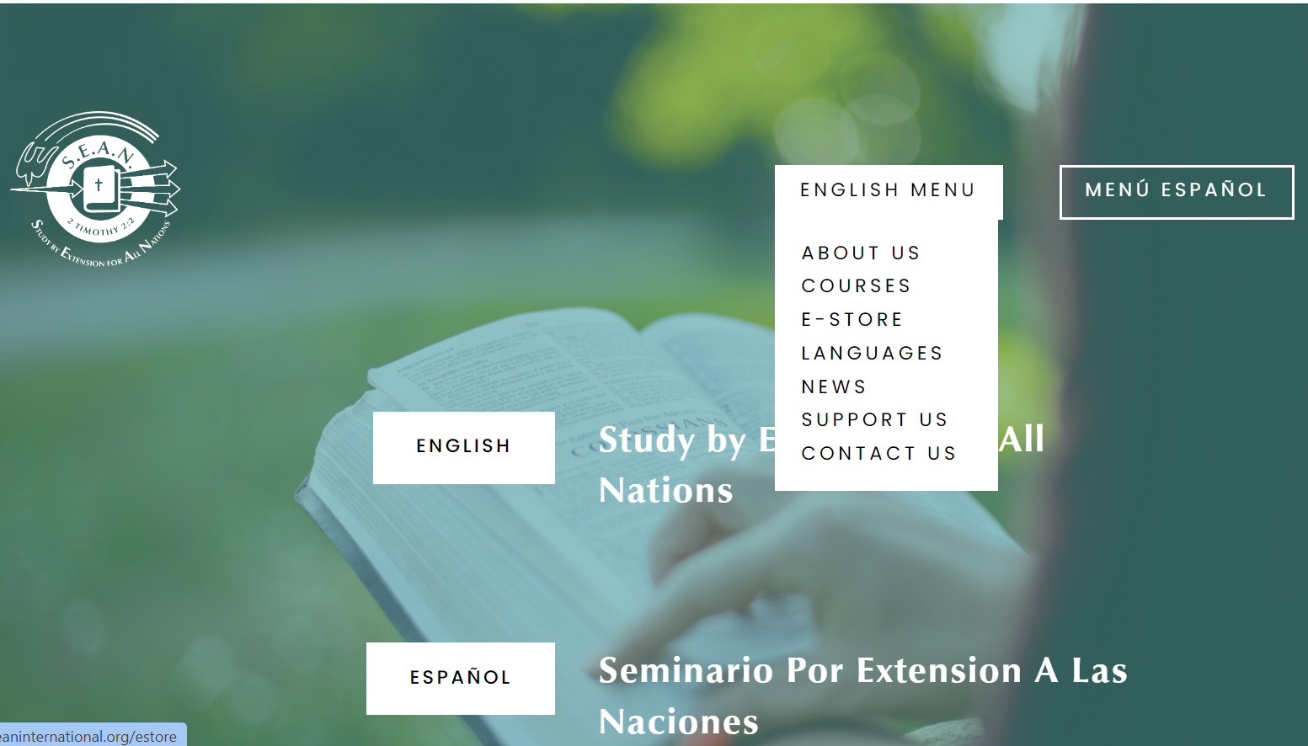
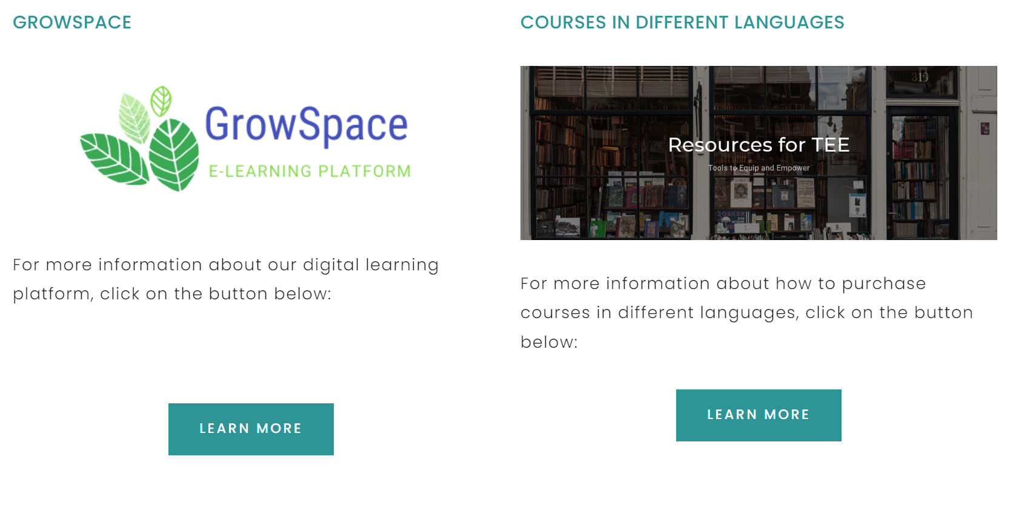
TEE Online Store
www.shop.seaninternational.org
www.seaninternational.org
/estore

Slide 7
Protect course content
Notes:
Nasdaq - National Association of Securities Dealers Automated Quotations Stock Market

Slide 8
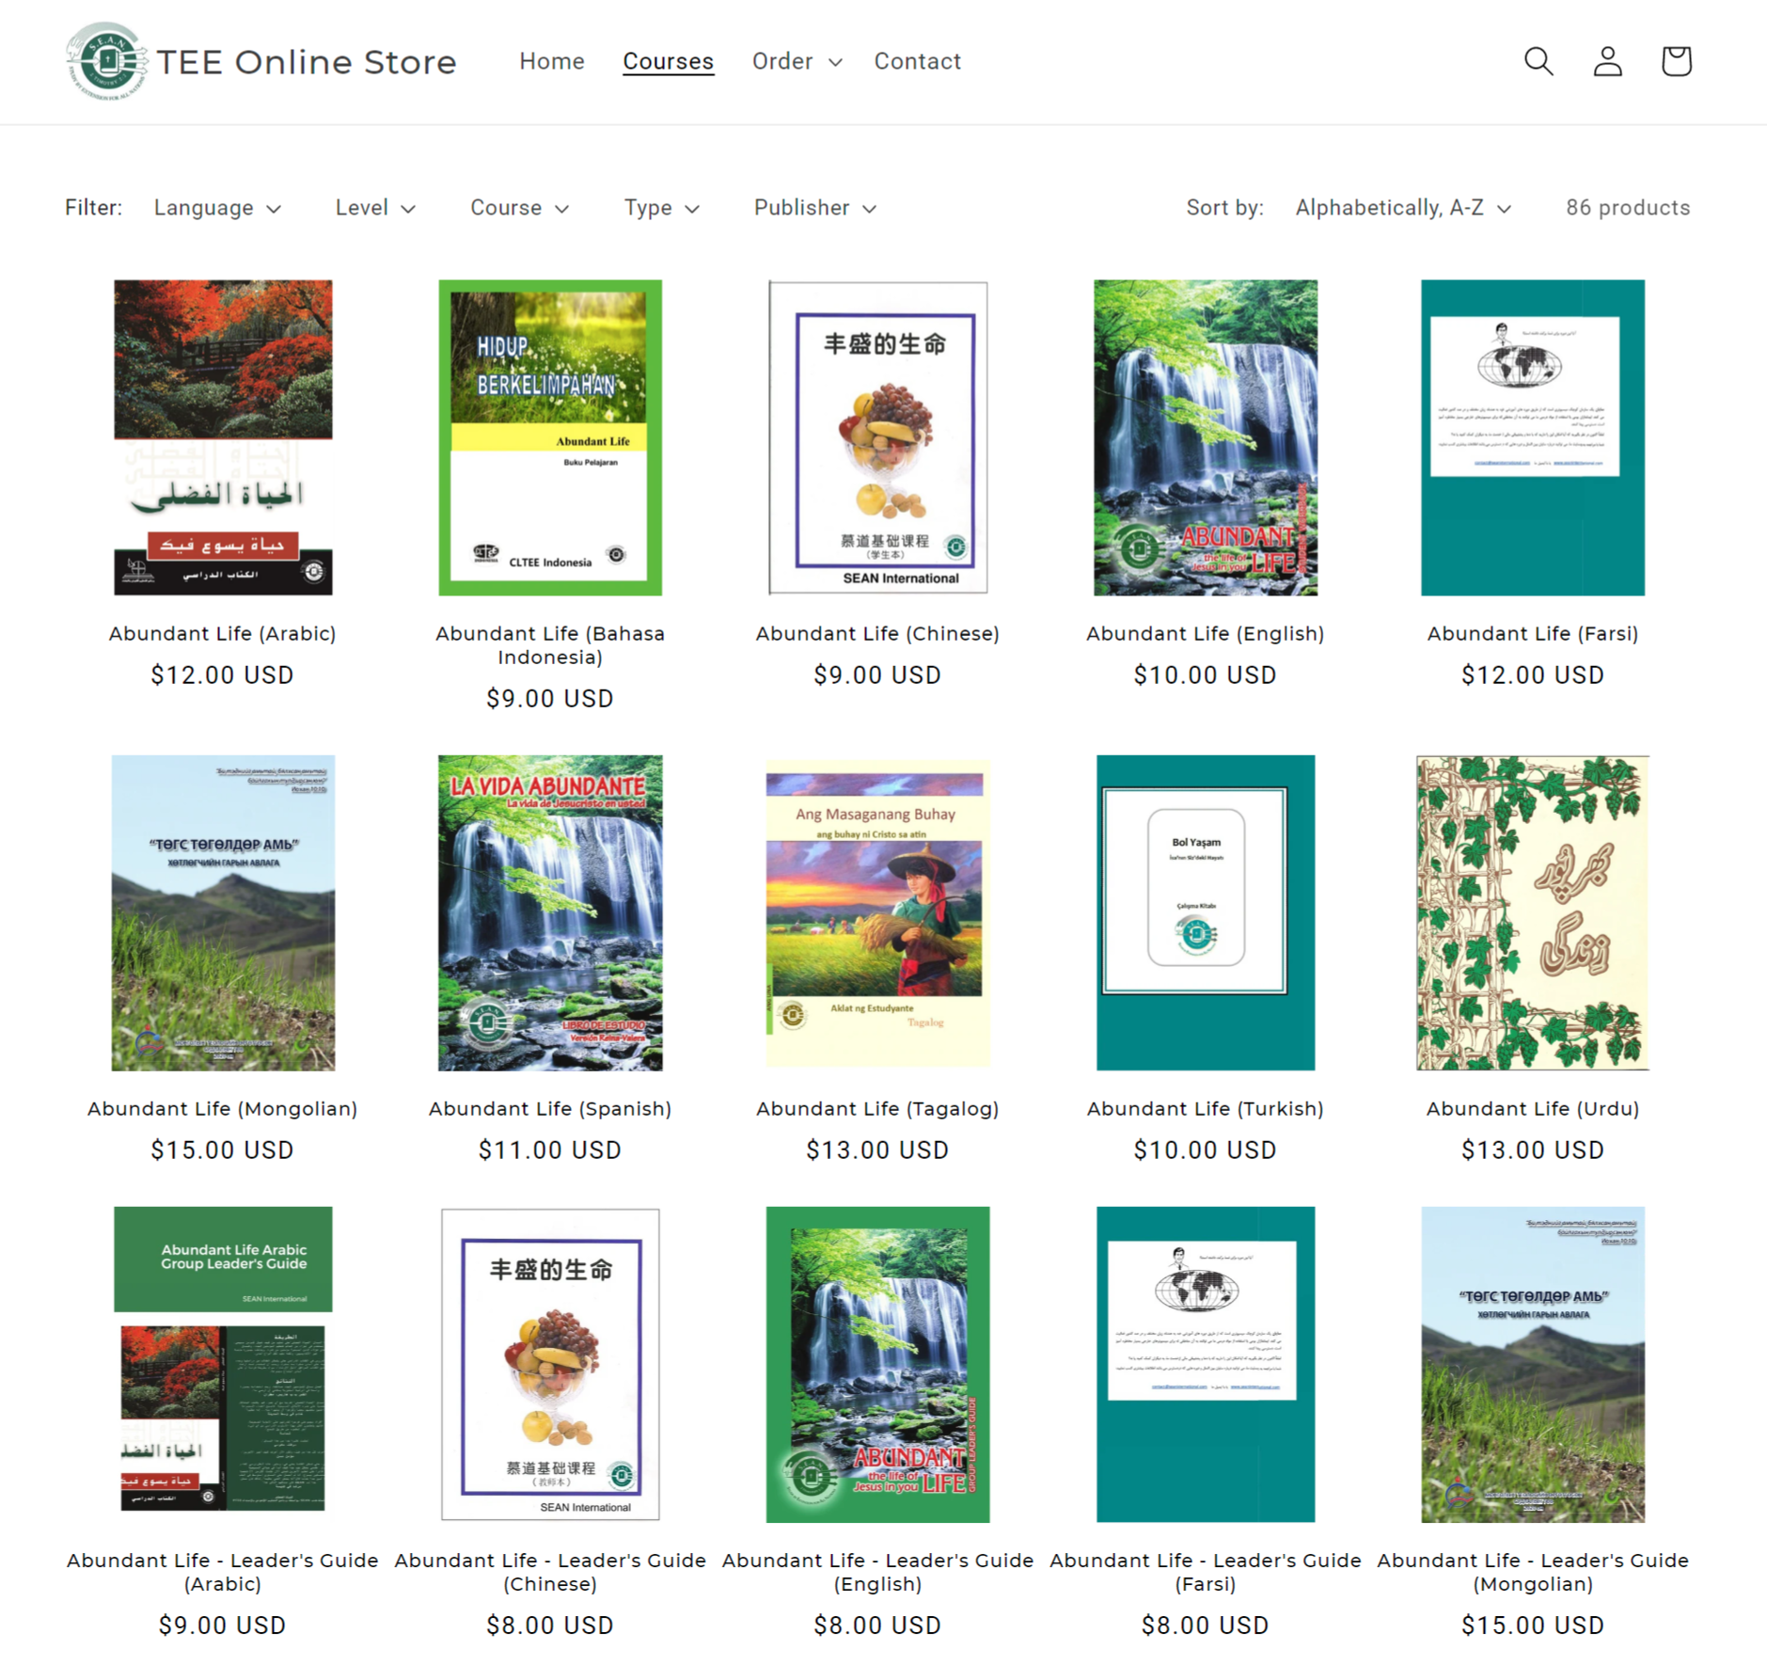
Protect course content

Like … but with control over who can purchase
No sharing PDFs.
PDFs not accessible by customer at any stage.
Course material is much safer
?

Notes:
Nasdaq - National Association of Securities Dealers Automated Quotations Stock Market

Slide 9
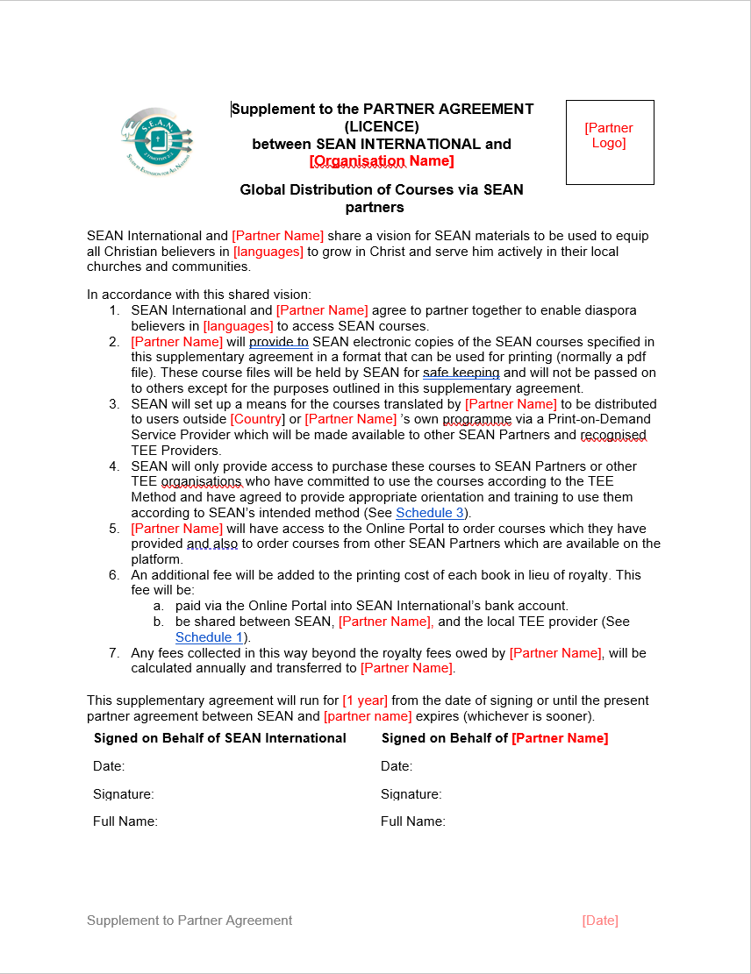
Protect course content
Supplement to Partner Agreement (Global distribution of Courses via SEAN Partners)
SEAN will not pass the courses on to other individuals/organisations.
Courses will only be available for purchase to SEAN Partners / TEE providers who are committed and qualified to using the TEE method.
The SEAN Partner will receive £1 per course book they translated, which is purchased anywhere in the world.

Slide 10
Restrict to qualified customers

Slide 11
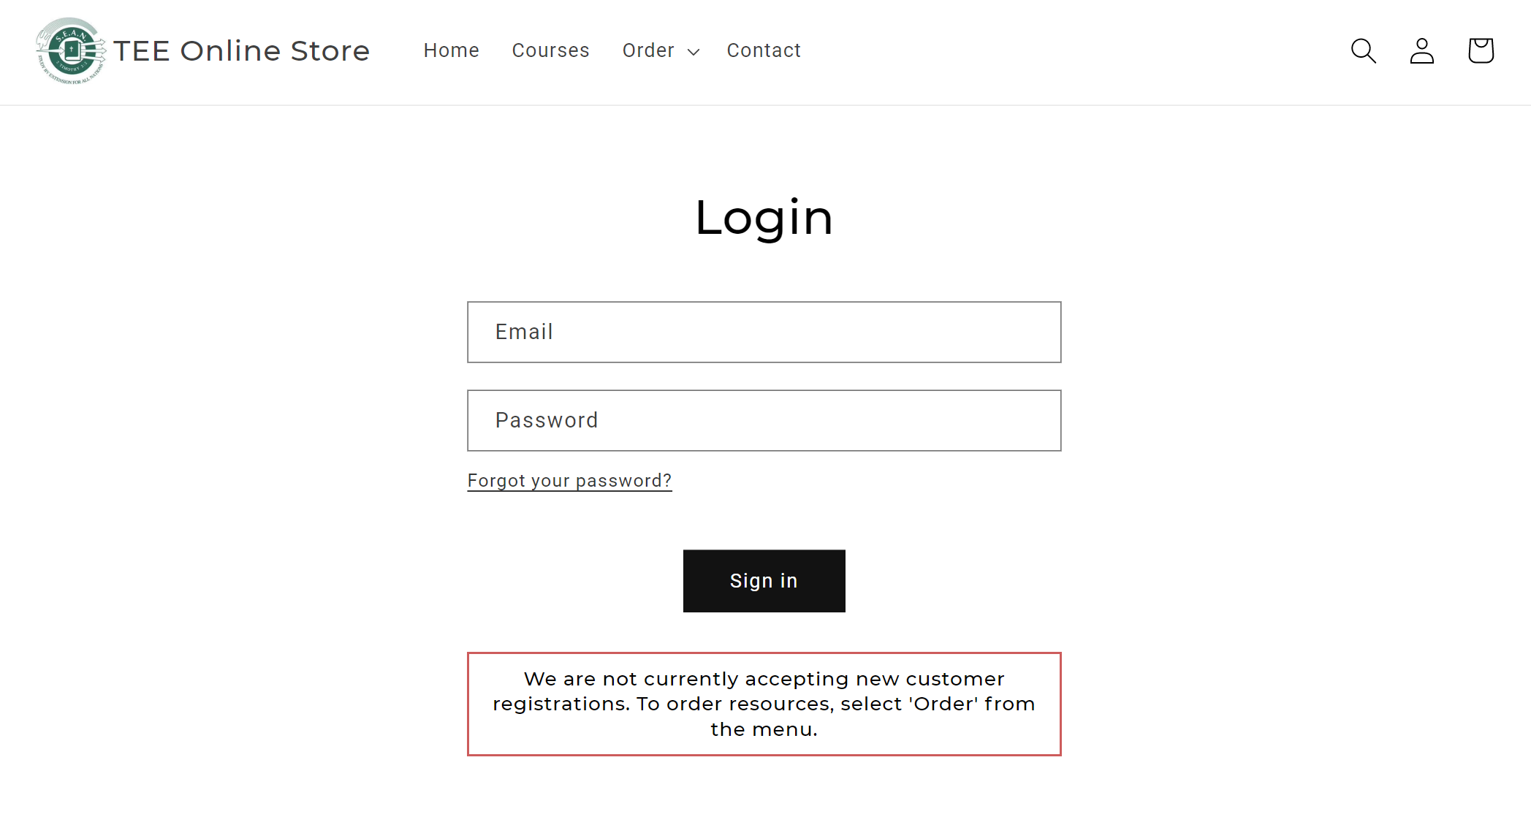
Restrict to qualified customers

Slide 12
Restrict to qualified customers

Slide 13
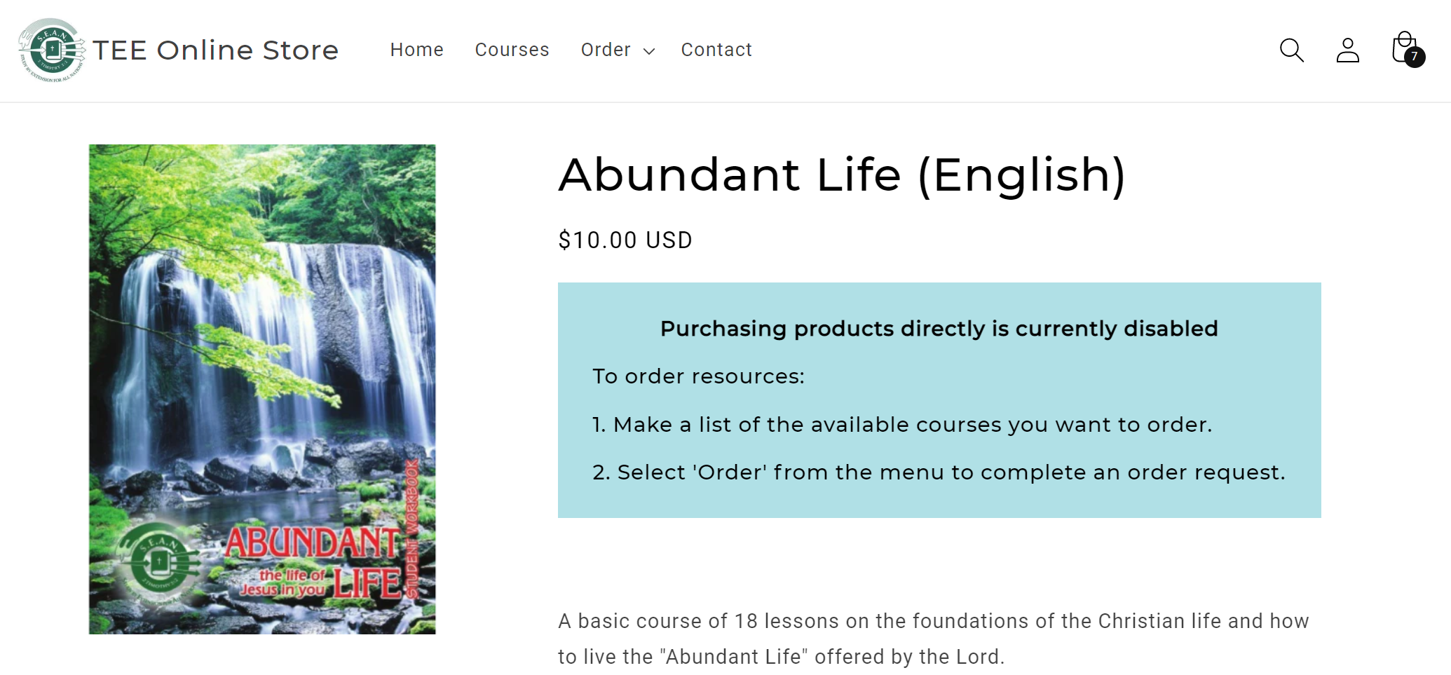
Restrict to qualified customers

Slide 14
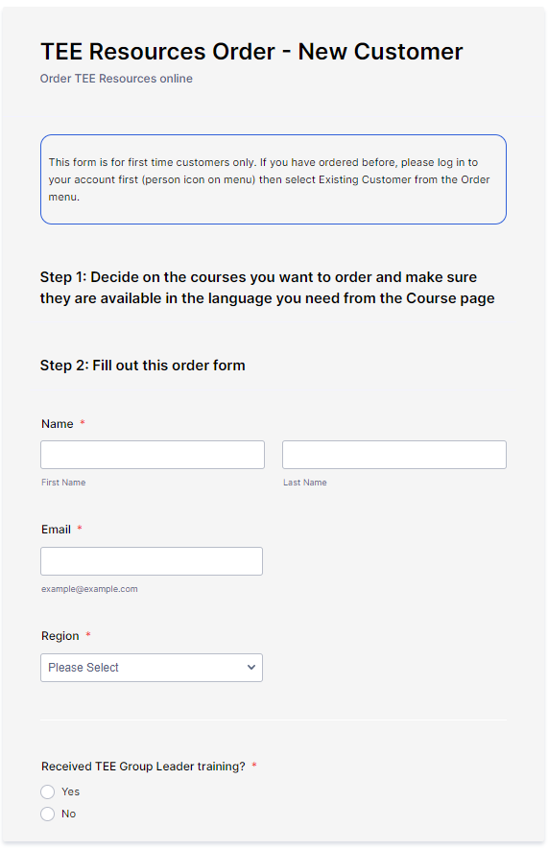
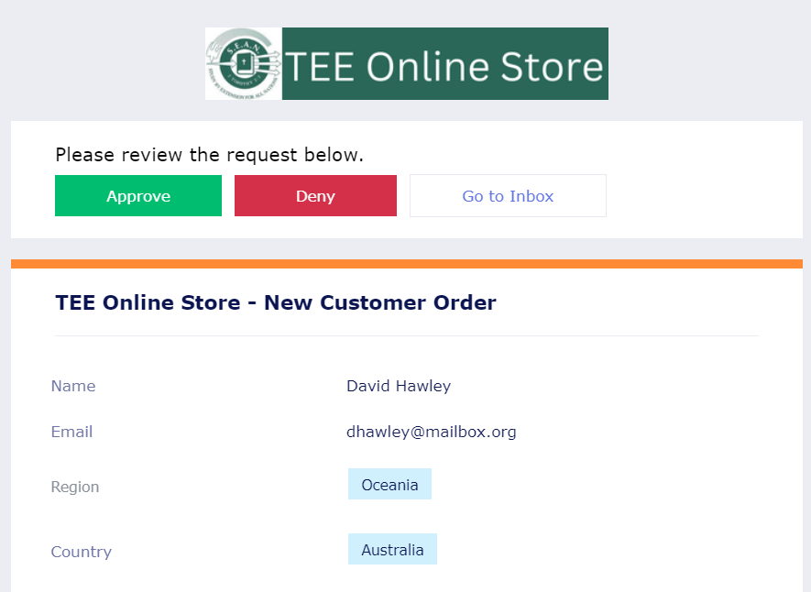
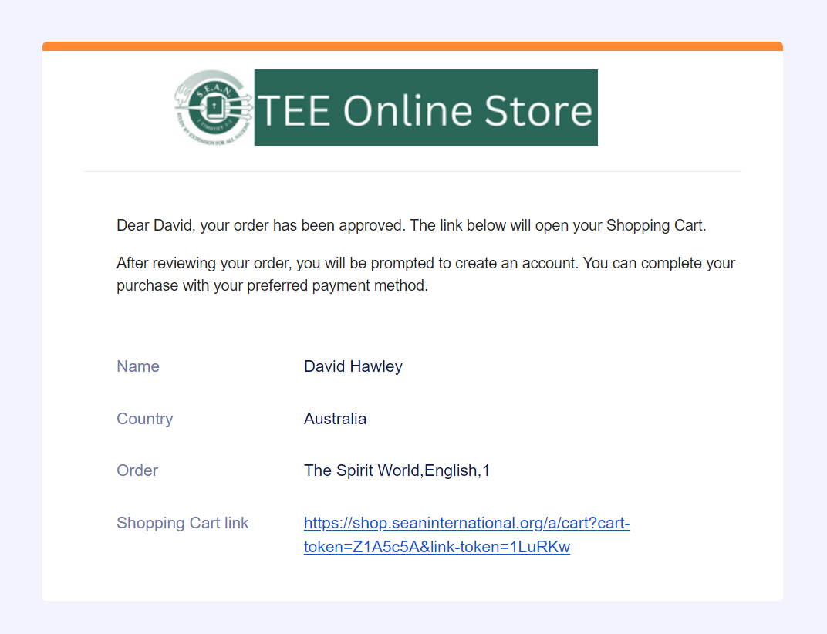
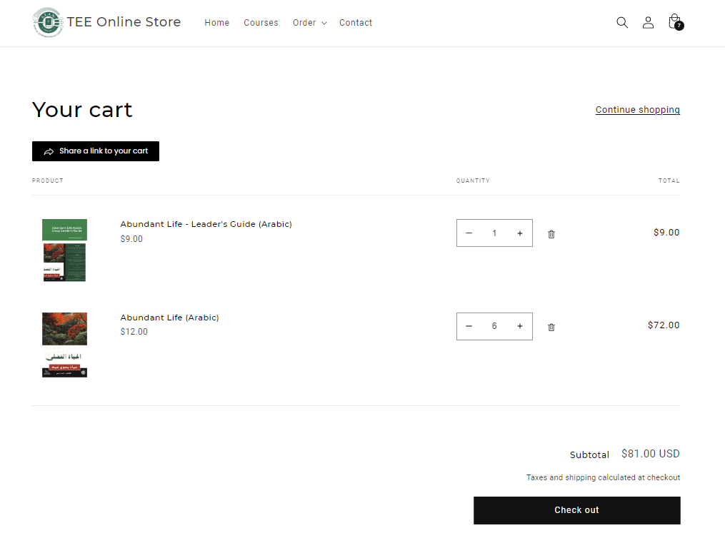
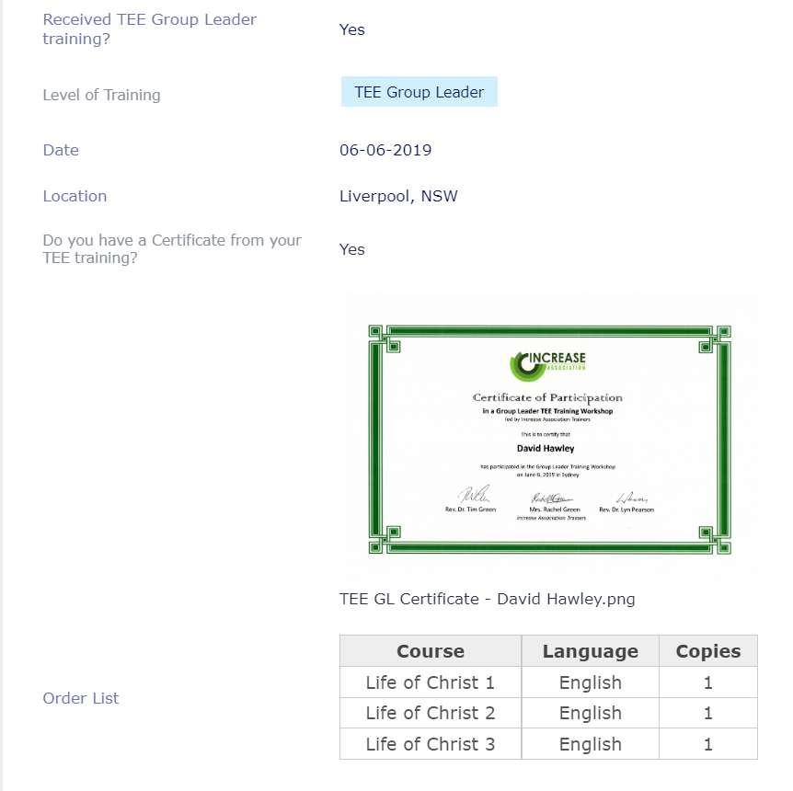
Restrict to qualified customers
Customer orders resources
Manager approves or rejects order request
Manager creates the shopping cart and sends link to customer
Customer completes order
Region | Manager
Africa | Daniel Muwanguzi
Americas | Terry Barratt
Asia | David Ball
Europe | Markus Voelker
Oceania | Ben Stansfield
Region | Manager
Africa | Daniel Muwanguzi
Americas | Terry Barratt
Asia | David Ball
- Malaysia | ? Raymond Lee
Europe | Markus Voelker
- United Kingdom | ? Jacqui Brown
Oceania | Ben Stansfield
- Australia | ? David Hawley
- New Zealand | ? Lewis Varley
TEE courses and quantities requested
Name
Email
Country
TEE Group Leader training date and location
Certificate OR Name of trainer
TEE Experience

Slide 15
Efficient ordering process

Slide 16
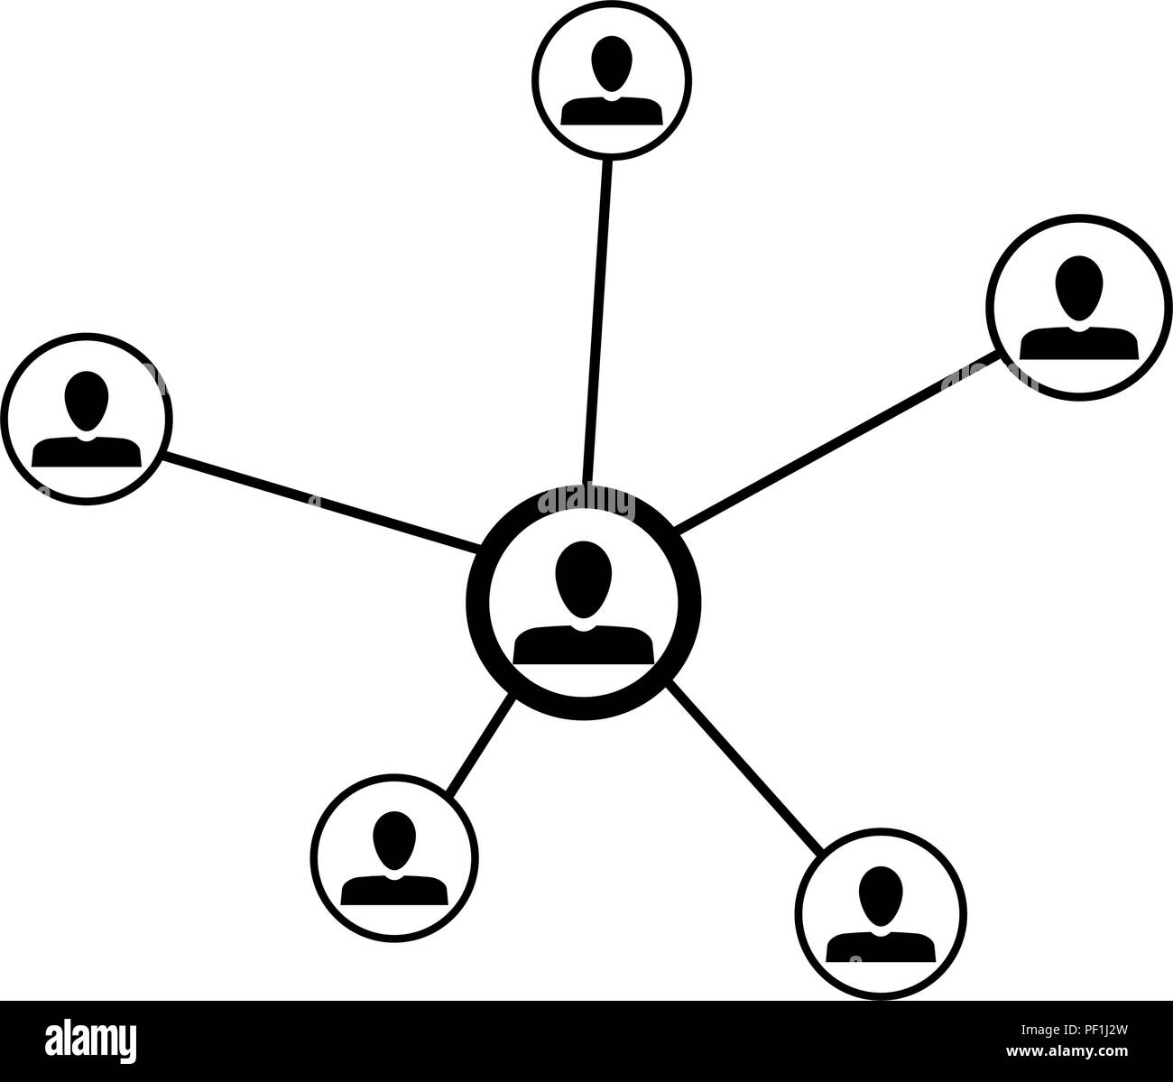
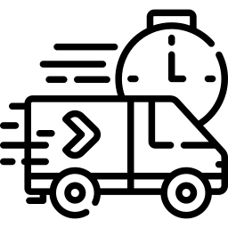
Efficient ordering process
Avoid multiple agreements with churches/organisations in multiple countries.
Avoid needing to liaise with multiple people in different countries for each order.
Payment in local currency (no international bank transfer fees).
Printing and shipping handled automatically, from closest physical location
Course books typically arrive within 7-10 business days.

Slide 17
Keep contact with customers

Slide 18
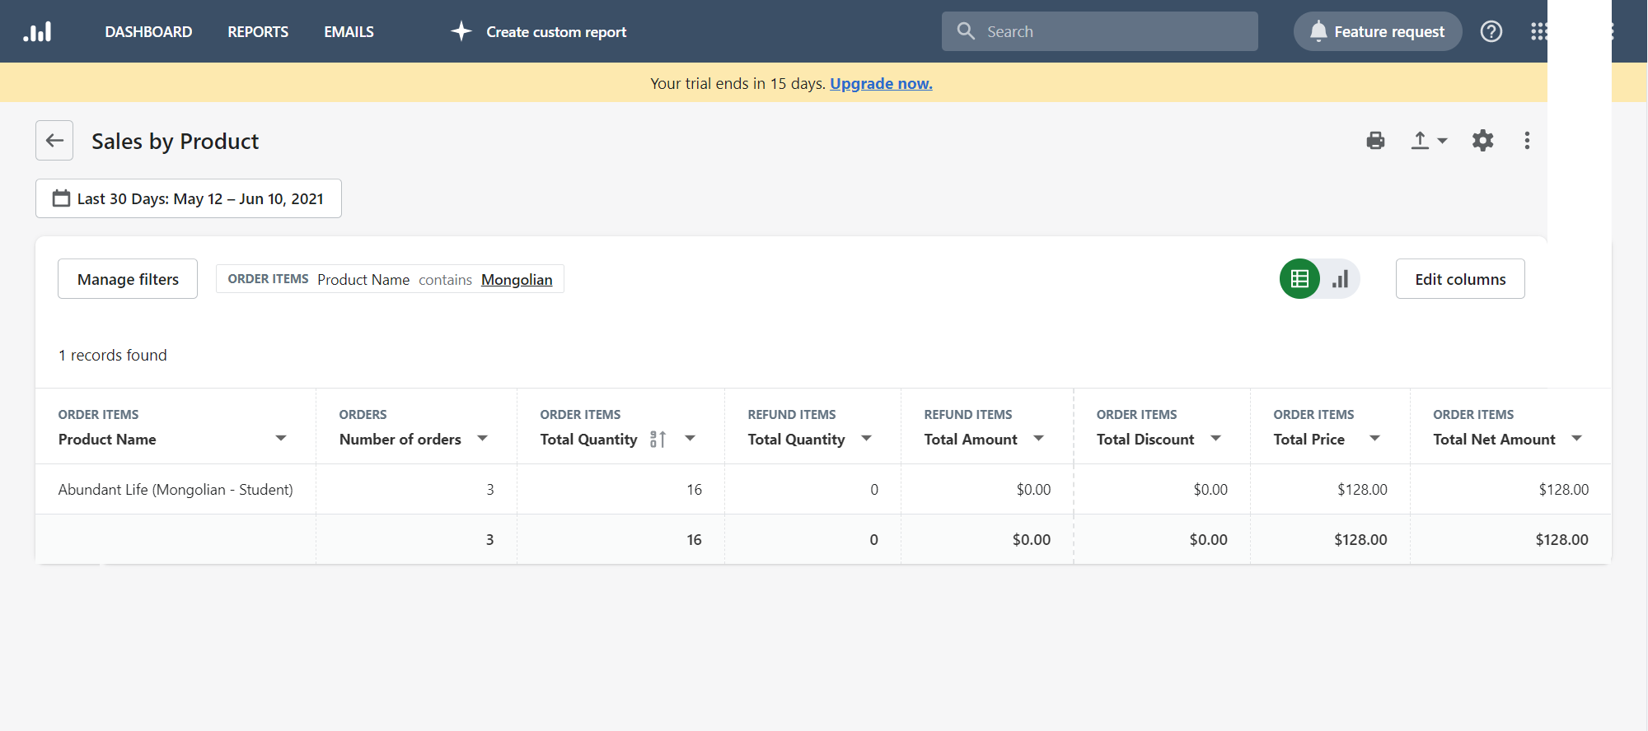
Keep contact with customers

Slide 19
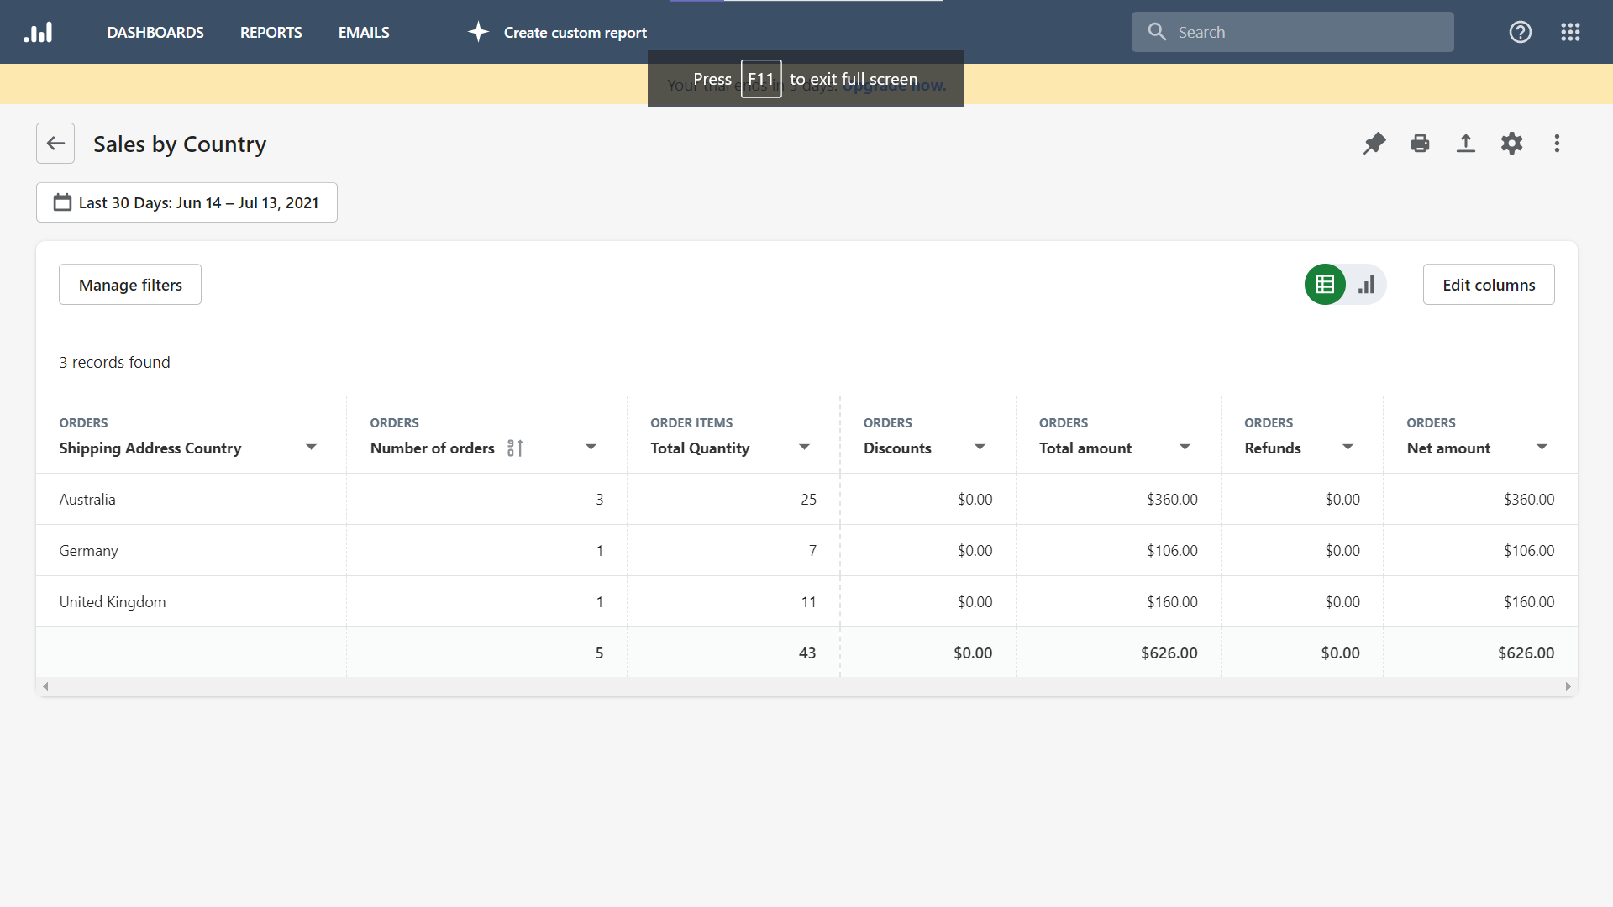
Keep contact with customers

Slide 20
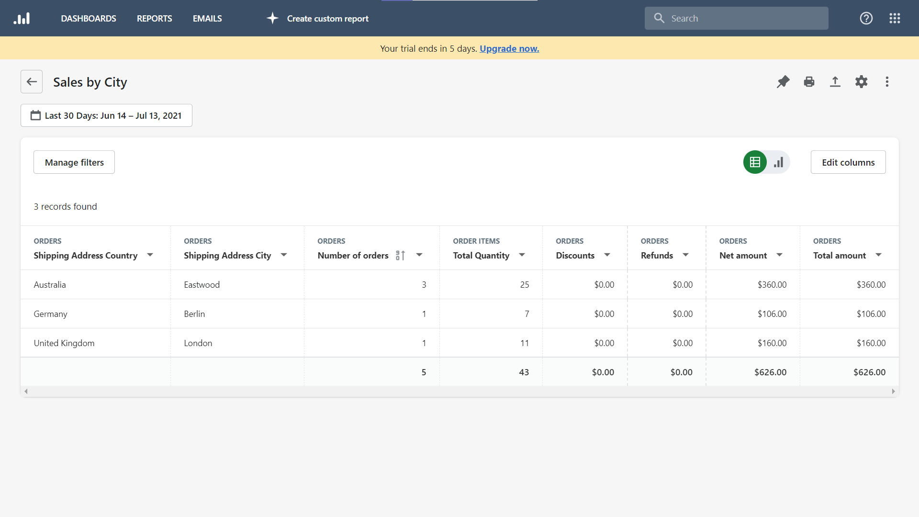
Keep contact with customers
Plus over 50 more report types

Slide 21
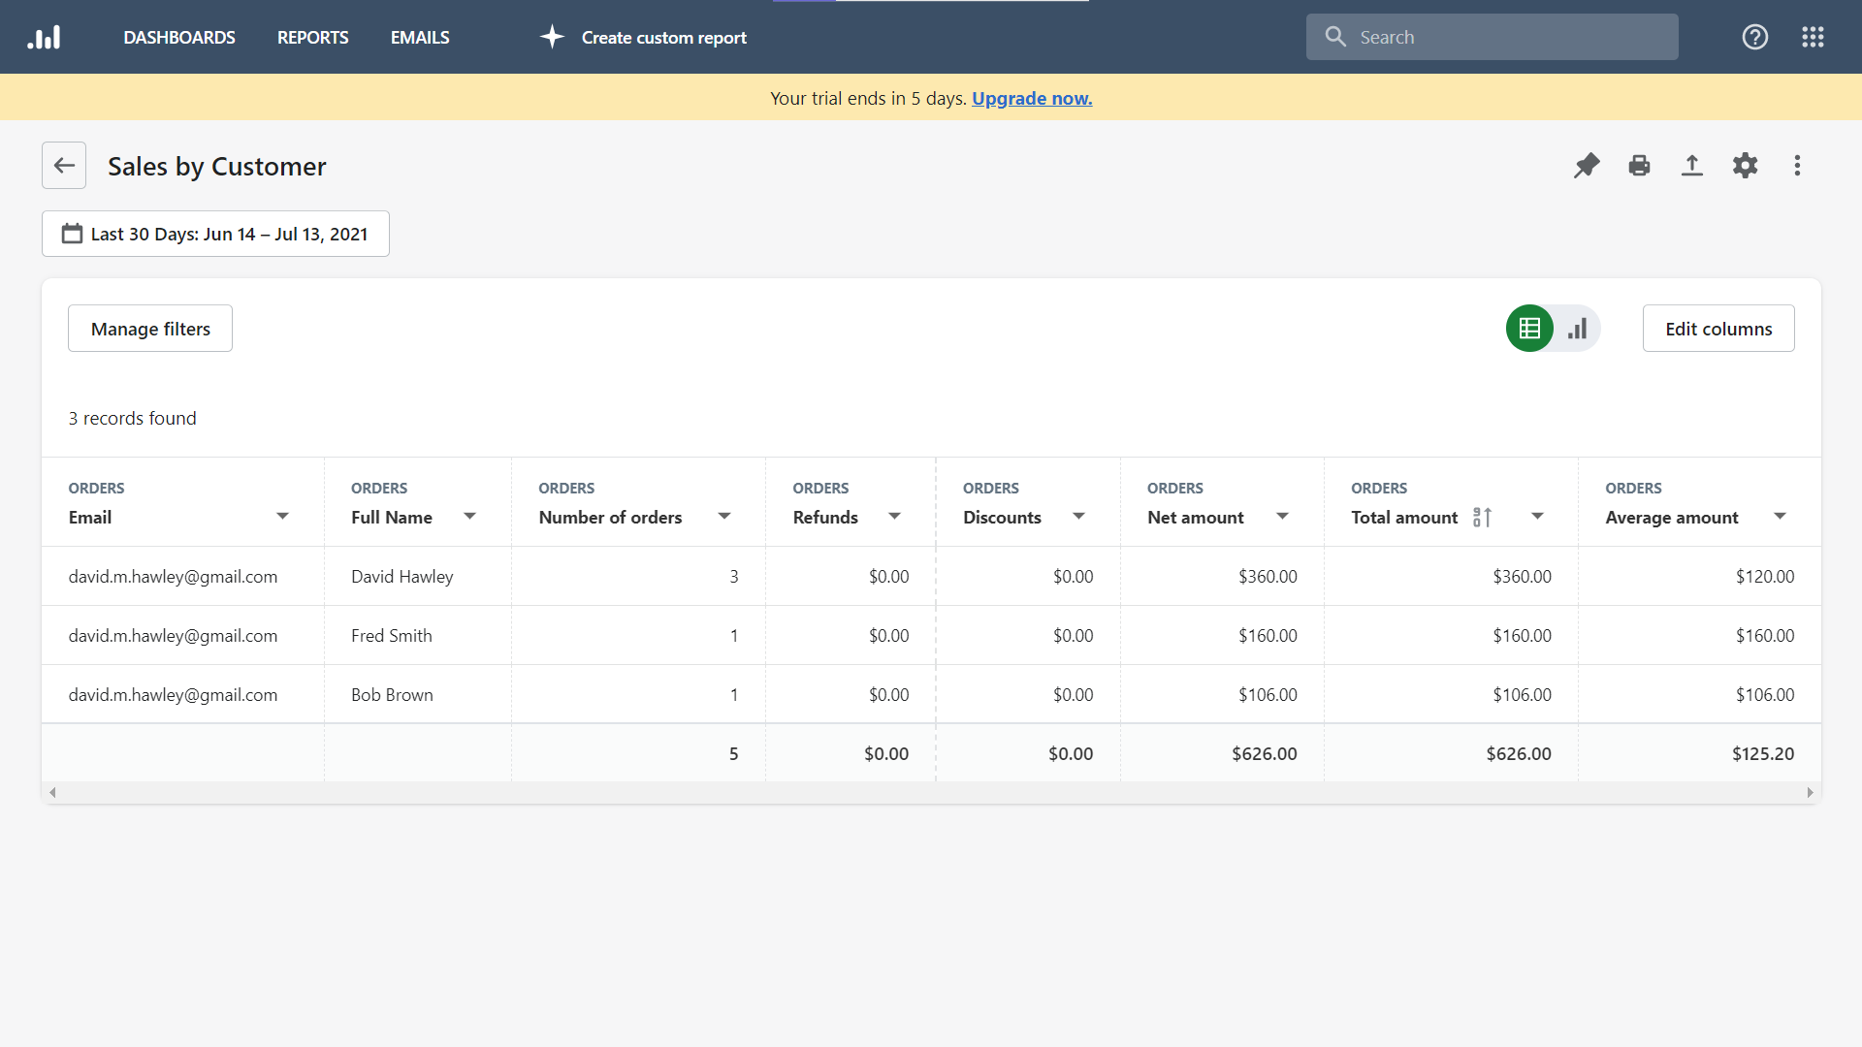
Keep contact with customers

Slide 22
Receive payments / royalties

Slide 23
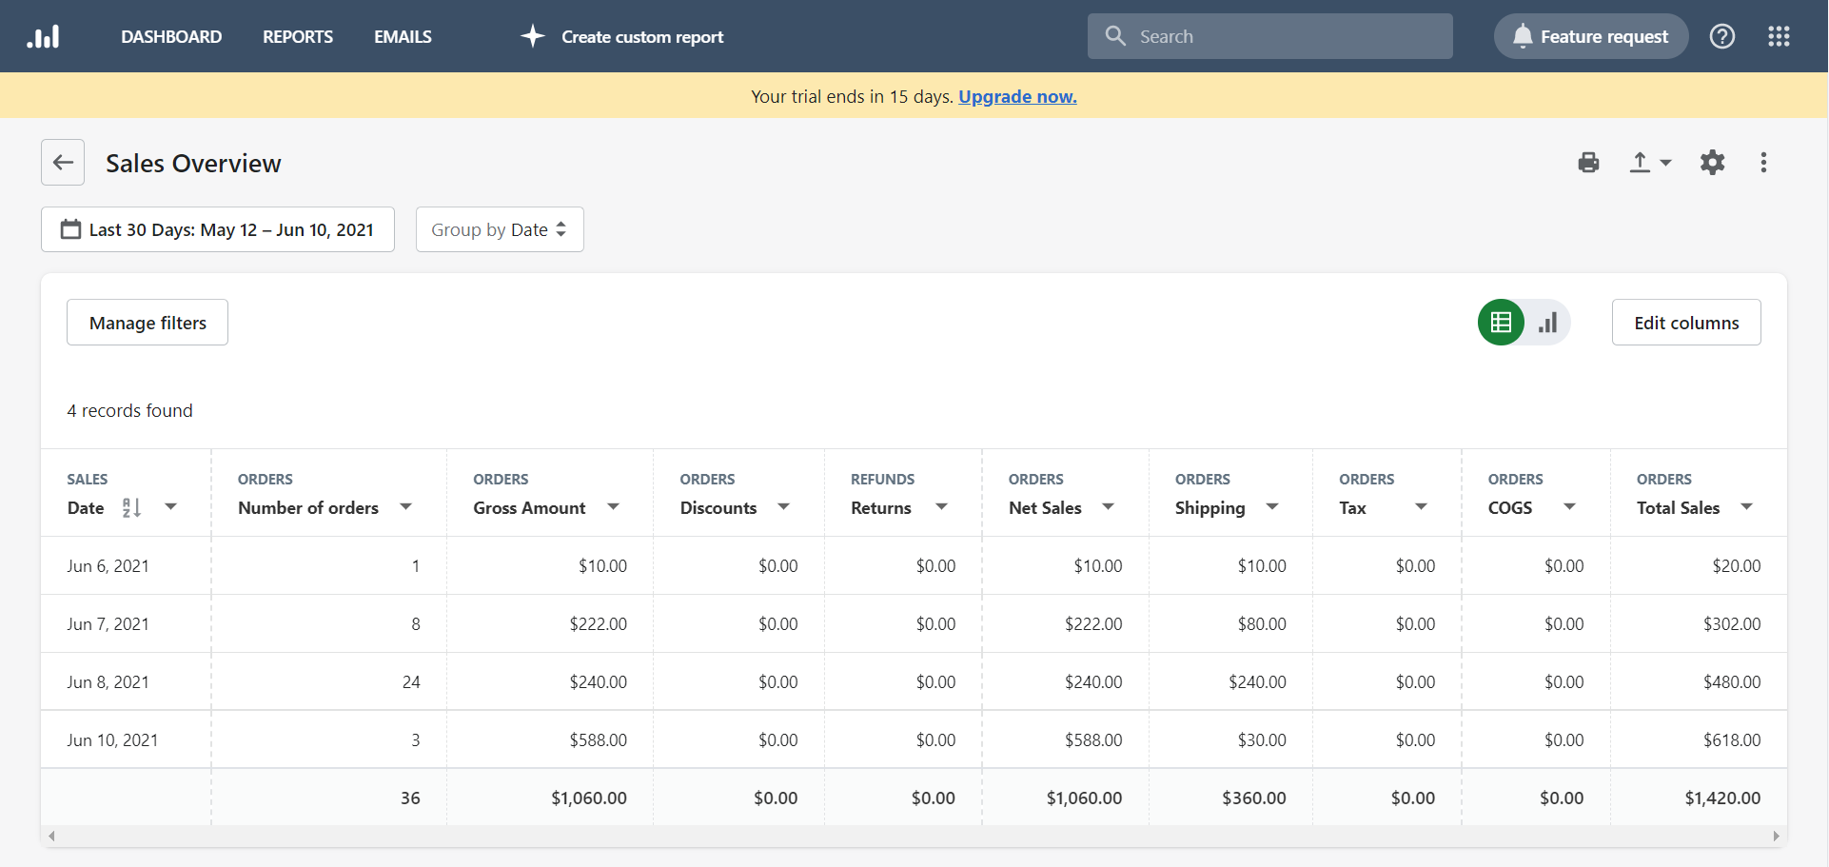
Receive payments / royalties
Sales by Organisation
ITEEN
KTEE
MTEE
SEAN

Slide 24
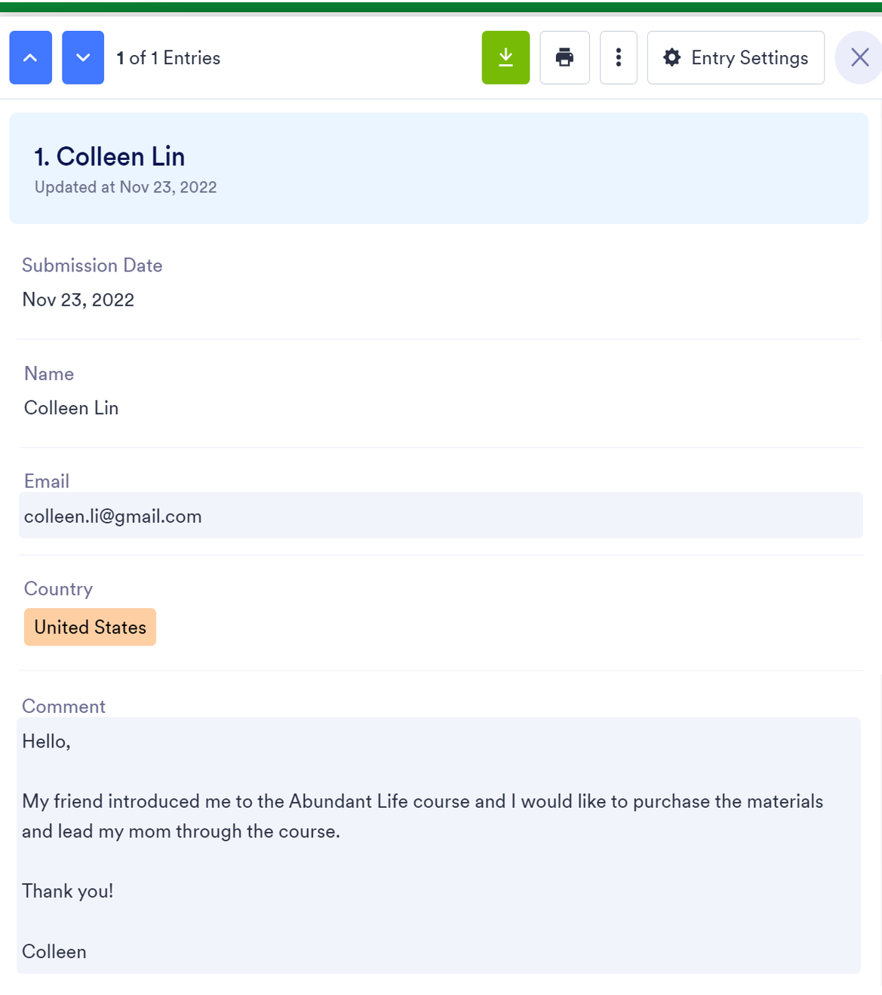
Next Steps
Paul’s Vision of the Man of Macedonia – Acts 16
⁹ During the night Paul had a vision of a man of Macedonia standing and begging him, “Come over to Macedonia and help us.”
¹⁰ After Paul had seen the vision, we got ready at once to leave for Macedonia, concluding that God had called us to preach the gospel to them.
Hello,
My friend introduced me to the Abundant Life course and I would like to purchase the materials and lead my mom through the course.
Thank you!
Colleen
Help resource young TEE organisations and equip them to disciple the worldwide diaspora.
With SEAN
Supplement Partner Agreement
Supply courses
Assign a country manager for TEE Store
Notes:
Paul and his companions are in modern day Turkey.
⁶ Paul and his companions traveled throughout the region of Phrygia and Galatia, having been kept by the Holy Spirit from preaching the word in the province of Asia. ⁷ When they came to the border of Mysia, they tried to enter Bithynia, but the Spirit of Jesus would not allow them to. ⁸ So they passed by Mysia and went down to Troas.

Slide 25
Questions
Find out more at the Special Interest Group on Wednesday at 7:30pm
www.shop.seaninternational.org
Notes:
Technical qns – ask me later

