Slide 1
Discipling the Nations in Diaspora
Plenary Session
Diaspora Working Group Members
David Ball, Rachel Green, David Hawley, Allan Mao, Lyn Pearson, Rina Robinson

Slide 2
Welcome
The TEE Method

Slide 3
Practical Application
Group Learning
Personal Study
Transformation
Intentionally Church-based

Slide 4
Goals
to renew the 2017 diaspora commitment
to understand how TEE reaches different diaspora groups
to make concrete steps to implement diaspora TEE
to commit sharing their courses using the online portal

Slide 5
A Pop Quiz
A Global Overview of Migration

Slide 6
How many international migrants in the world in 2020?
A
126 millions
B
353 millions
C
281 millions
D
83 millions

Slide 7
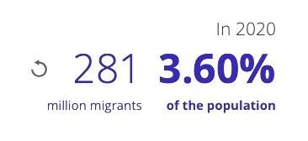
How many international migrants in the world in 2020?
C
281 million

Slide 8
Which region hosts most of the international migrants in 2020?
A
Northern America
B
Europe
C
Asia
D
Oceania

Slide 9
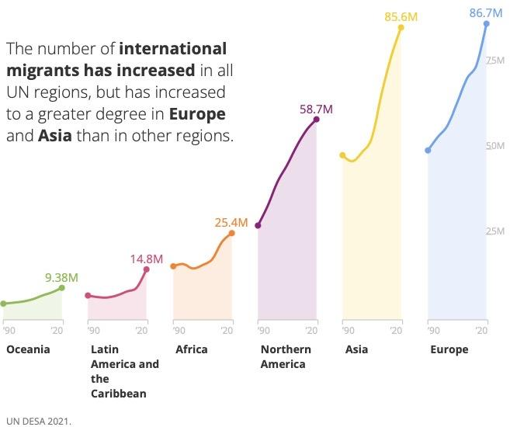
Which region hosts most of the international migrants in 2020?
B
Europe

Slide 10
Which of the following three languages used among diaspora in Malaysia?
A: Nepali, Mongolian, Burmese | B: Nepali, Norwegian, Bangla
C: Nepali, Burmese, Bangla | D: Bangla, Mongolian, Burmese
A
B
C
D

Slide 11
Which of the following three languages used among diaspora in Malaysia?
A: Nepali, Mongolian, Burmese | B: Nepali, Norwegian, Bangla
C: Nepali, Burmese, Bangla | D: Bangla, Mongolian, Burmese
C

Slide 12
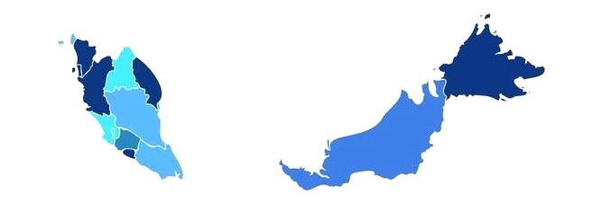
Which is the largest diaspora community in Malaysia? Select the correct answer:
A
Nepali
B
Indonesian
C
Filipino
D
Bangladeshi

Slide 13
Which is the largest diaspora community in Malaysia? Select the correct answer:
B
Indonesian

Slide 14
How many languages are spoken in Australian according to the 2021 census?
A
25
B
78
C
253
D
429

Slide 15
How many languages are spoken in Australian according to the 2021 census?
English, Mandarin, Arabic, Vietnamese, Cantonese, Punjabi, Greek, Italian, Hindi, Spanish, Nepali, Tagalog, Korean, Urdu, Tamil, Filipino, Sinhalese, Gujarati, Malayalam, Indonesian, Persian, French, German, Bengali, Portuguese, Thai, Macedonian, Turkish, Telugu, Japanese, Serbian, Russian, Croatian, Afrikaans, Samoan, Polish, Hazaraghi, Khmer, Assyrian, Dari, Dutch, Maltese, Marathi, Chaldean, Malay, Tongan, Burmese, Swahili…
D
429

Slide 16
At which conference did Increase make a commitment in discipling diaspora believers ?
A
Chiang Mai
2017
B
Petalling Jaya
2015
C
Seoul 2011
D
Istanbul 2019

Slide 17
At which conference did Increase make a commitment in discipling diaspora believers ?
A
Chiang Mai
2017

Slide 18
Increase’s Diaspora Commitment
A Story from the Bible

Slide 19
Dr David Ball SEAN International, Coordinator for Asia
Blessing and Being Blessed Elijah’s experience as an exile in Zarephath
1 Kings 17:7-16
Notes:
- Play the video clip “001_Blessing and Being Blessed (with subtitles)”

Slide 20
Increase’s Commitment
The 2017 Diaspora Commitment

Slide 21
Discipling the Diaspora
Conference Statement
We recognise that people groups are migrating and settling across our region of Asia and around the world more than ever before.
We see that God is building and renewing his church in a fresh and exciting ways through these diaspora and multi-ethnic communities.

Slide 22
Discipling the Diaspora
Conference Statement
We share a common vision for church-based training resources to be made available across Asia and beyond to equip all Christian believers to grow in Christ and serve him actively in their local churches and communities.

Slide 23
Discipling the Diaspora
Conference Statement
We commit to work together over the next five (2023-2028) years to:
Extend and deepen existing work among diaspora communities including identifying unreached diaspora groups, reaching 2nd generation migrants and expanding into new countries.

Slide 24
Discipling the Diaspora
Conference Statement
We commit to work together over the next five (2023-2028) years to:
Share courses more effectively including using digital delivery (both e-learning and m-learning), making courses available via the online portal and other cost-effective methods.

Slide 25
Discipling the Diaspora
Conference Statement
We commit to work together over the next five (2023-2028) years to:
Identify new partnerships and build and strengthen existing partnerships with churches and organisations around the world.

Slide 26
Discipling the Diaspora
Conference Statement
We commit to work together over the next five (2023-2028) years to:
Identify, equip, train and nurture more facilitators and leaders to serve diaspora communities.

Slide 27
Discipling the Diaspora
Conference Statement
We commit to work together over the next five (2023-2028) years to:
Work with others to share fruitful practice and recognise learning and training received in other contexts.

Slide 28
Discipling the Diaspora
Conference Statement
We commit to work together over the next five (2023-2028) years to:
Actively support and encourage those with a vision to empower churches in discipling diaspora believers in Asia and beyond.

Slide 29
Discipling the Diaspora
Conference Statement
We commit to work together over the next five (2023-2028) years to:
Make discipleship and leadership resources available to those who wish to use them for group learning in local churches.

Slide 30
Discipling the Diaspora
Conference Statement
We commit to work together over the next five (2023-2028) years to:
Partner with like-minded churches, organisations and networks in Asia and beyond to enable discipleship, ministry and mission training to take place among and through diaspora believers.

Slide 31
Increase’s Commitment
A Story from the Bible
The 2017 Diaspora Commitment
What has been achieved

Slide 32
Discussion Groups
How has diaspora TEE work moved forward for you in the last five years?

Slide 33
Testimonies
Pastor Jeremy @ Petaling Jaya Evangelical Free Church
Notes:
- Play the video clip “002_Pas Jeremiah's Testimony”

Slide 34
Interview
TEE Malaysia

Slide 35
Testimonies
Australia Christ Training Centre (AUSCTC)
https://youtu.be/mwzn0zoy6IE
Notes:
- click the link and play the video from Youtube.

Slide 36
Going Forward (2023-2027)
Sharing TEE courses around the world
Why online portal?
Notes:
- Play the video clip “004_Shopify Online Portal (with subtitles)”

Slide 37
Going Forward (2023-2027)
Sharing TEE courses around the world
Why online portal?
Online Portal Launch

Slide 38
TEE Online Store

Slide 39
TEE Online Store
✓
Protect course content
Restrict to qualified users
Efficient ordering process
Keep contact with customers
Receive & distribute payments/royalties
✓
✓
How does it actually work?
✓
✓
www.shop.seaninternational.org
Like … but with control over who can purchase

Slide 41
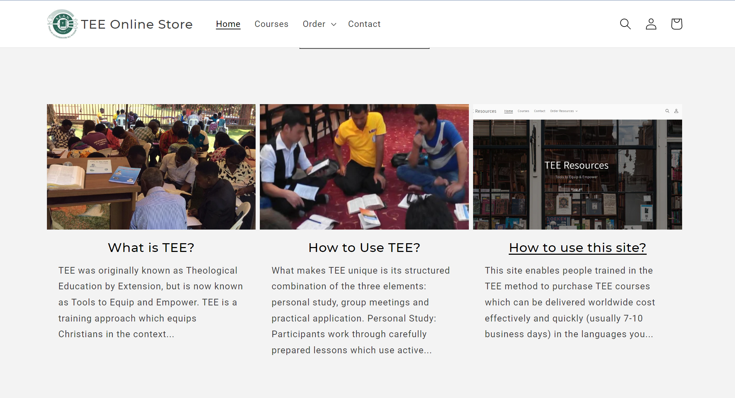

Slide 42
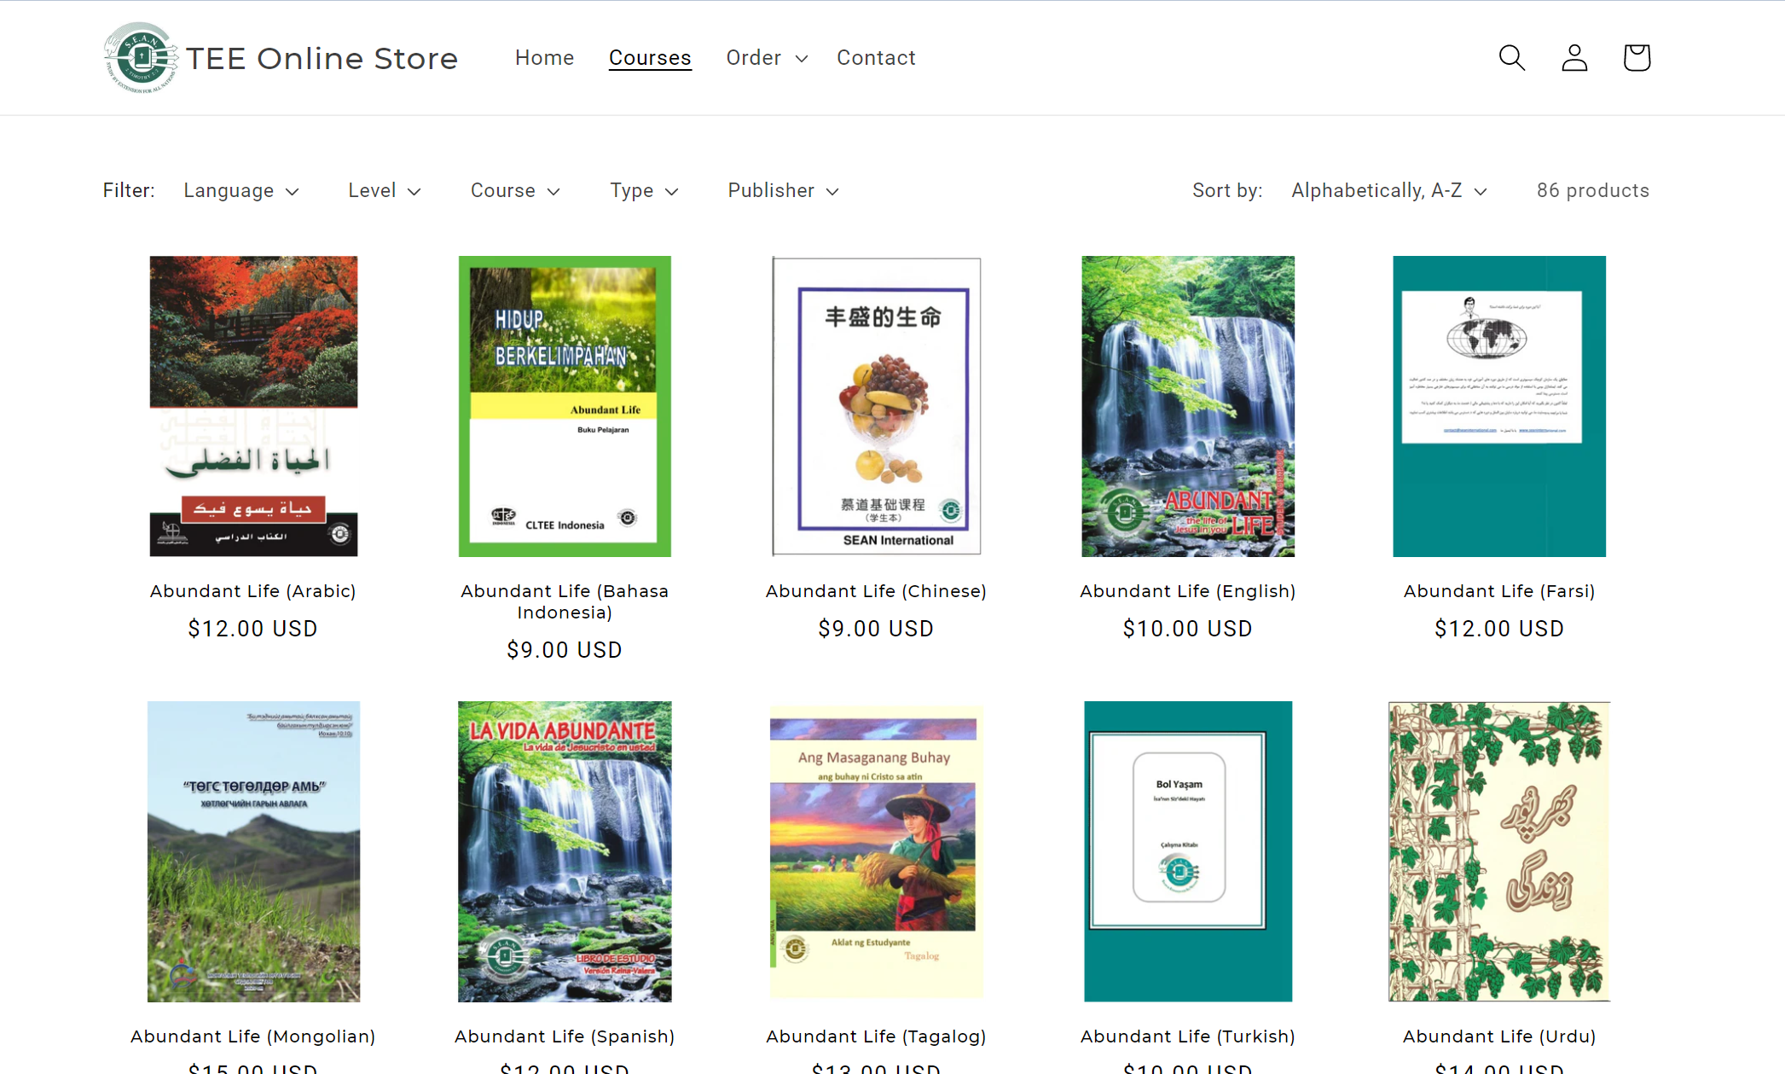
12 languages
86 courses
Abundant Life
The Big Picture
Ephesians
Life of Christ
Paul’s Life & Letters
Jeremiah
30 languages
300 courses

Slide 43
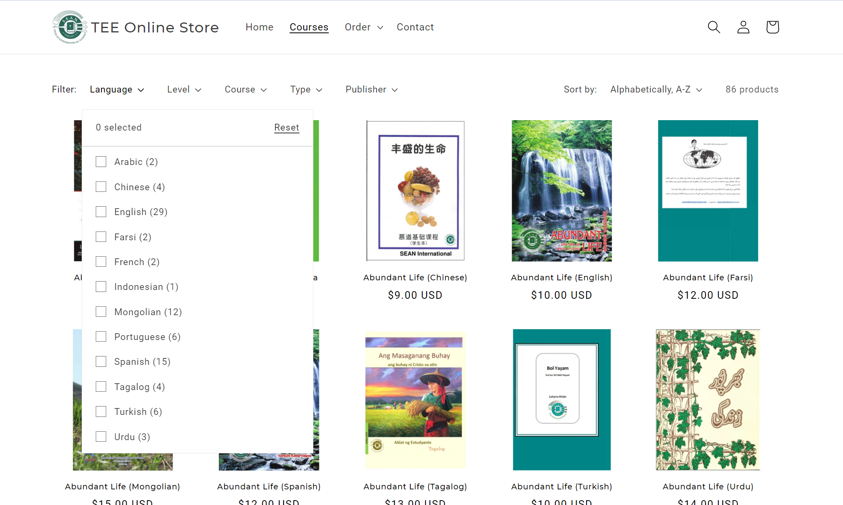

Slide 44
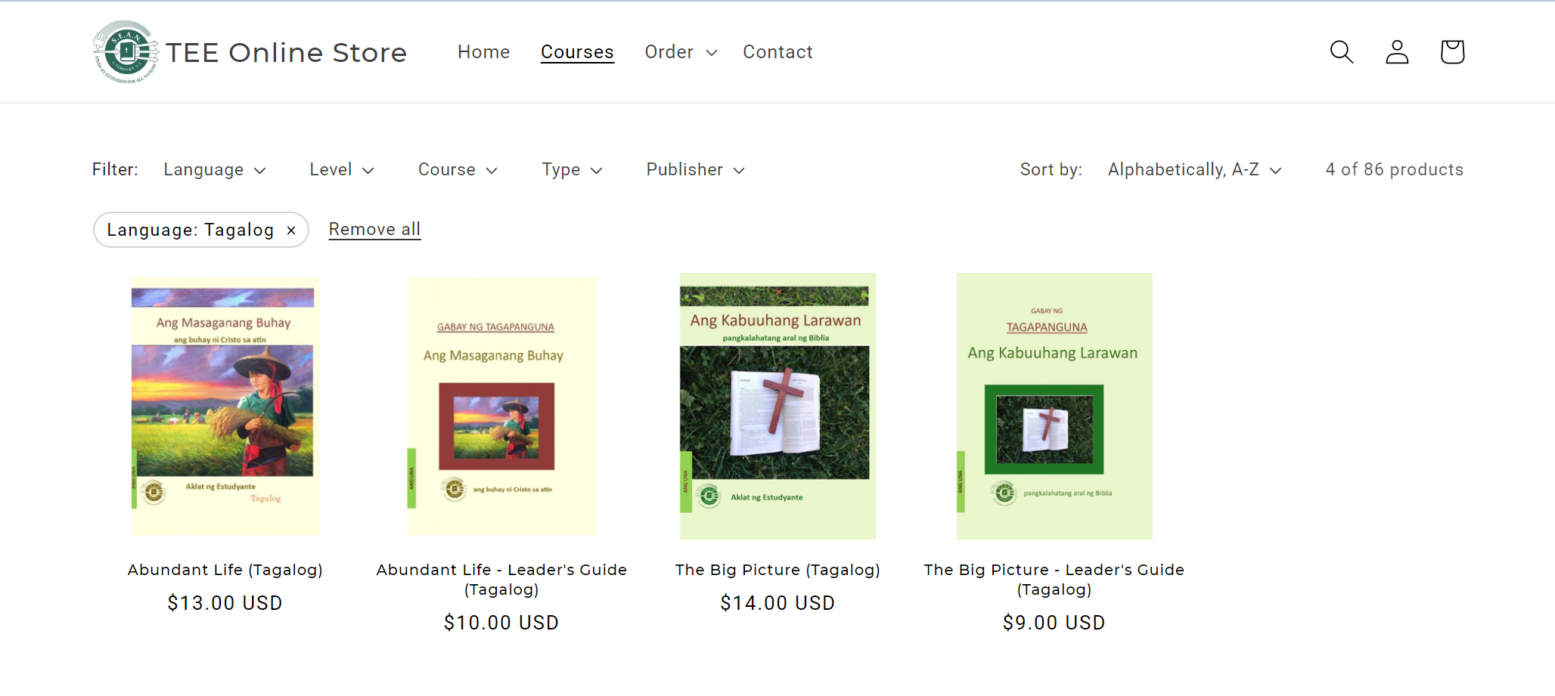

Slide 45
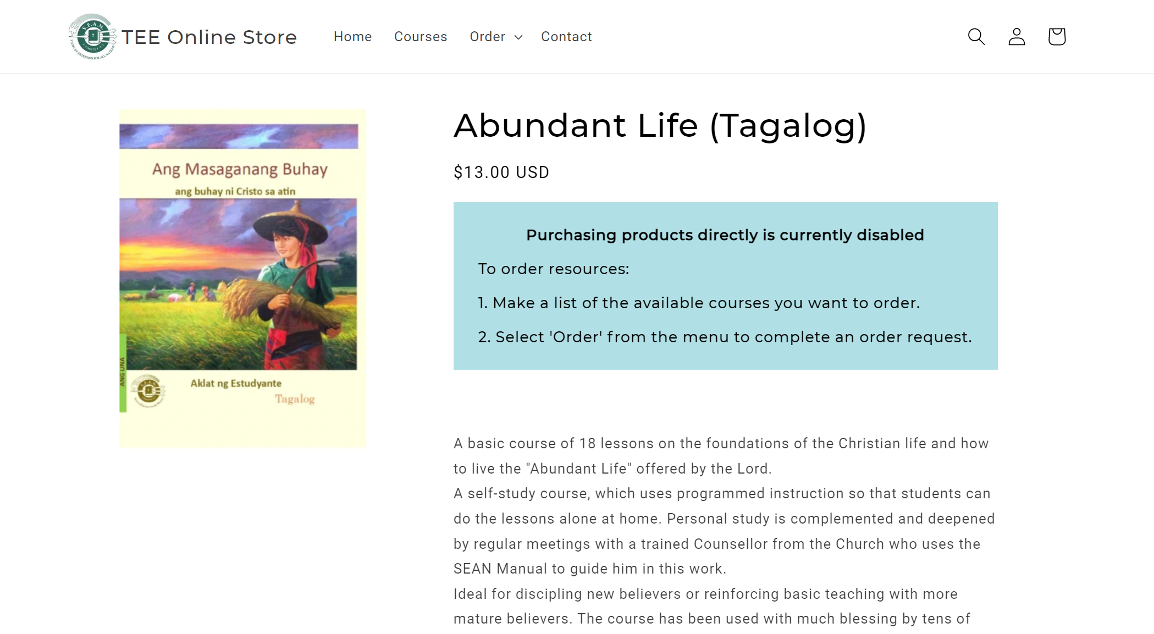

Slide 46
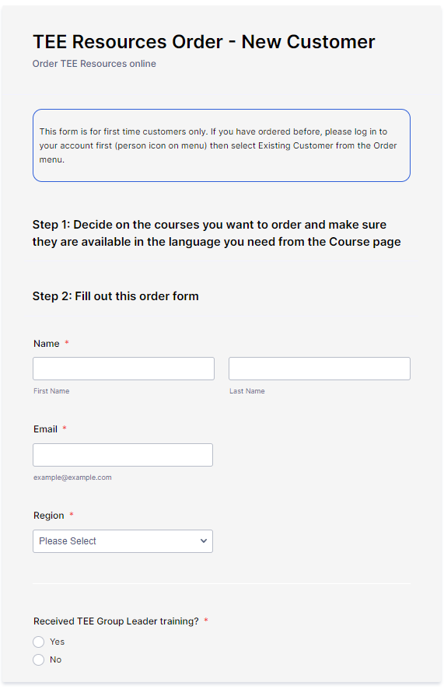
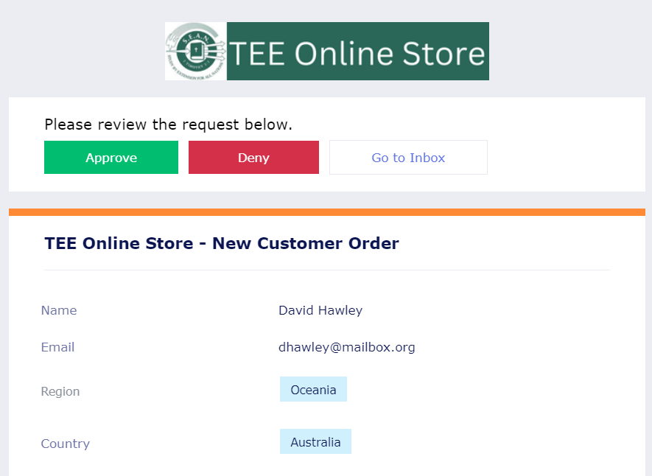
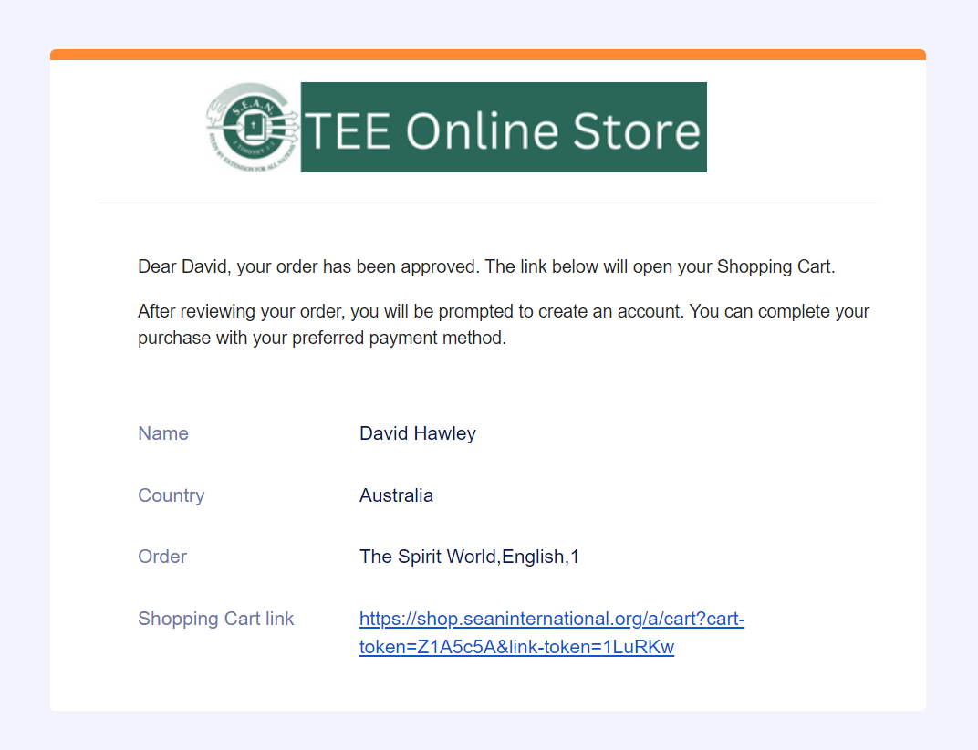
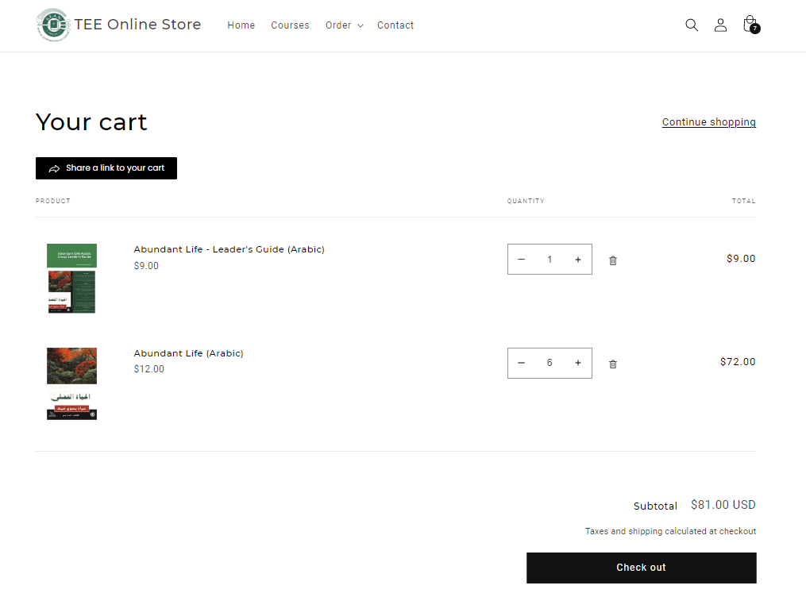
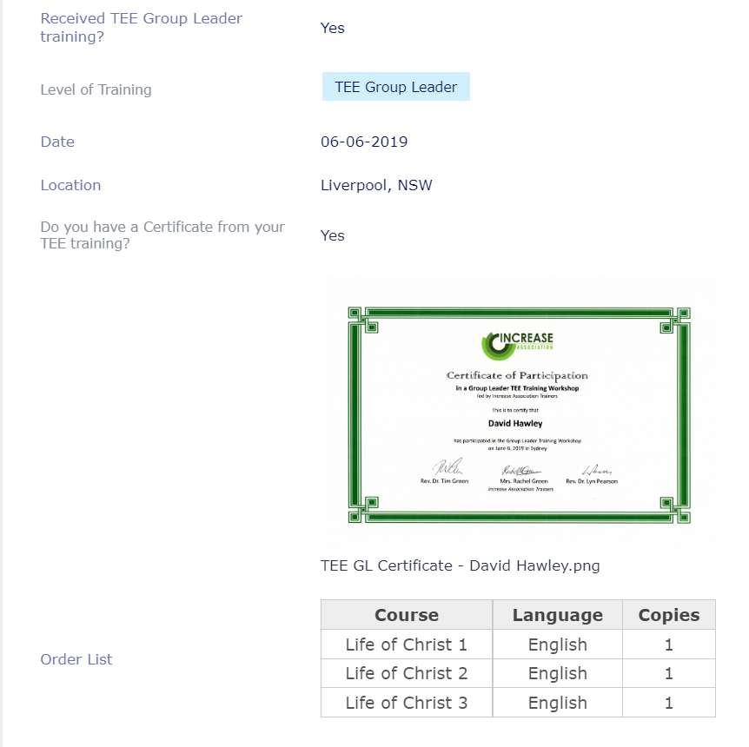
Manager approves or rejects order request
Manager creates the shopping cart and sends link to customer
Customer orders resources
Customer completes order
Name
Country
Date and location of TEE Group Leader training
Certificate OR Name of trainer
TEE Experience
TEE courses and quantities requested

Slide 47
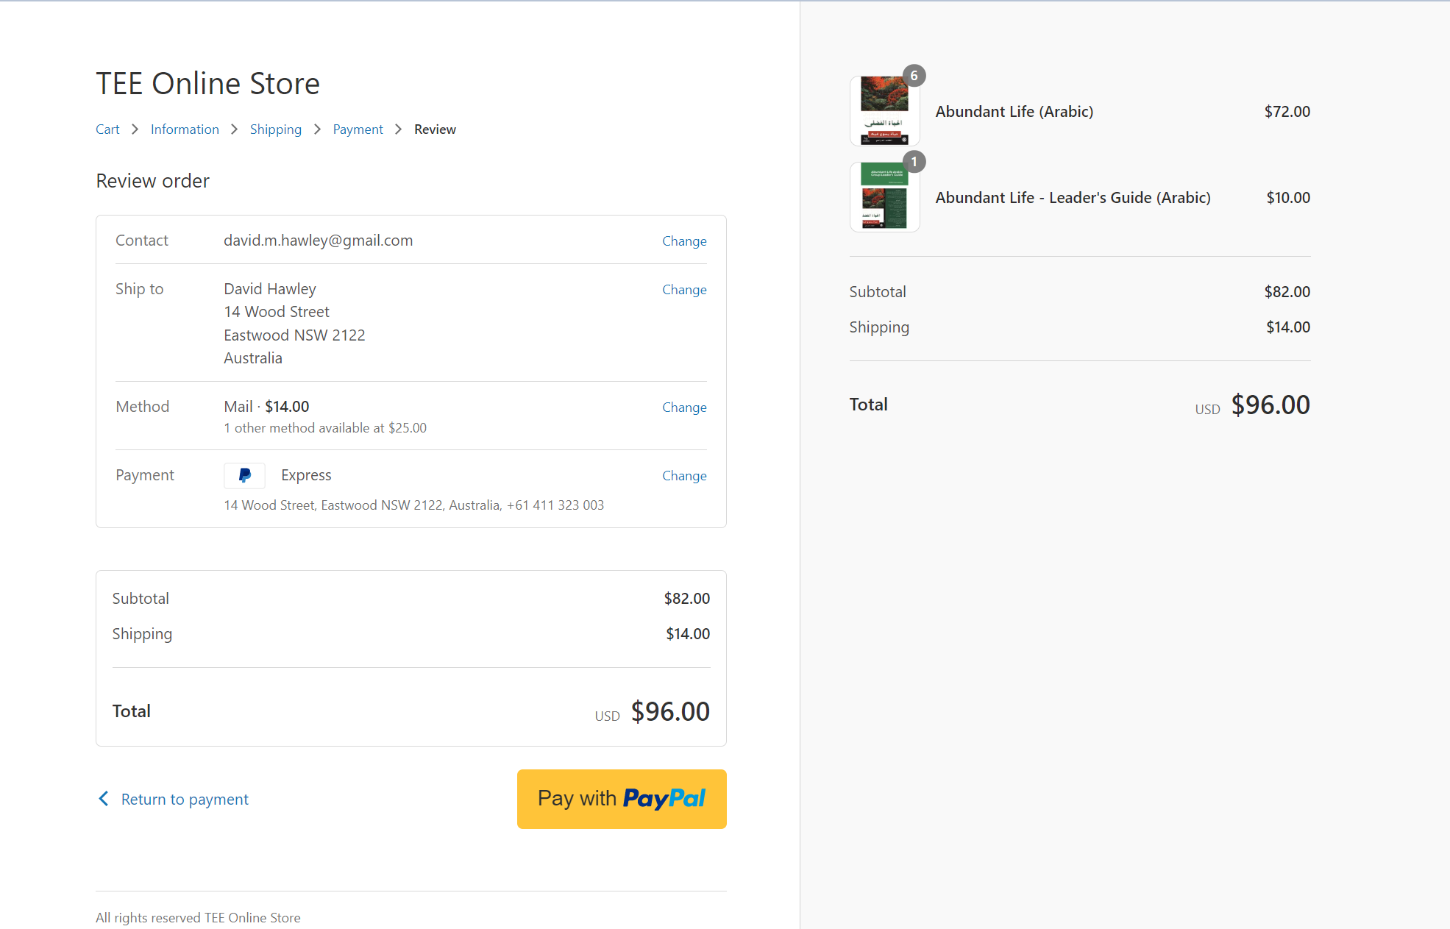

Slide 48
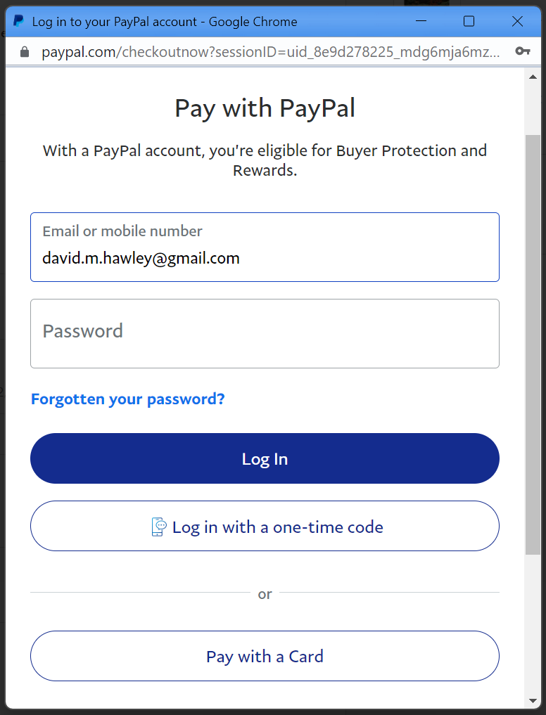
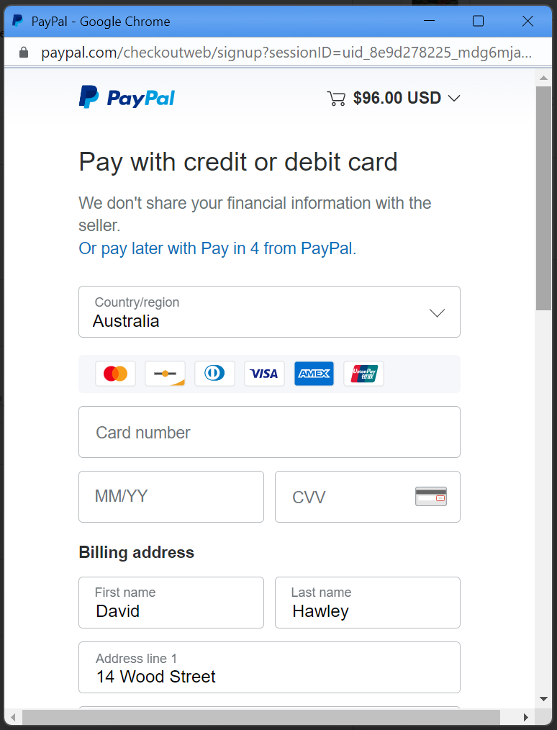

Slide 49
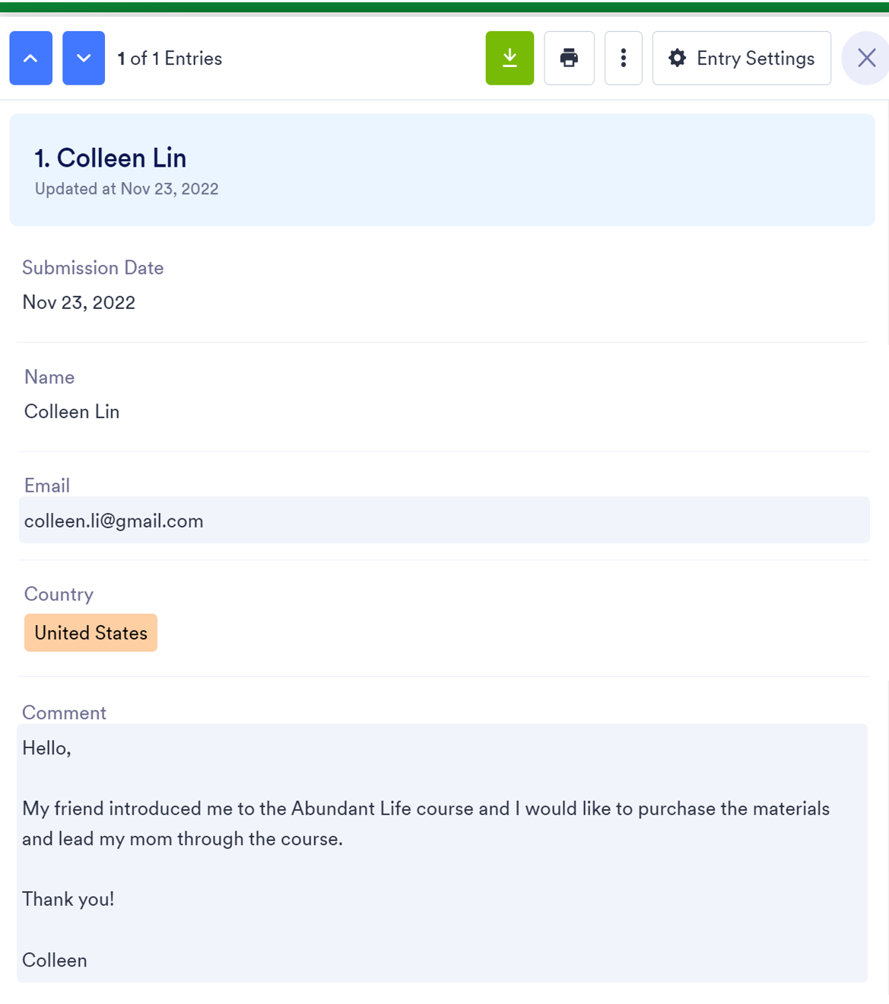
If you would like to know more, come to the Diaspora Special Interest Group tonight at 7:30pm
Hello,
My friend introduced me to the Abundant Life course and I would like to purchase the materials and lead my mom through the course.
Thank you!
Colleen

Slide 50
TEE Online Store –shop.seaninternational.org

Slide 51
Testimonies
TEE Training for Russian-speaking Koreans - Valentina Ten
Notes:
- play video clip “005_took”

Slide 52
Discussion Groups
Are there any specific things you would like to update in the Commitment for the next 5 years?

Slide 53
Feedback together
What might you want to do looking forward?
Personally
as a TEE program
Are there any specific things you can share with us all?

Slide 54
Questions?
Come to the Special Interest Group Tonight!!

Slide 55
New Commitment

Slide 56
Prayer

