Slide 1
TEE Online Store

Slide 2
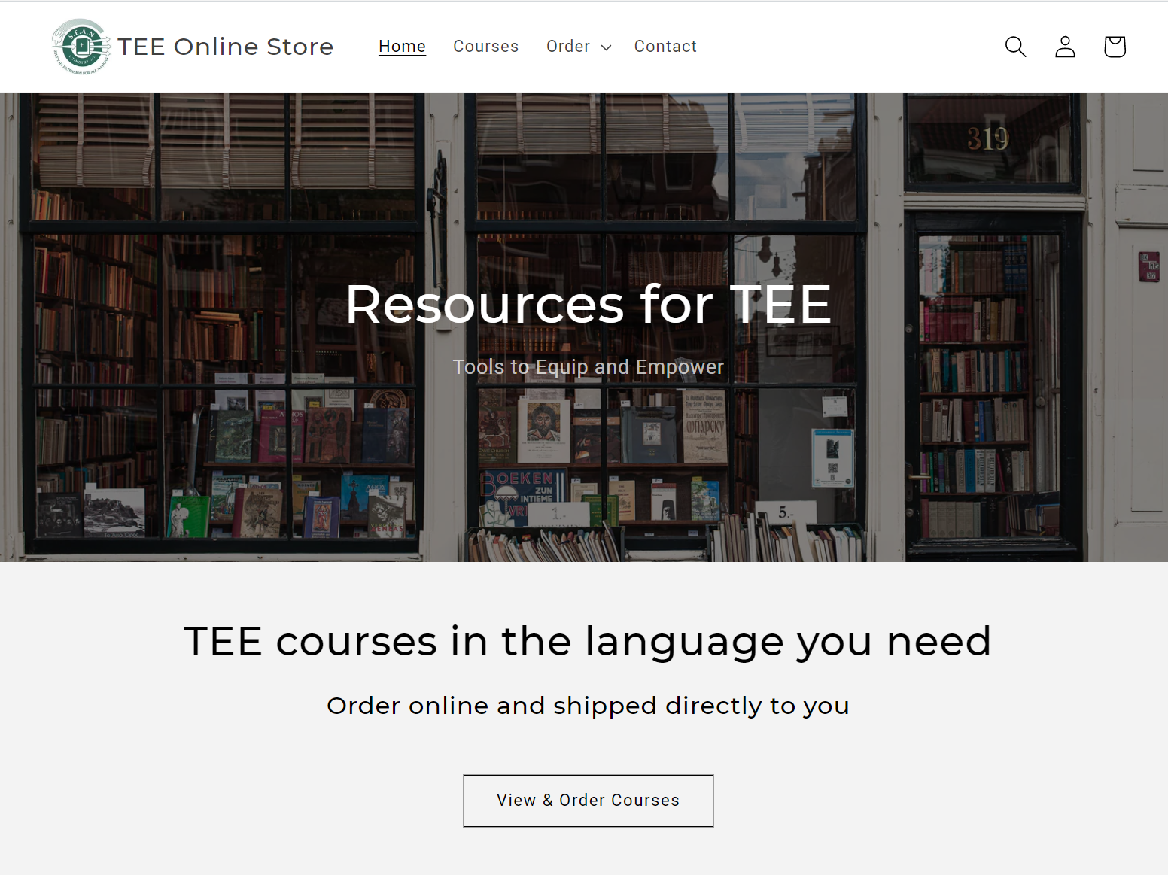
TEE Online Store
✓
Protect course content
Restrict to qualified users
Efficient ordering process
Keep contact with customers
Receive & distribute payments/royalties
✓
✓
How does it actually work?
✓
✓
www.shop.seaninternational.org
Like … but with control over who can purchase

Slide 3
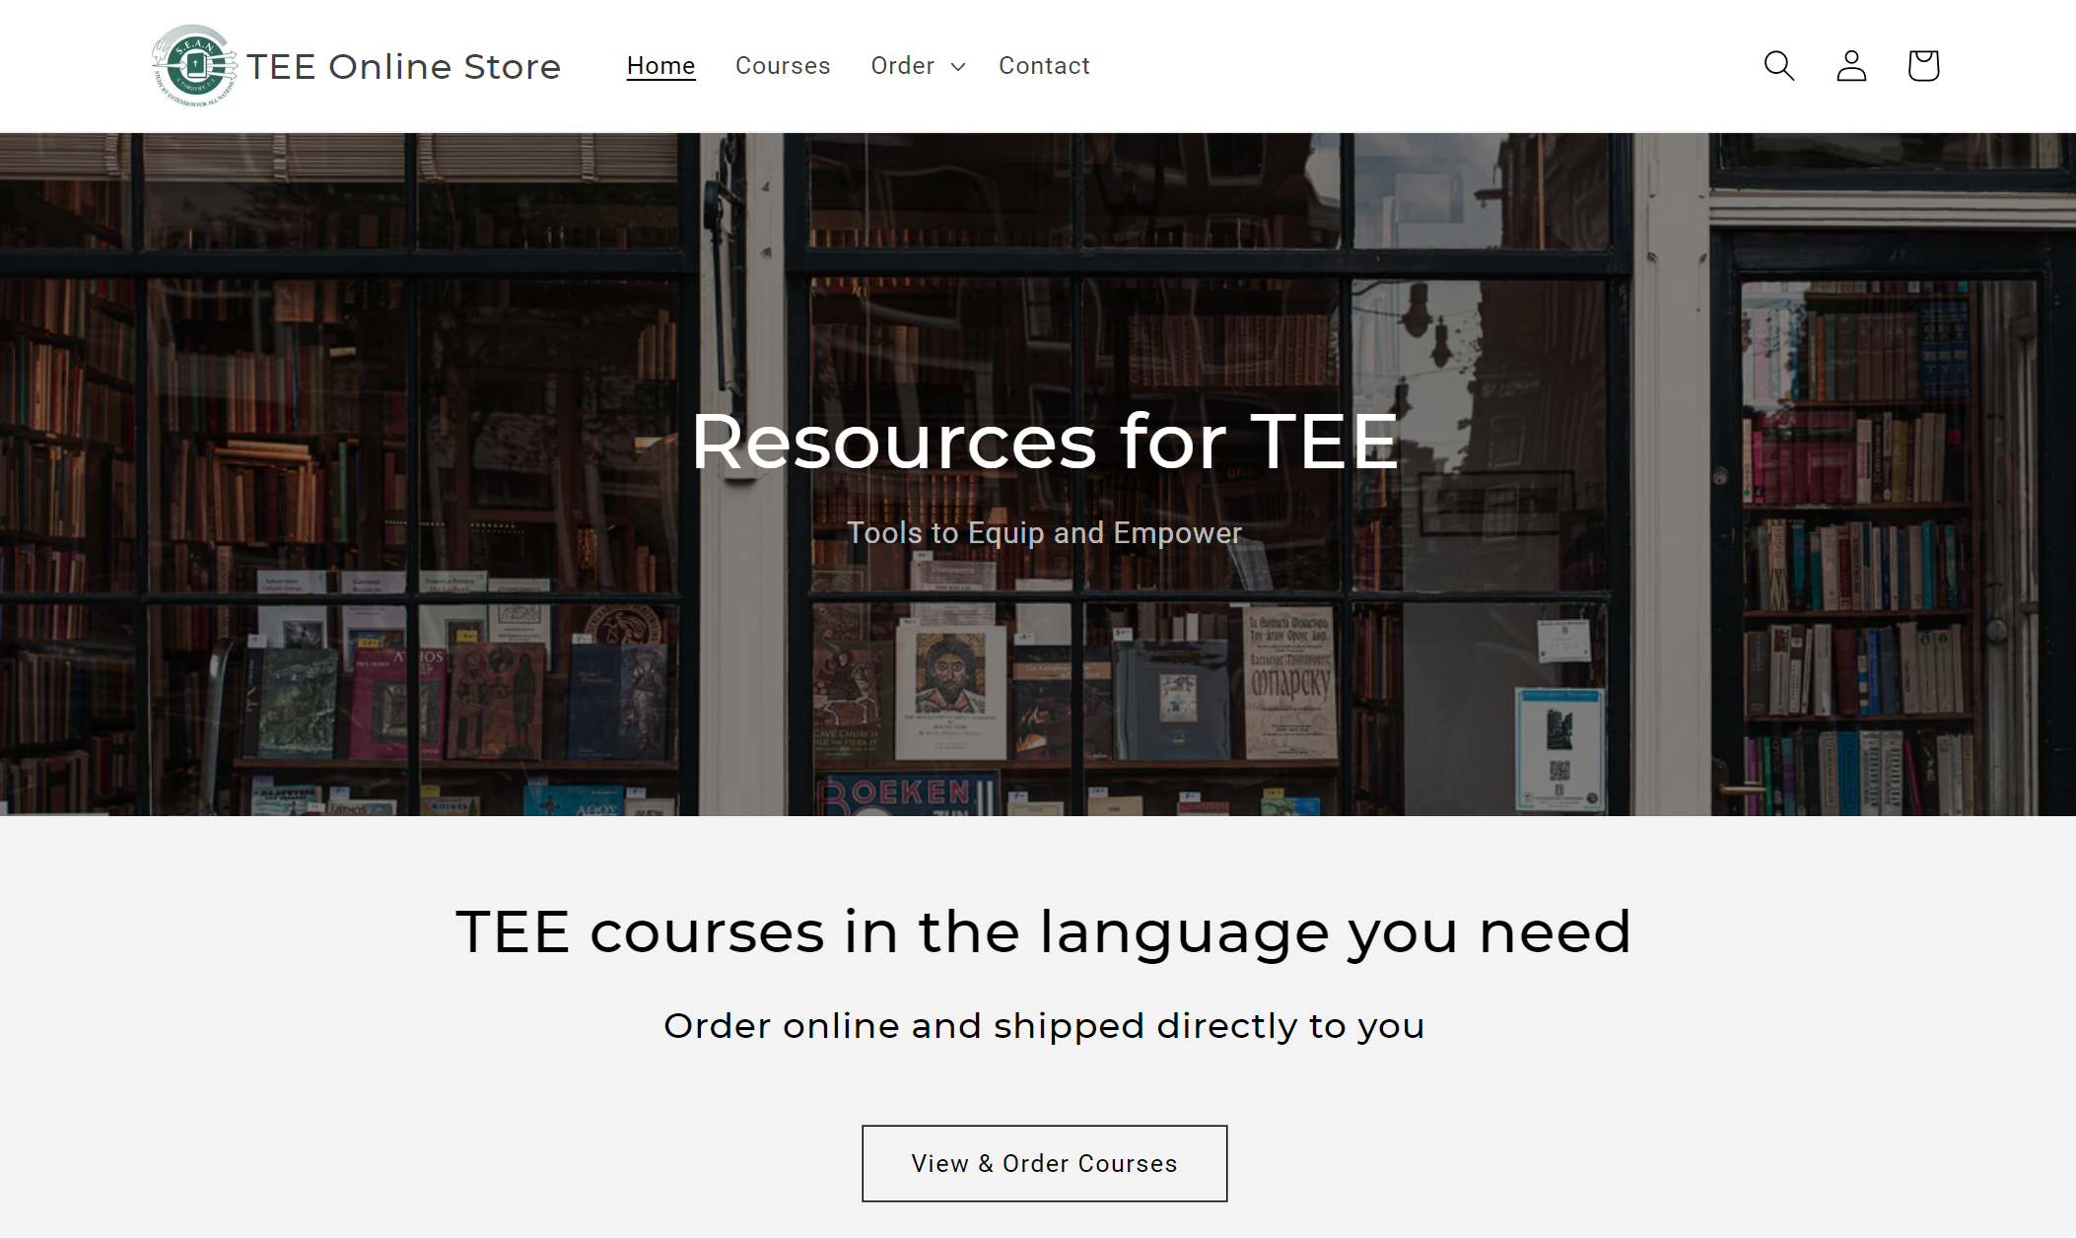

Slide 4
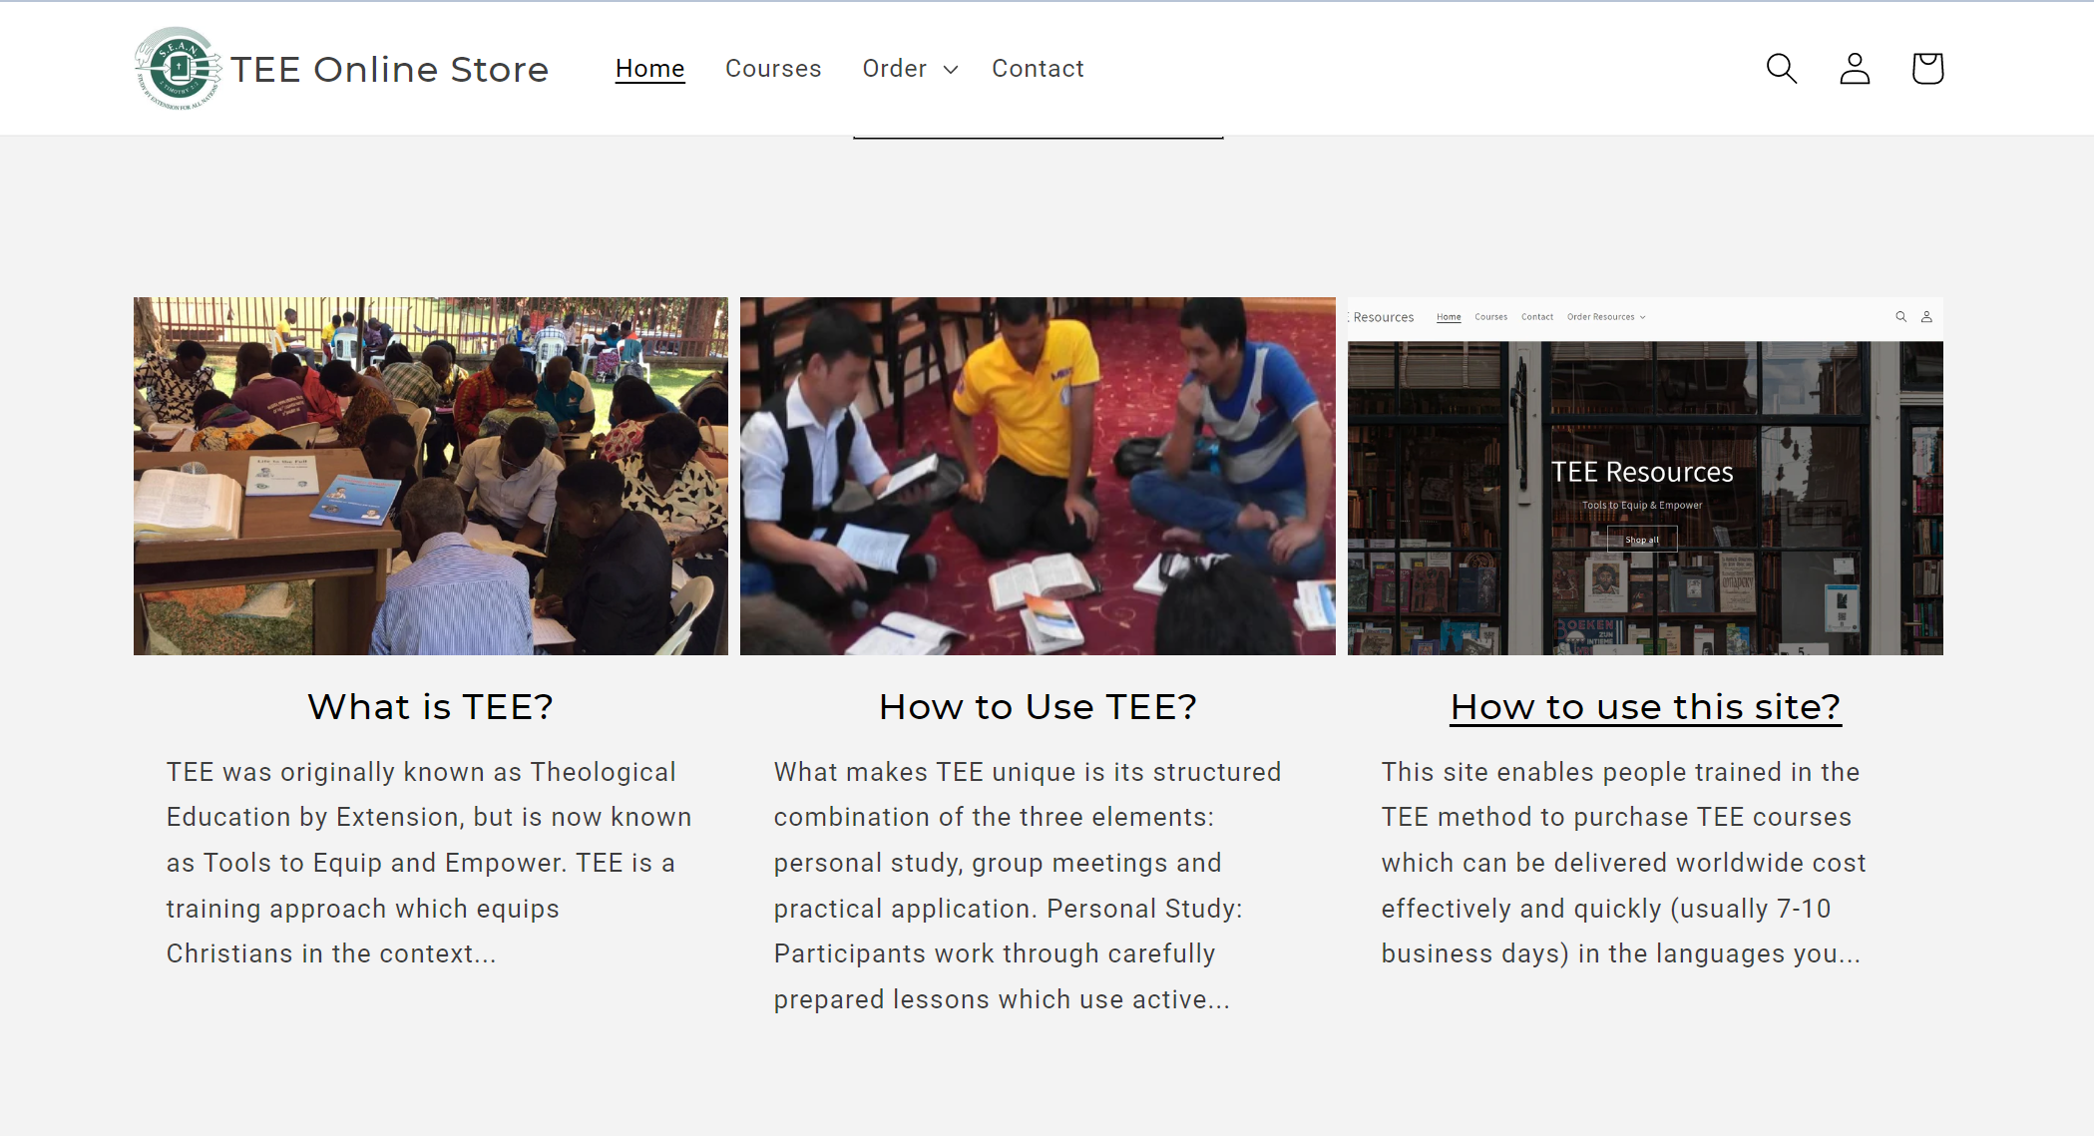

Slide 5
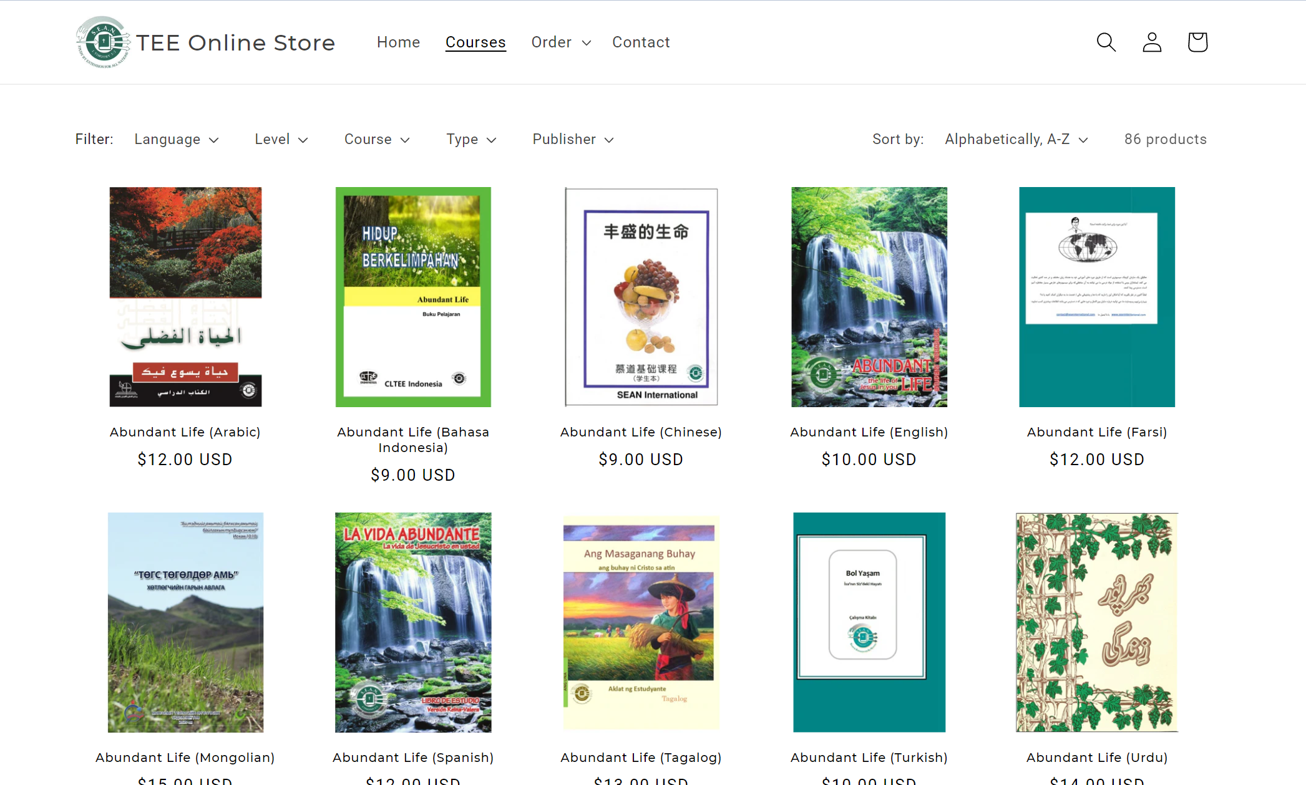
12 languages
86 courses
Abundant Life
The Big Picture
Ephesians
Life of Christ
Paul’s Life & Letters
Jeremiah
18 languages
30 languages
300 courses

Slide 6
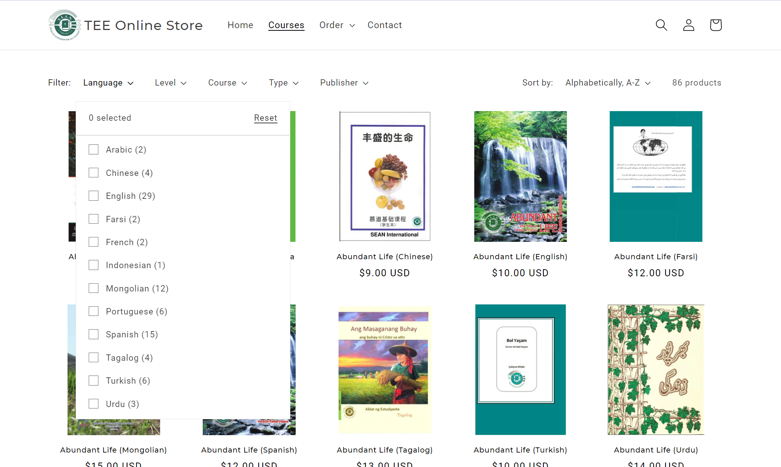

Slide 7
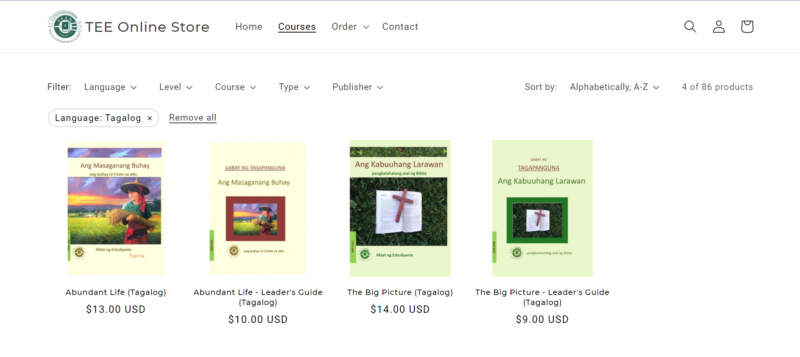

Slide 8
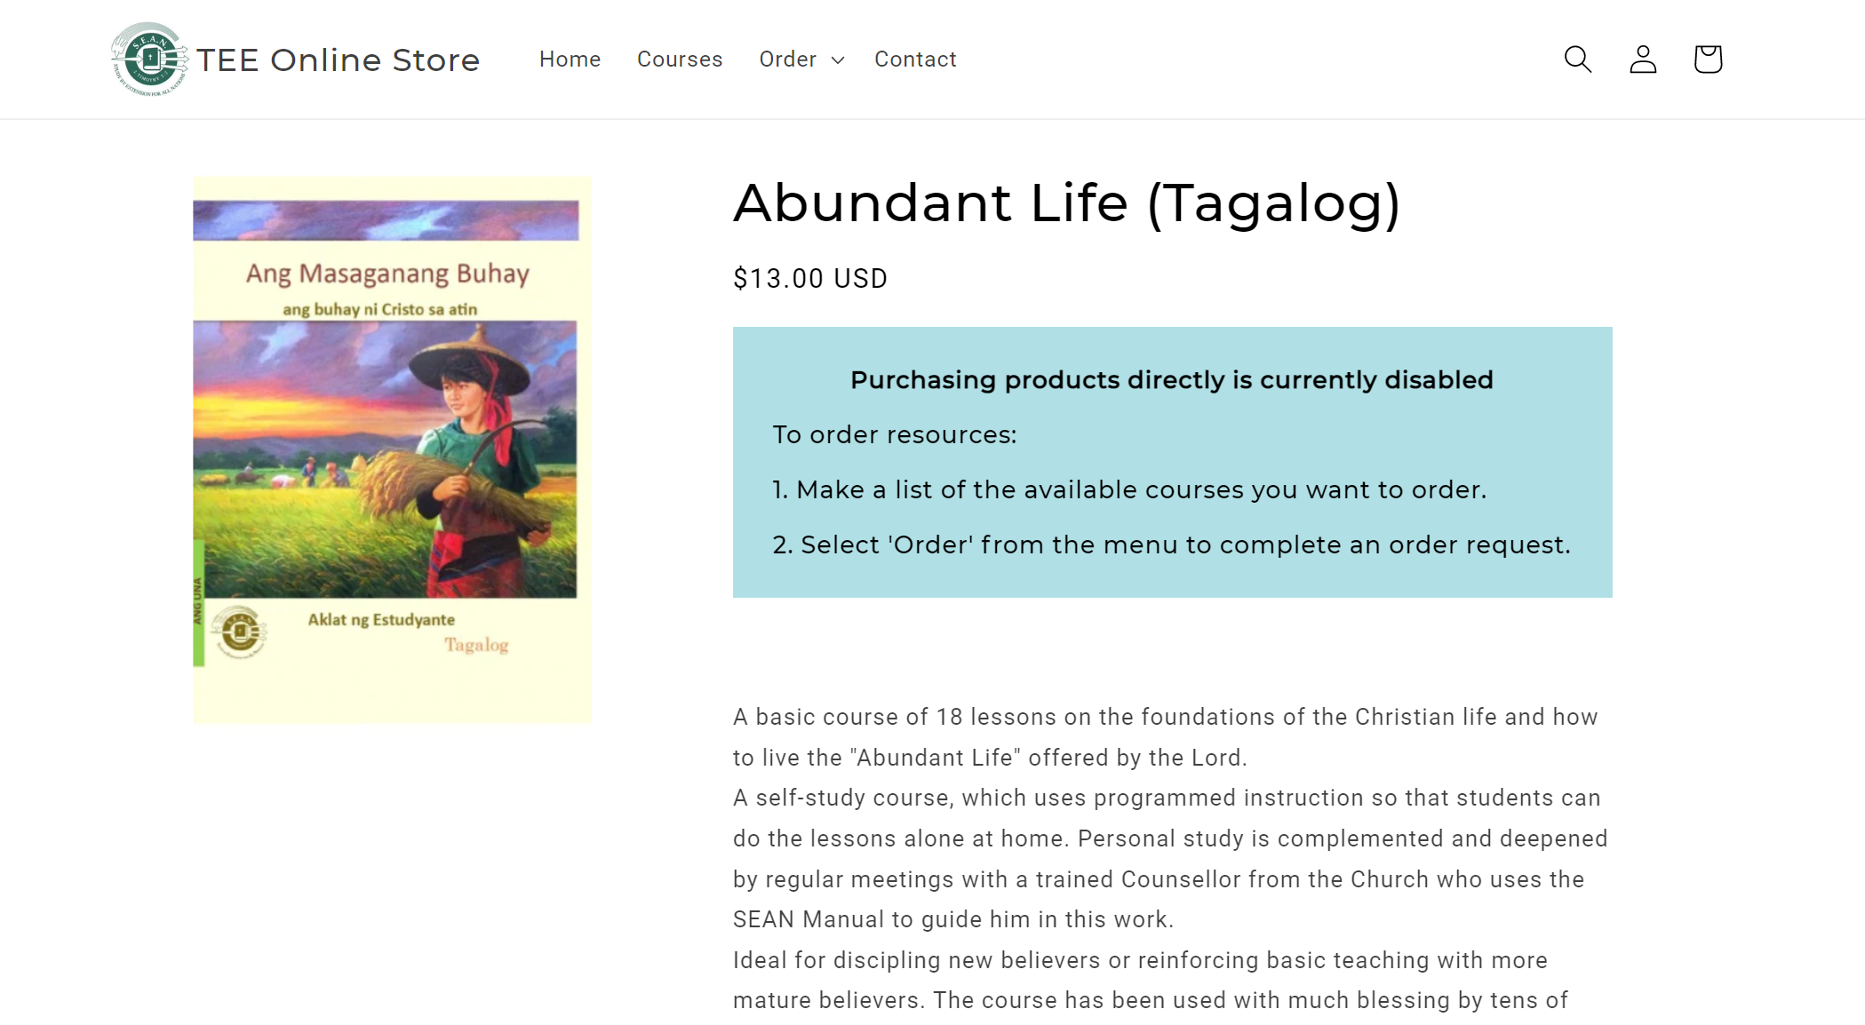

Slide 9
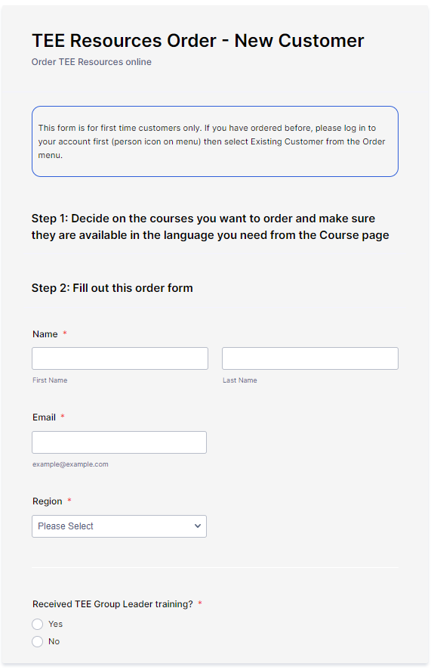
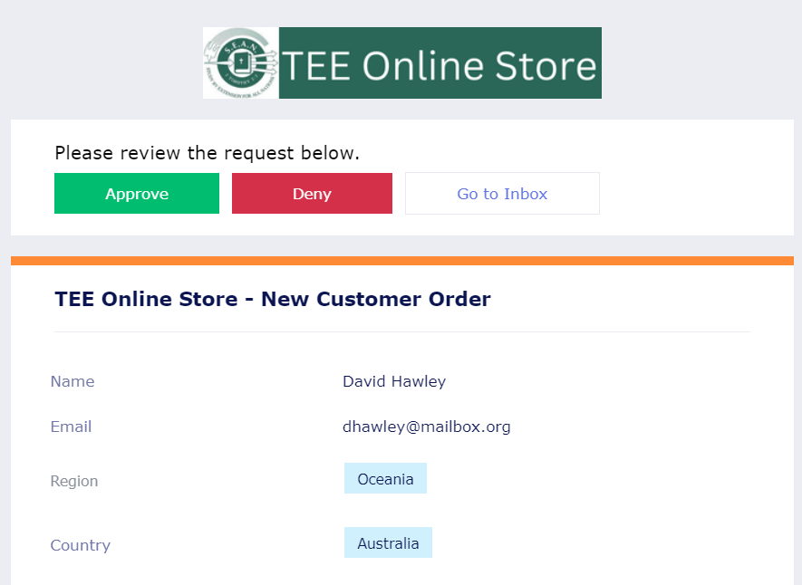
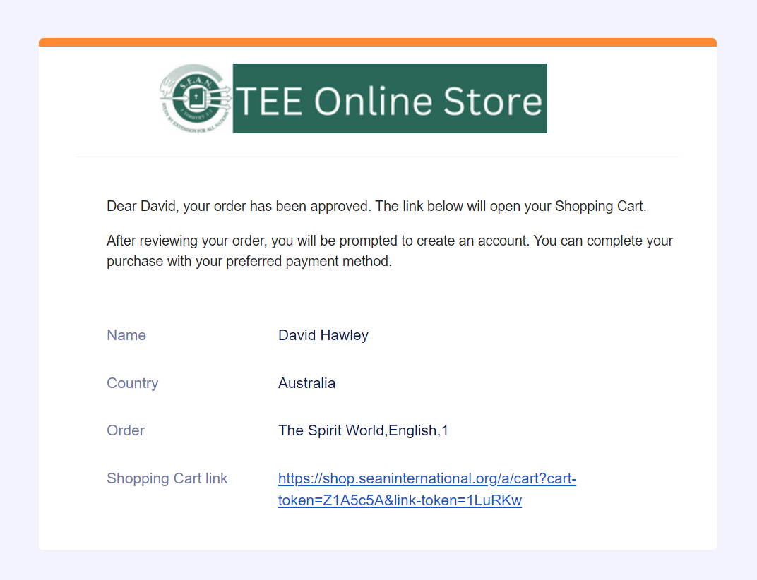
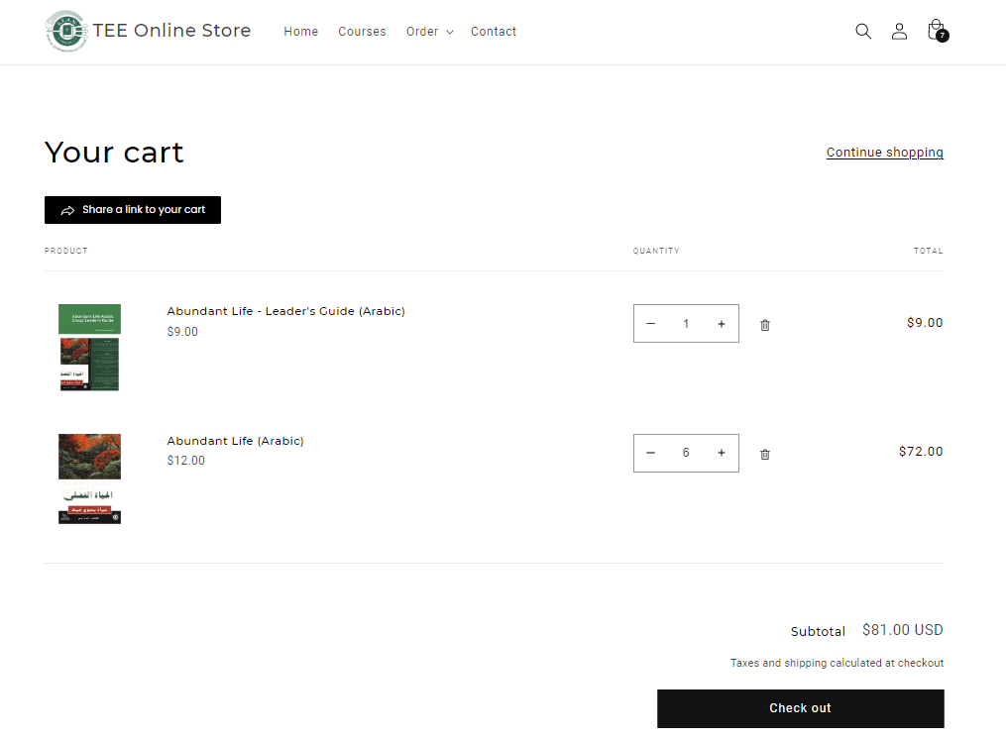
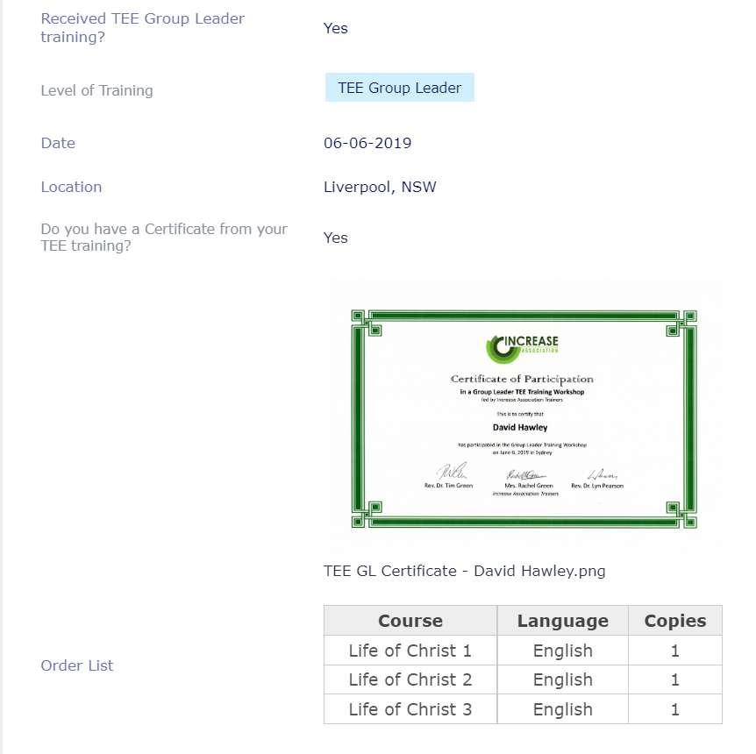
1. Customer orders resources
2. Manager approves or rejects order request
3. Manager creates the shopping cart and sends link to customer
4. Customer completes order
Name
Country
Date and location of TEE Group Leader training
Certificate OR Name of trainer
TEE Experience
TEE courses and quantities requested

Slide 10
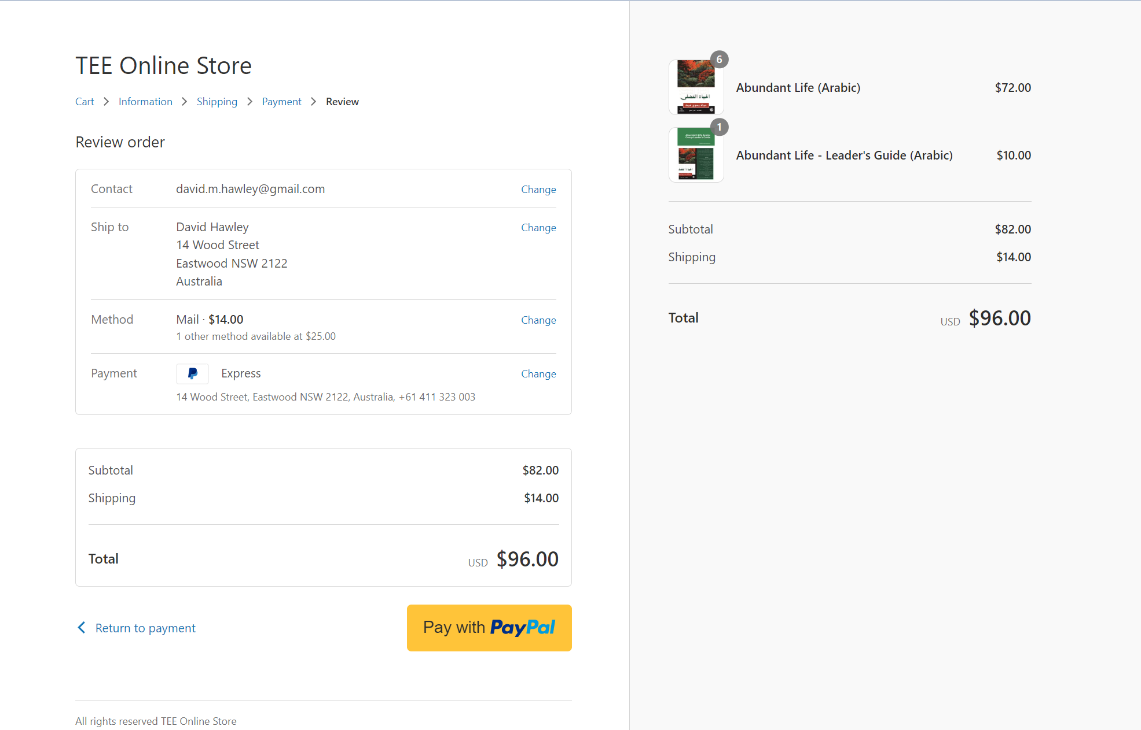

Slide 11
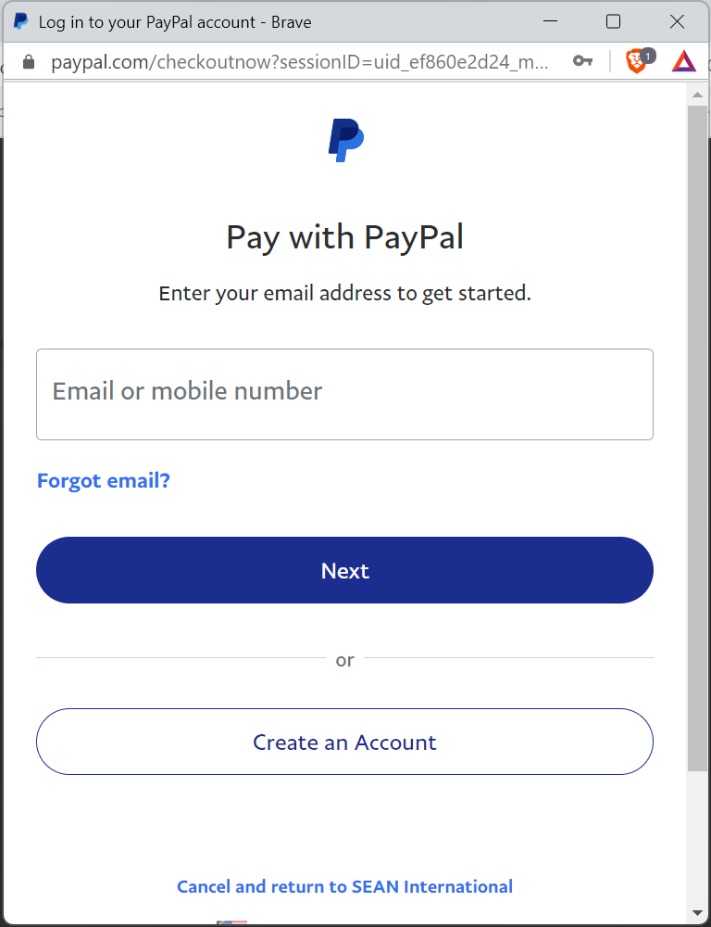
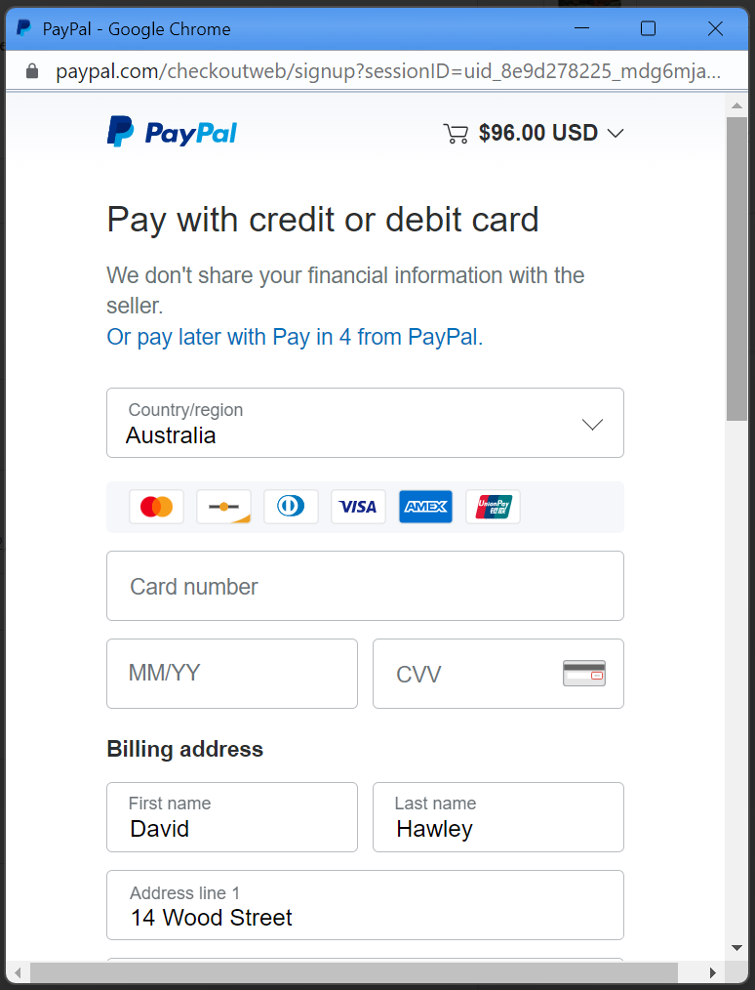

Slide 12
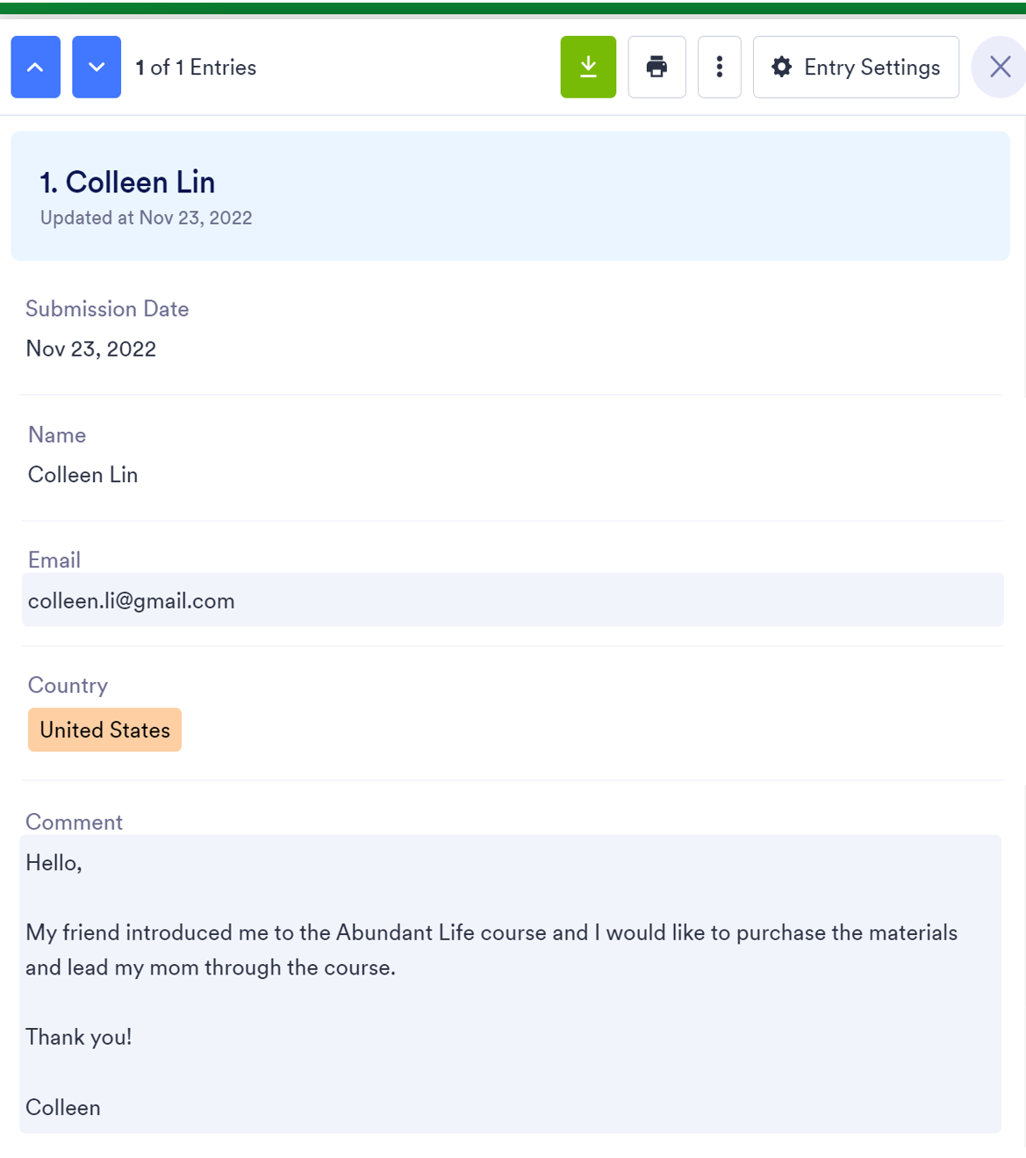
Hello,
My friend introduced me to the Abundant Life course and I would like to purchase the materials and lead my mom through the course.
Thank you!
Colleen

Slide 13
Like to know more?
Find out more at the Special Interest Group tonight at 7:30pm
www.shop.seaninternational.org
Notes:
Technical qns – ask me later

Slide 14
TEE Online Store –shop.seaninternational.org

